Slide 1
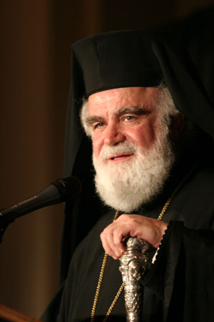
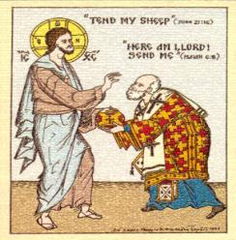
Metrop0lis of Atlanta Strategic Plan Presentation
~ ~ ~ ~ ~ ~ Clergy/Laity Assembly 2015 – Part 1 ~ ~ ~ ~ ~ ~
“Where there is no vision, the people will perish” Proverbs 29:18

Slide 2
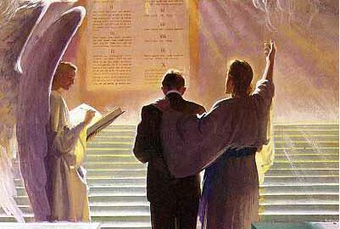
“That the end of our lives may be Christian, without pain, blameless and peaceful,
and for a
GOOD ACCOUNT BEFORE THE AWESOME JUDGMENT SEAT OF CHRIST”

Slide 3
TODAY, WE MAKE HISTORY TODAY, WE MAKE A DIFFERENCE

Slide 4
We Can Make A Difference!

Slide 5
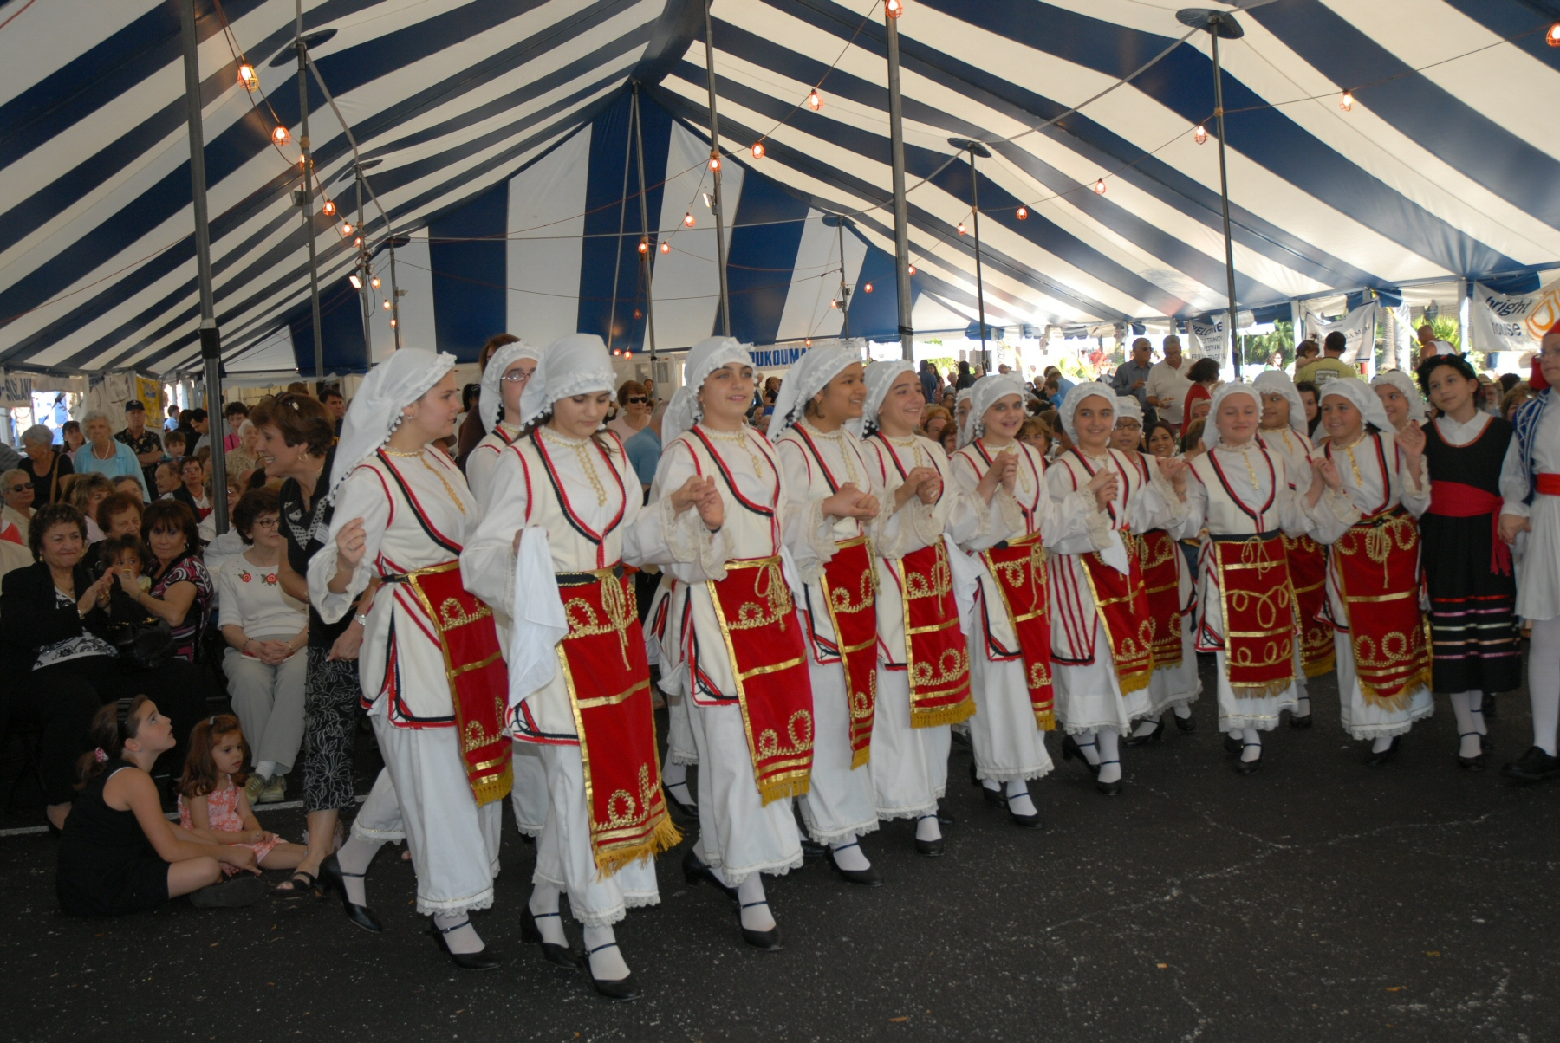

Slide 6
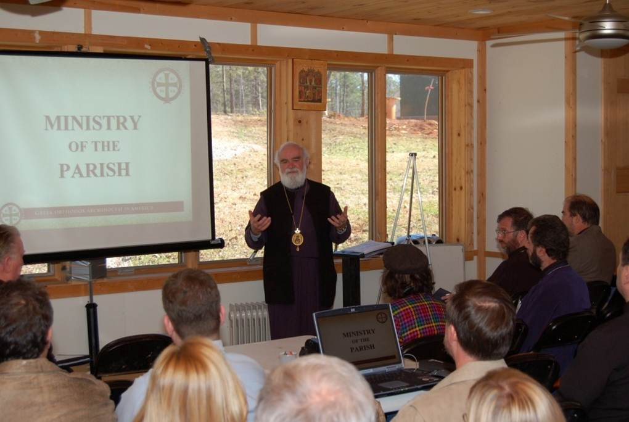
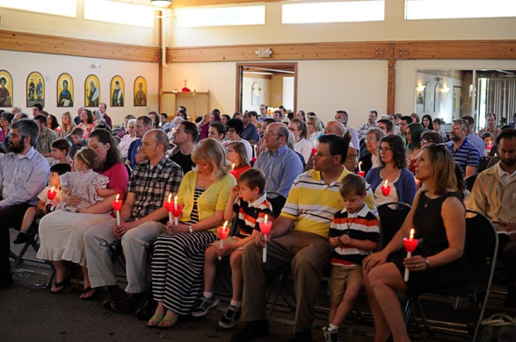

Slide 7
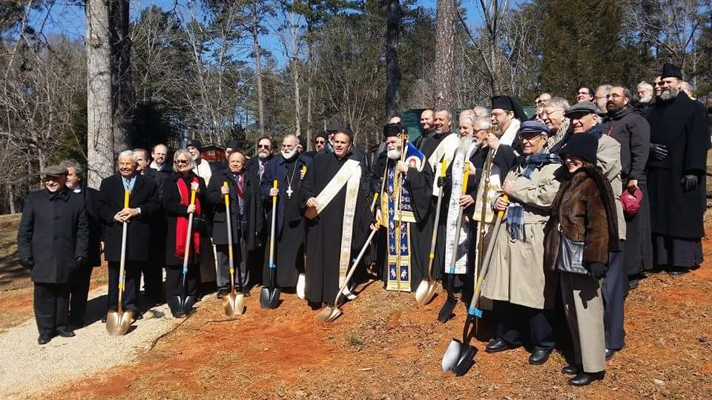

Slide 8
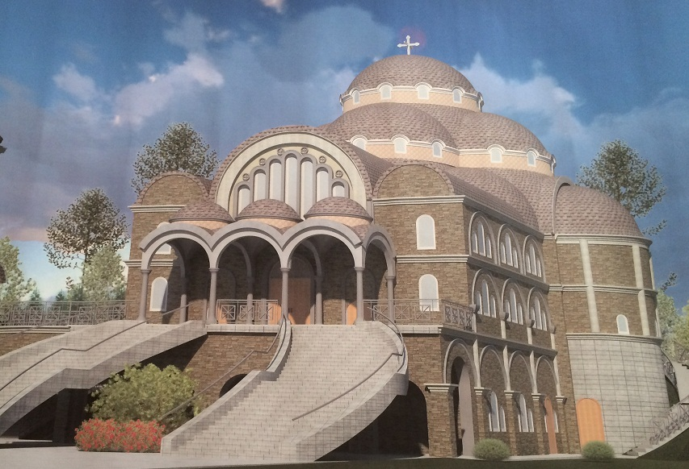

Slide 9
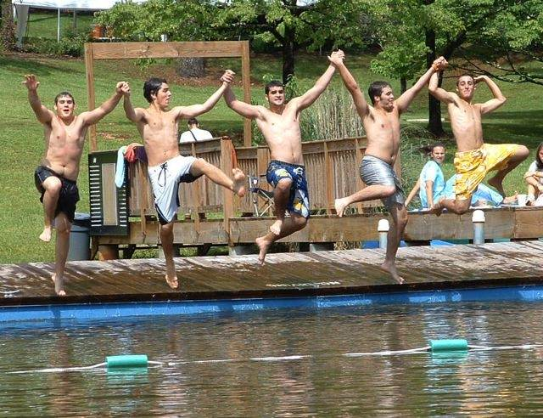

Slide 10
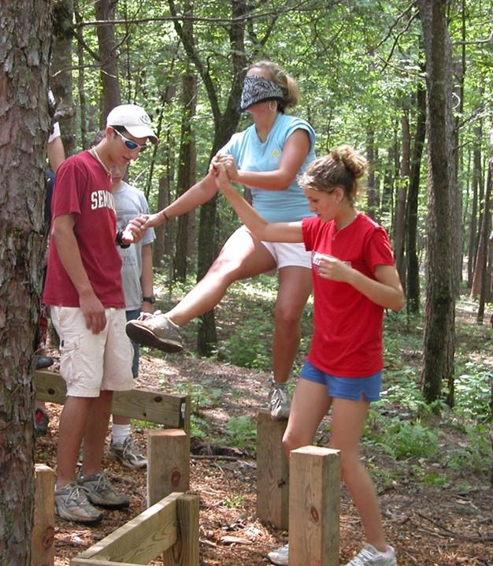
We live in a dream if we really think everything's alright.

Slide 11
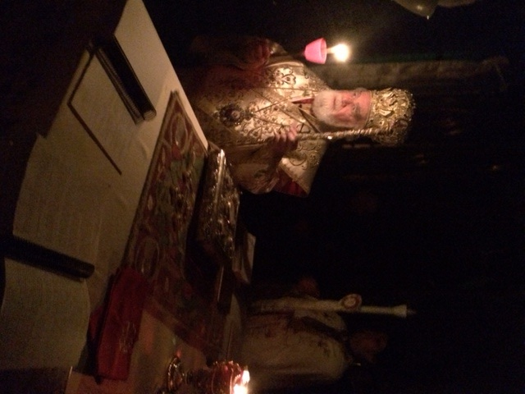
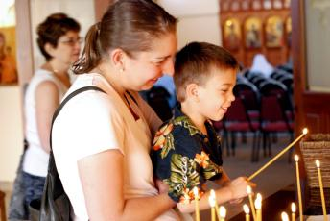
This world is in need, crying out to be freed,
we gotta shed some light.

Slide 12
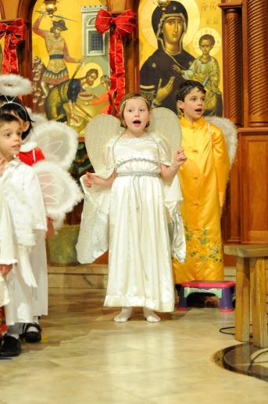
Teach the world to smile (and hear angels sing).
Feel the breath of God (and the power it brings).

Slide 13
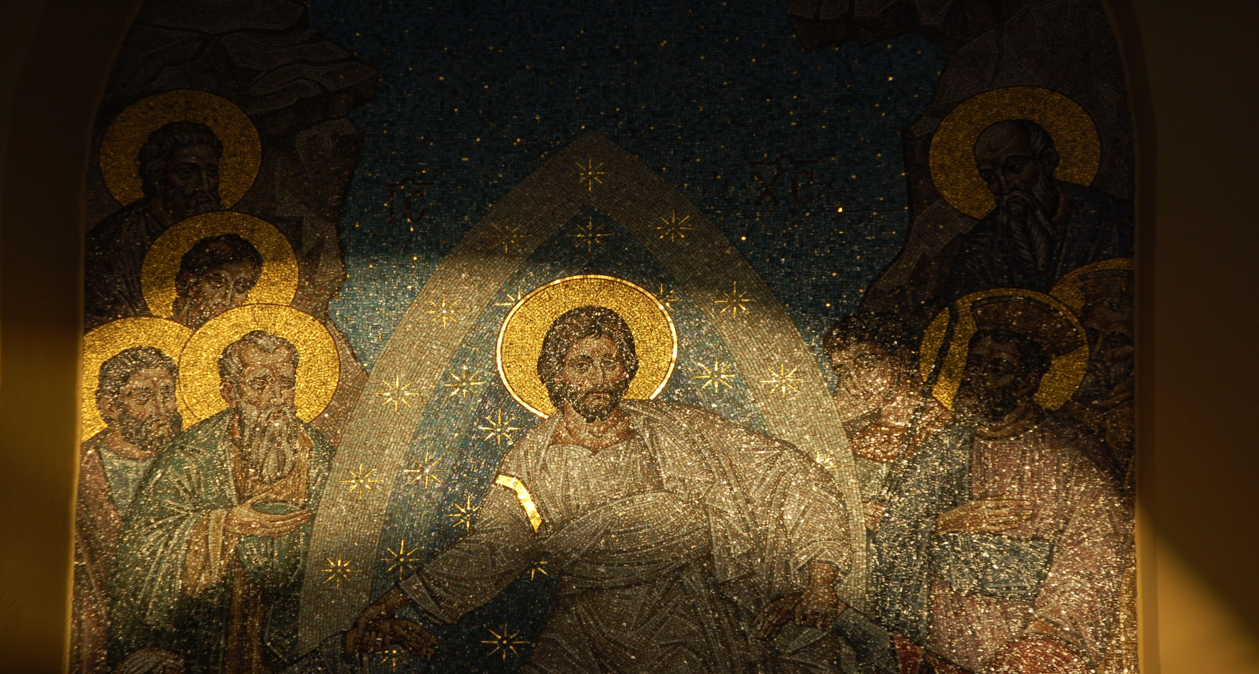
It's time to come together, you and I and share the love of Jesus Christ.

Slide 14
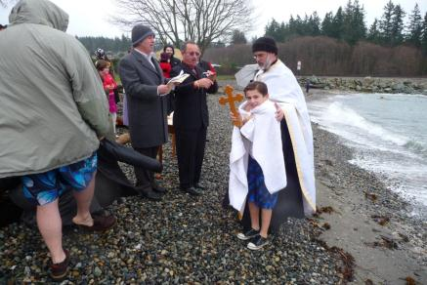
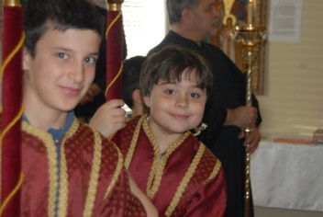
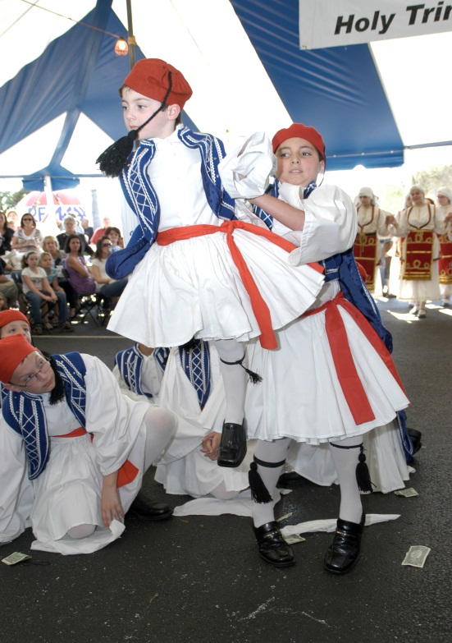
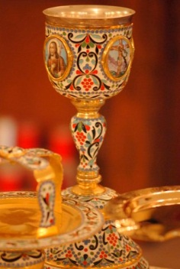
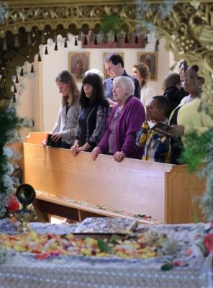
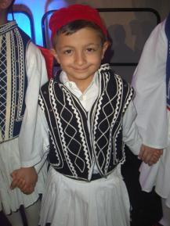
We can make a difference.
We can make a change. We can make the world a better place. We can make a difference. We can make a change. We can make the sun shine through the rain, shine on through the rain.

Slide 15
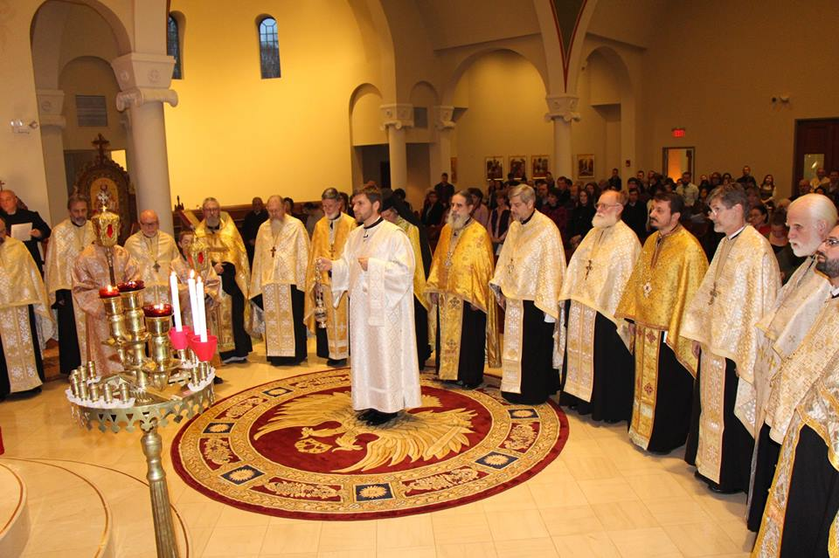

Slide 16
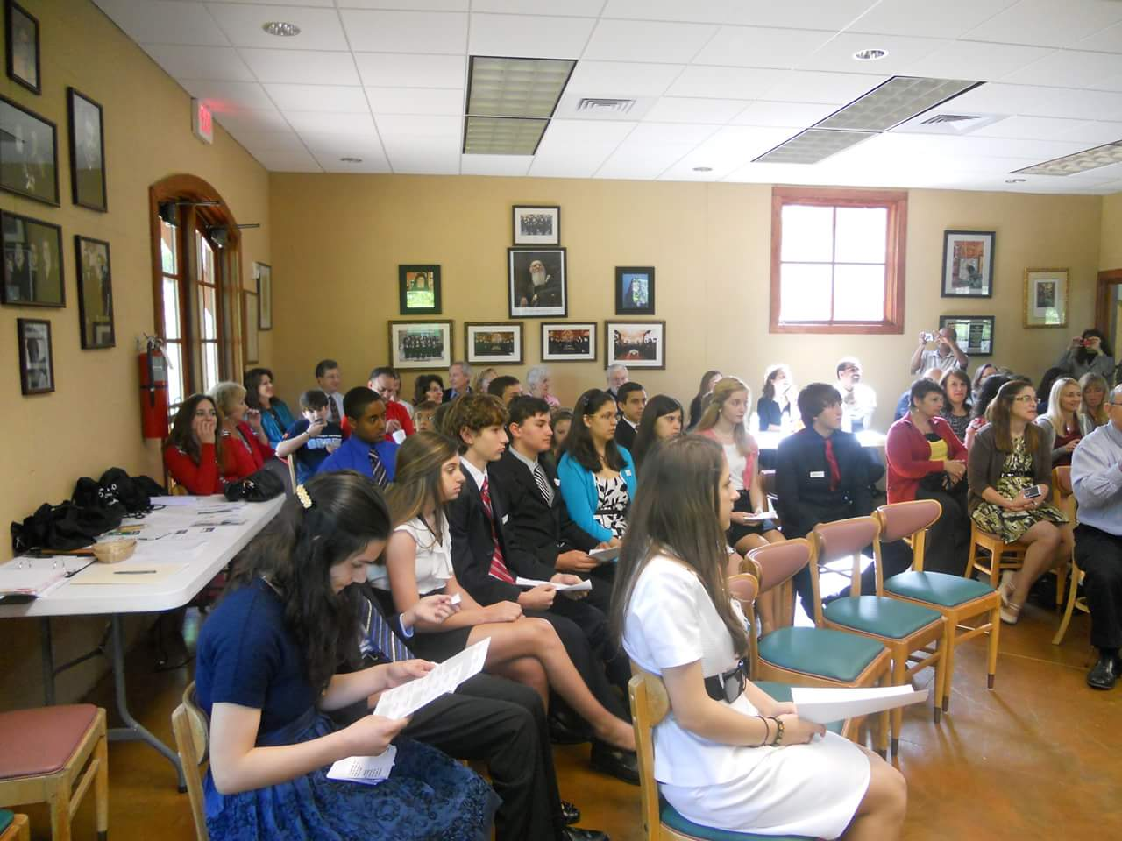

Slide 17
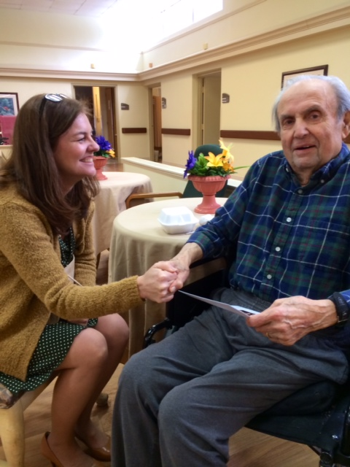
Do you know a man, who's needing a hand, don't ya walk on by.

Slide 18
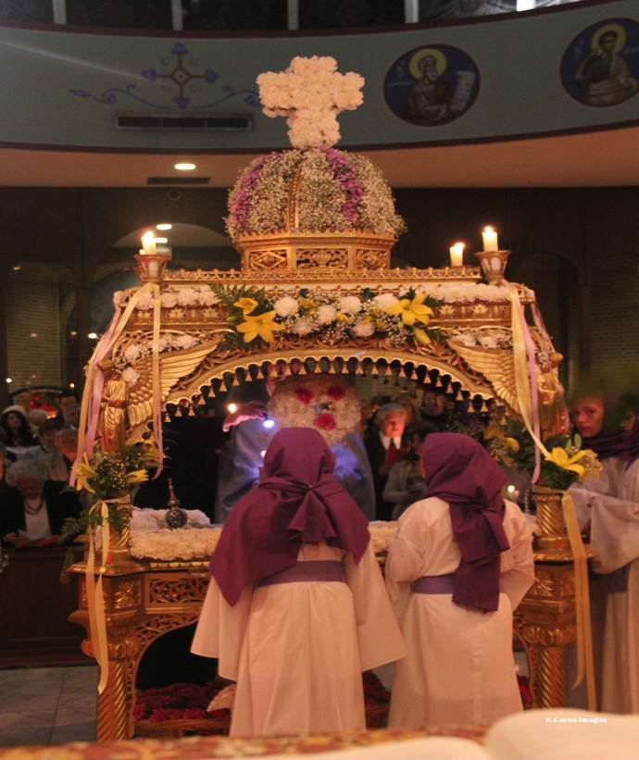
A sister is sad,
lost all that she had,
we gotta take the time.

Slide 19
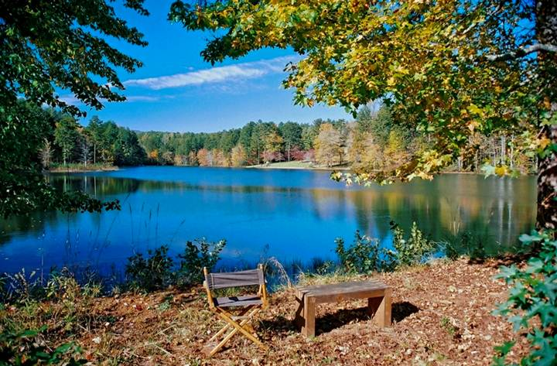
Look around your world (it will testify).

Slide 20
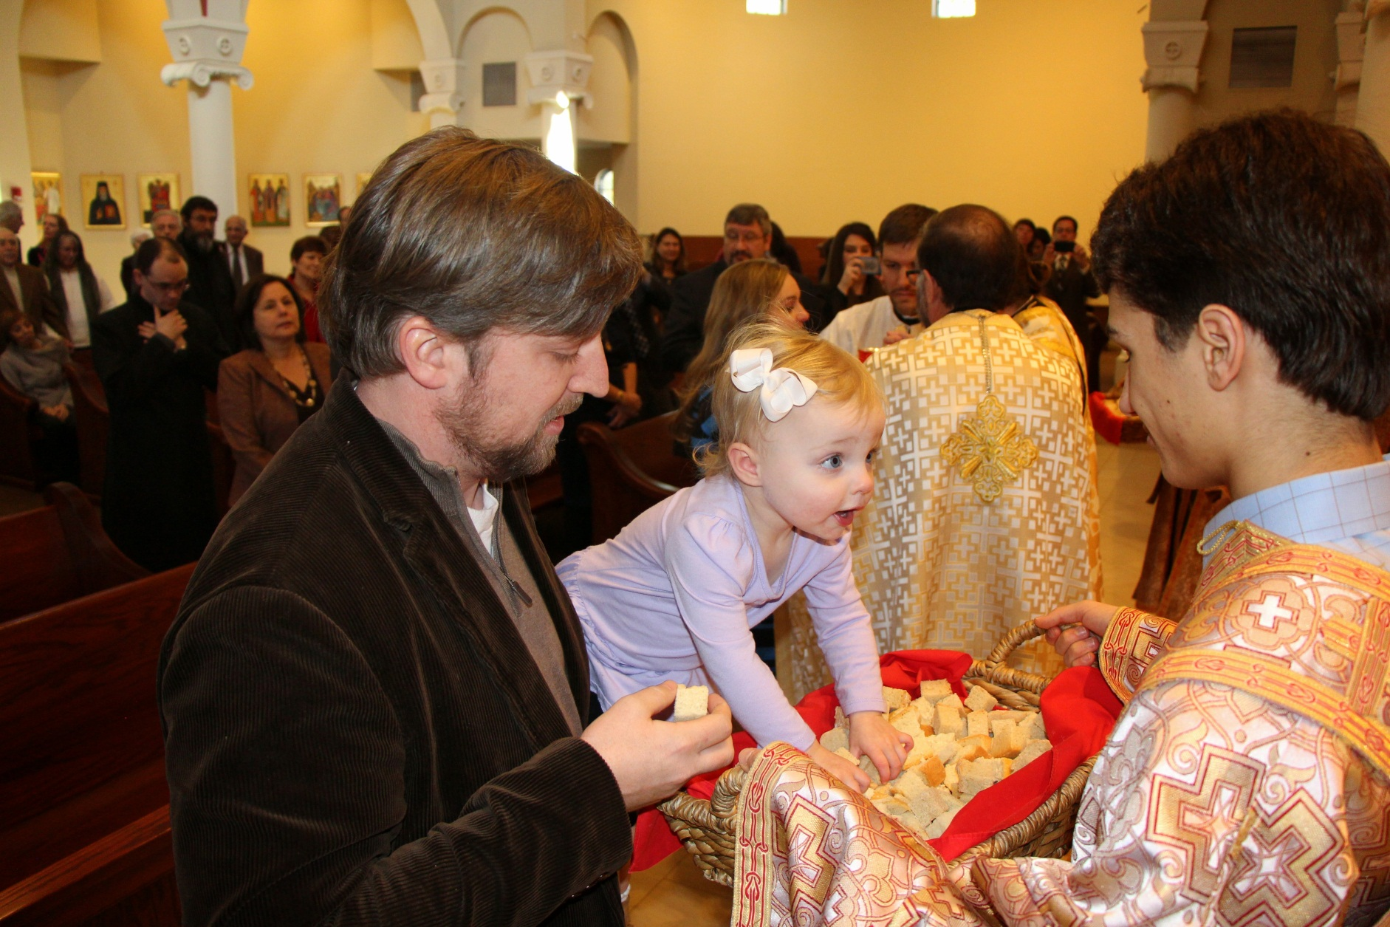
Some have empty hearts. (Some have hungry eyes.)

Slide 21
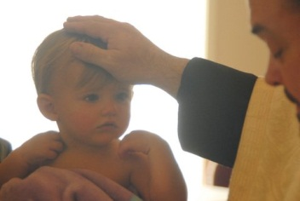
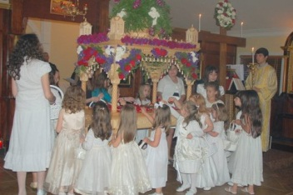
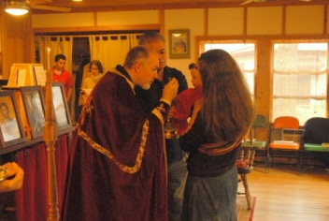
God can heal the suffering through our hands. Find compassion, take a stand.

Slide 22
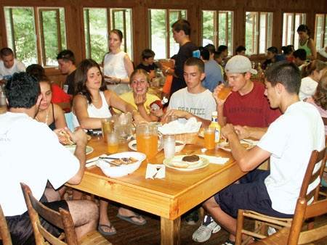
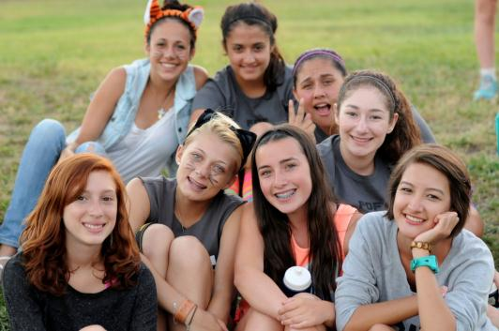
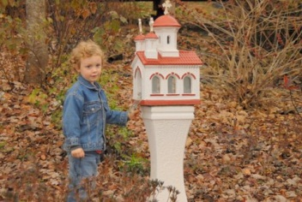
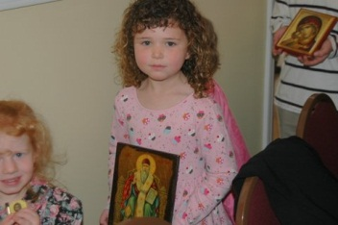
We can make a difference.
We can make a change. We can make the world a better place. We can make a difference. We can make a change. We can make the sun shine through the rain, shine on through the rain.

Slide 23
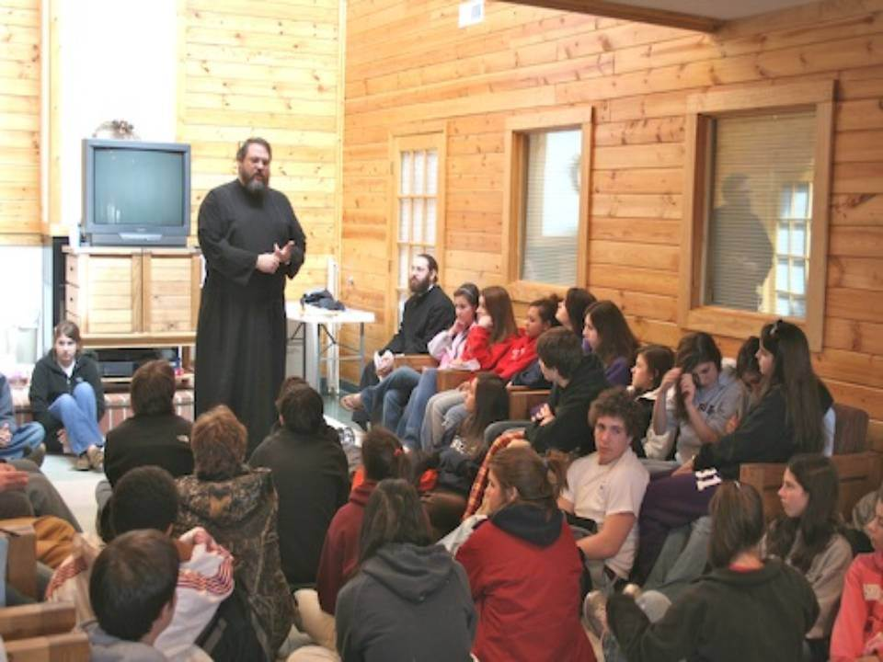

Slide 24
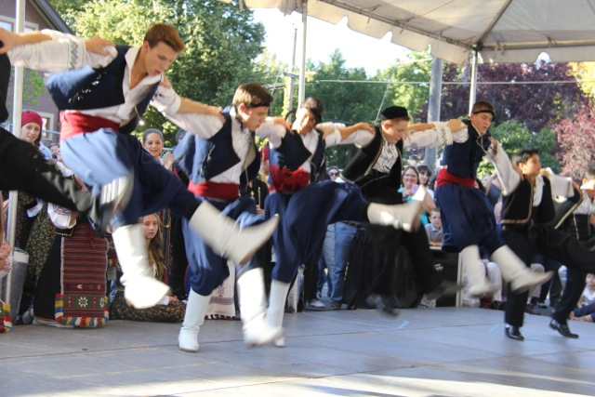
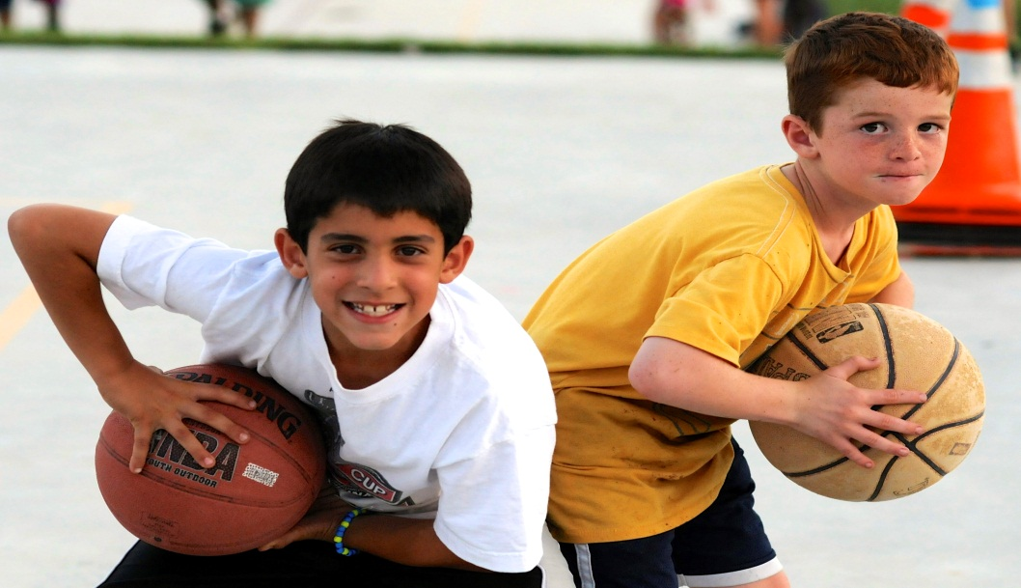
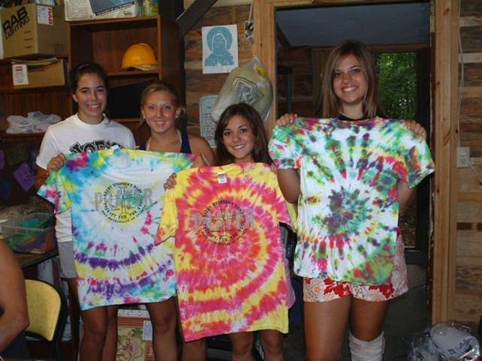
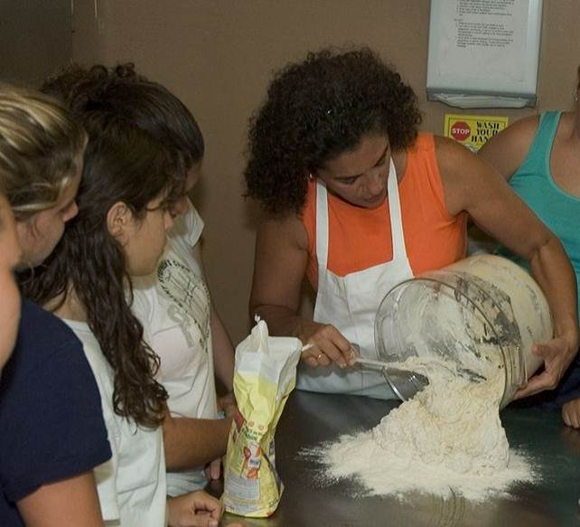

Slide 25
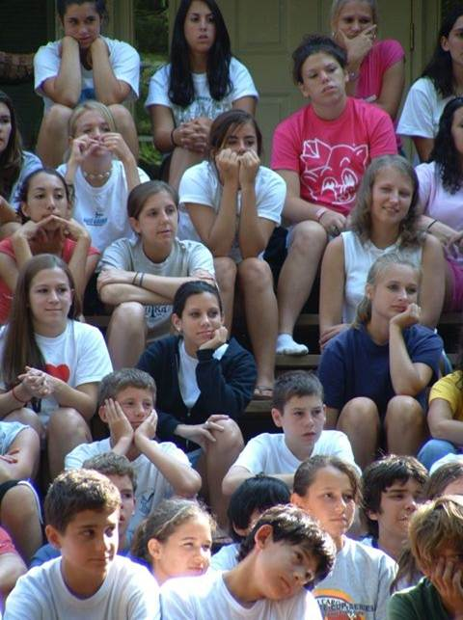
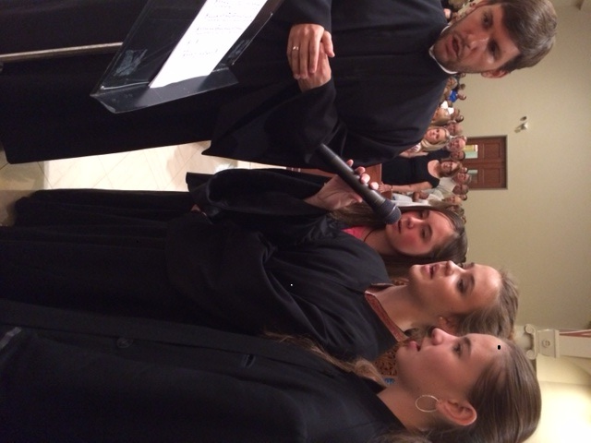

Slide 26
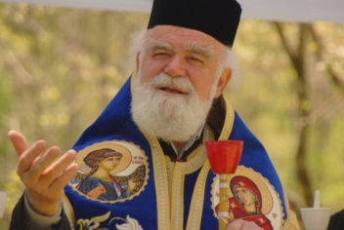
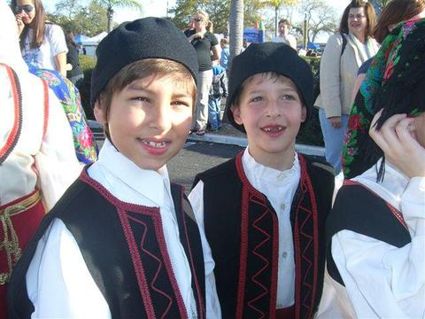
Teach the world to smile (and hear angels sing).
Feel the breath of God (and the power it brings).

Slide 27
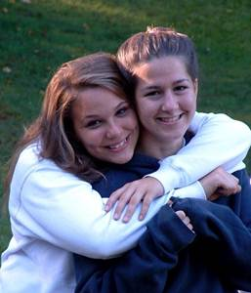
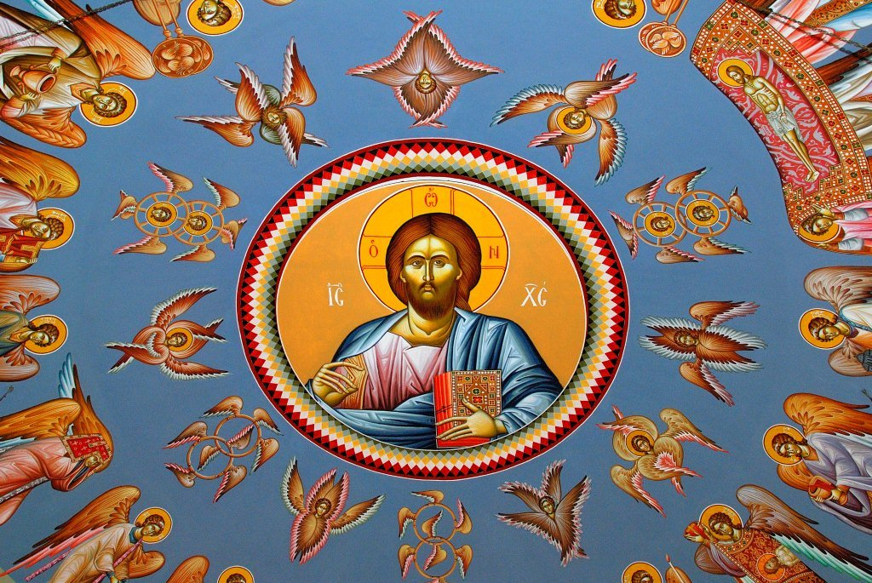
It's time to come together, you and I,
and share the love of Jesus Christ.

Slide 28
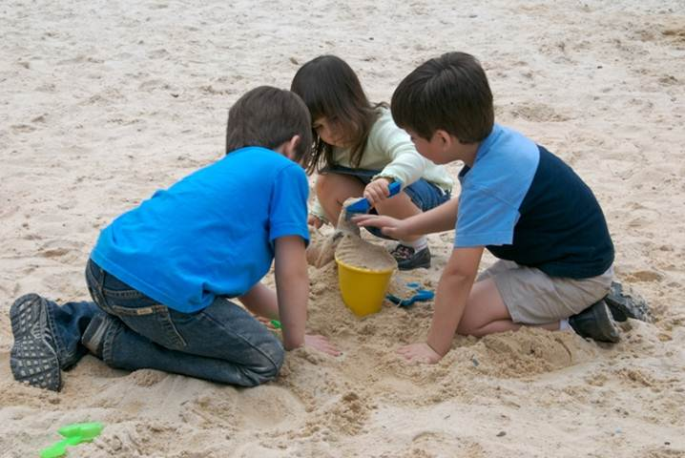
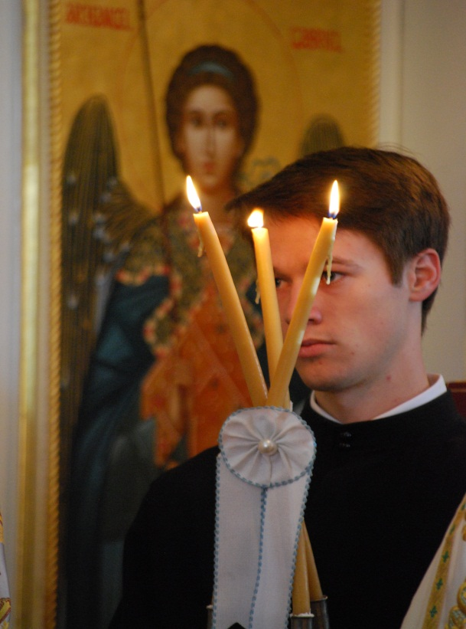
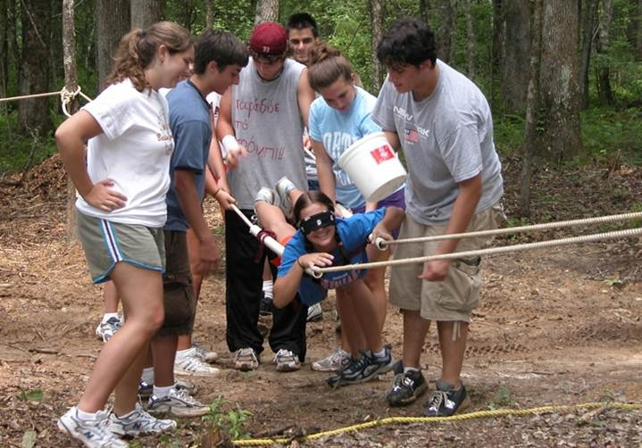
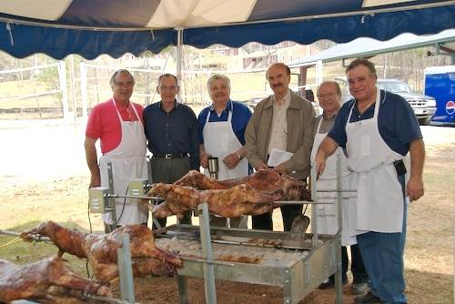
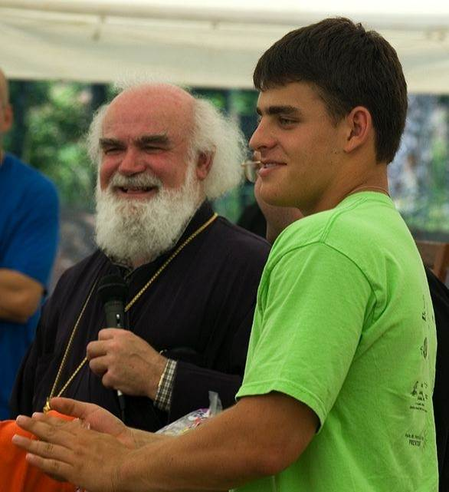
We can make a difference. We can make a change. We can make the world a better place. We can make a difference. We can make a change. We can make the sun shine through the rain, shine on through the rain.

Slide 29
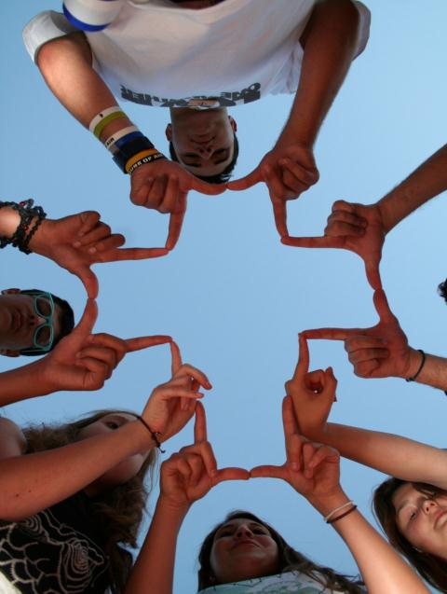
We can make a difference!
We can make a
change.
We can make a difference.

Slide 30
You have now been called as one of the 70 Disciples
Luke 10:1

