Slide 1
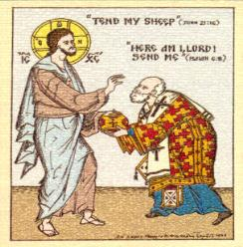
Christian Unity on Matters of Religious Liberty and Being a Disciple of Christ in Your Jerusalem
~ ~ ~ ~ ~ ~ ~ ~ ~ ~ ~ ~
“For unto whomsoever much is given, of him shall be much required. Luke 12:48
Bill Marianes
www.stewardshipcalling.com
Copyright © December, 2015

Slide 2
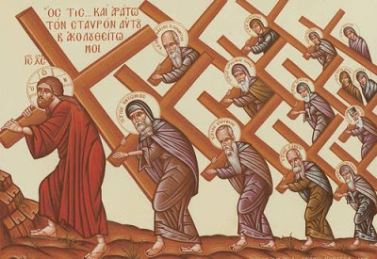
My 4 Questions For You
What are you willing to die for?
What are you willing to go to jail for?
What are you willing to advocate for?
What are you willing to do?

Slide 3

DISCLAIMER
The views and opinions expressed are merely those of the presenter, and not the official positions of St. Katherine Greek Orthodox Church, the Greek Orthodox Metropolis of Atlanta, the Greek Orthodox Archdiocese of America, the Archons of the Ecumenical Patriarchate, McGuire Woods LLP, or anyone else for that matter. The presenter is not a theologian, law professor or constitutional scholar. He is merely a “simple country lawyer.”

Slide 4
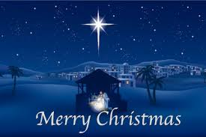
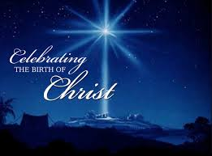
My Prayer For You: May You Have A Blessed and Merry Christmas

Slide 5
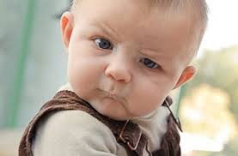
My Prayer For You: May You Have A Blessed and Merry Christmas
If my prayer for you offends you…

Slide 6
The Provision Of The U.S. Constitution That Guarantees Your Right Not To Be Offended

Slide 7
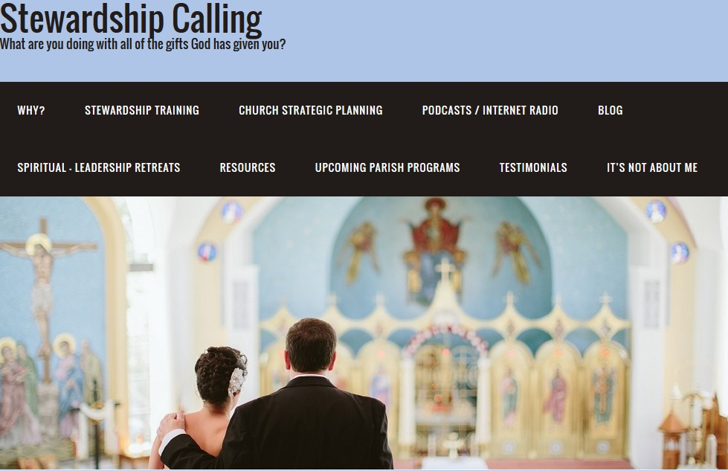
This entire presentation and other resources and content in the areas of personal and church calling, stewardship and strategic planning is available to download at the always free resource:
www.stewardshipcalling.com
This presentation is under the Spiritual - Leadership Retreats tab
Bill Marianes: Bill@stewardshipcalling.com (404) 443-5700

Slide 8


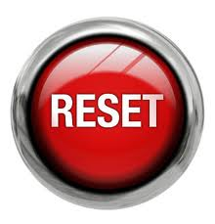
Today’s Goal

Slide 9
Awaken

Slide 10
Reset Something
In Your Life

Slide 11
Make Something Happen!

Slide 12

Brief review of how our world is changing?
For many more facts and statistics regarding the rapidly changing world in which we live, go to: www.stewardshipcalling.com

Slide 13


Slide 14
We are living in exponential times¹…
… the speed of change is unimaginable and accelerating
¹ The following is based on the pioneering YouTube video “Did You Know?” (with certain updated statistics).
Did You Know? is licensed by Karl Fisch, Scott McLeod, and XPLANE under a Creative Commons Attribution Non-Commercial Share-Alike license. You are free to copy, distribute, remix and transmit the presentation as long as you give proper attribution to the original creators and share the resulting work under the same license. You may not use Did You Know? for commercial purposes without permission from the creators. (Selected statistics have been updated, as much as reasonably possible, from available sources.)

Slide 15

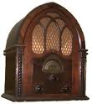




Years it took to reach 50 million users:
Telephone – 75 years
Radio – 38 years
TV – 13 years
Internet – 4 years
Google Plus – 88 days
Angry Birds – 35 days

Slide 16

The amount of new technical information is currently estimated to double every 72 hours as of 2010.

Slide 17
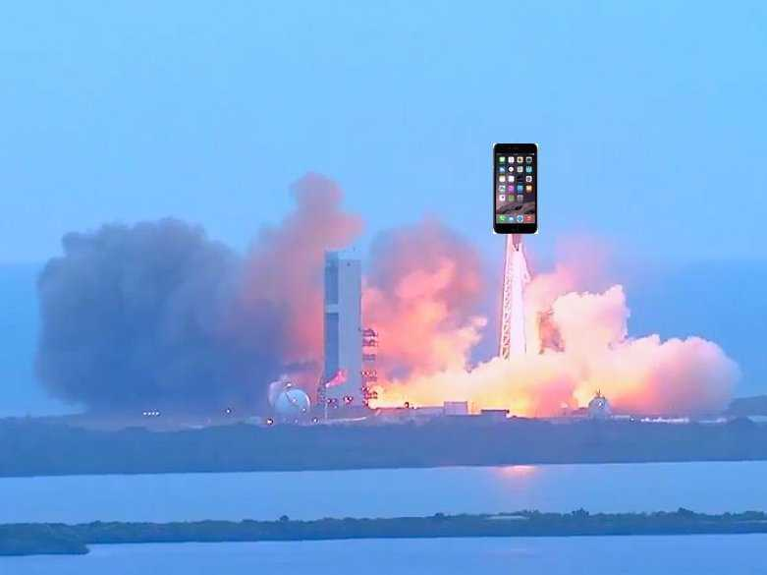
Modern Smart phones have much more computing power than did the NASA Apollo mission computers that took man to the moon in the 1960s.

Slide 18
We are living in exponential times…

Slide 19


More video content was uploaded to You Tube in the last 2 months…
Then the amount of content that would be aired if all three major networks broadcast content
24 hours per day for 62 years

Slide 20

Facebook started about 12 years ago in October 2003
It now has over 1.55 Billion active monthly users.
It is has over 1 Billion active daily users.

Slide 21

If Facebook were a country . . .
. . .it would be the 2nd largest country in the world
. . . behind only China.
Slightly larger than India and 4.7 times bigger than the U.S.

Slide 22
Recent PEW research concluded that:
over 30% of people now get their news from
74% of adults in the US use Facebook

Slide 23
We are living in exponential times…
So what does this mean for
Your Parish and the
Christian Churches in America?

Slide 24
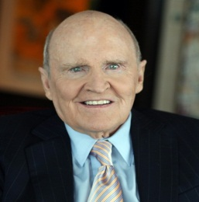

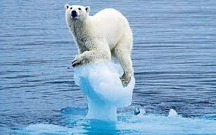
Jack Welch
Chairman & CEO - General Electric
~ ~ ~ ~ ~ ~ ~ ~ ~ ~ ~ ~ ~ ~ ~ ~ ~ ~ ~ ~
“If the rate of change on the outside exceeds the rate of change on the inside, the end is near.”
~ ~ ~ ~ ~ ~ ~ ~ ~ ~ ~ ~ ~ ~ ~ ~ ~ ~ ~ ~ ~ ~
“Change before you have to.”

Slide 25
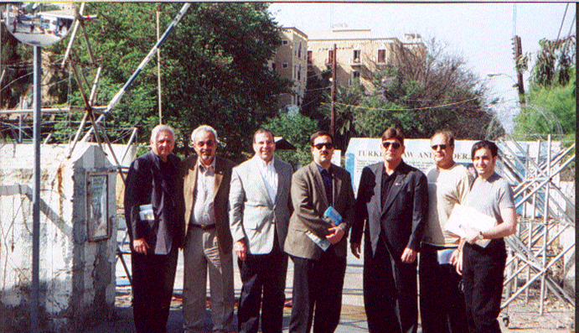
Part 1
Where Did My Religious Freedom Journey Begin?

Slide 26
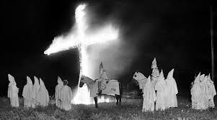
Ku Klux Klan
In national elections in the 1920’s, the KKK passed out cards declaring:
When cotton grows on a fig tree
And alfalfa hangs on a rose
When the aliens run the United States
And the Jews grow a straight nose
When everyone praises the Pope
In the land of Uncle Sam
And a Greek is elected President
THEN - the KU KLUX won’t be worth a damn.

Slide 27
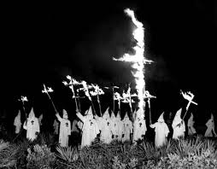
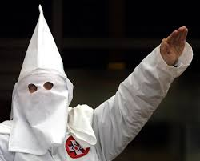
Klan Anti Mask Statutes
GEORGIA Code - Crimes and Offenses, Section 16-11-38.
(a) A person is guilty of a misdemeanor when he wears a mask, hood, or device by which any portion of the face is so hidden, concealed, or covered as to conceal the identity of the wearer and is upon any public way or public property…. (1951)

Slide 28



Georgia Ku-Klux-Klan Anti-Mask Statute Constitutionality
State v. Miller
260 Ga. 669, 398 S.E.2d 547 (1990)
“In conclusion, we hold that the Anti-Mask Act proscribes mask-wearing conduct that is intended to conceal the wearer's identity and that the wearer knows, or reasonably should know, gives rise to a reasonable apprehension of intimidation, threats or impending violence. So construed, the Act passes constitutional muster.”

Slide 29
The Secret Mission of Faith
…a defining moment of truth

Slide 30
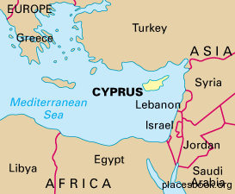
Cyprus

Slide 31
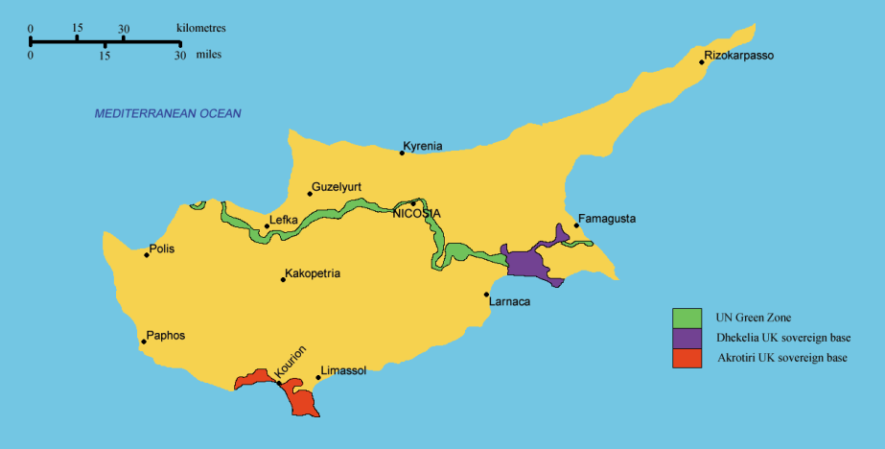
Cyprus

Slide 32
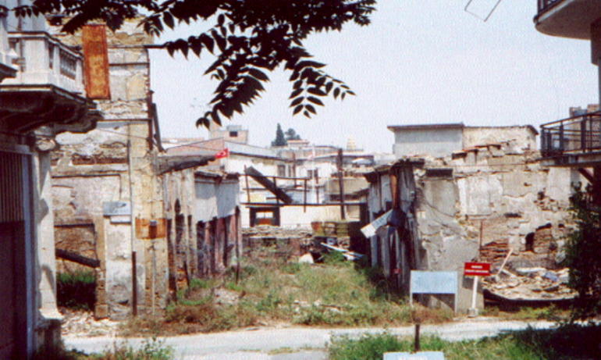
The Secret Mission of Faith
…a defining moment of truth

Slide 33
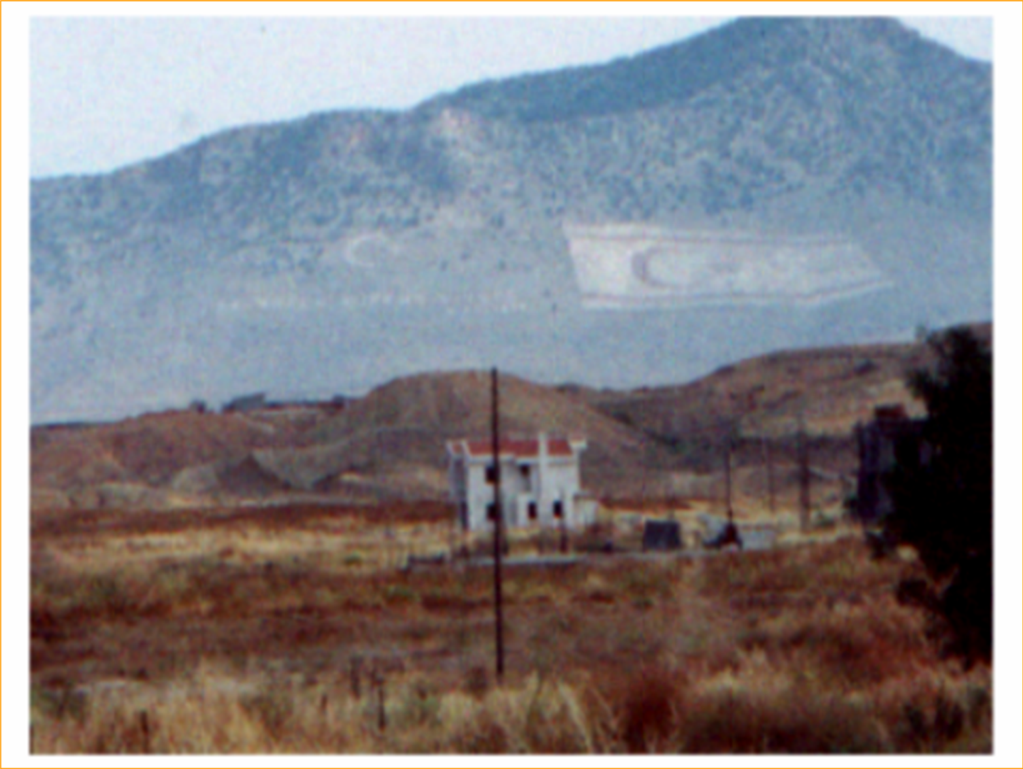
The Secret Mission of Faith
…a defining moment of truth

Slide 34
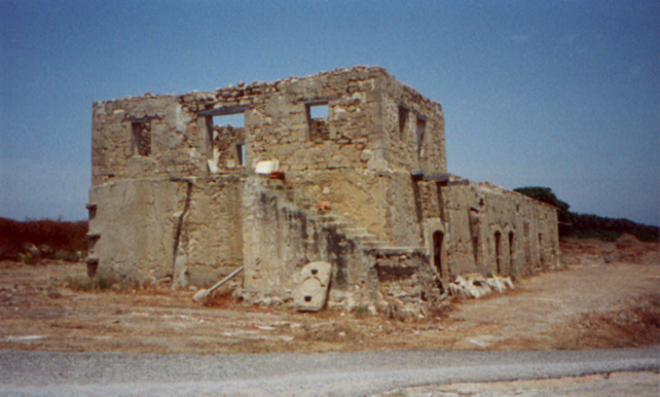
The Secret Mission of Faith
…a defining moment of truth

Slide 35
Cyprus

Slide 36
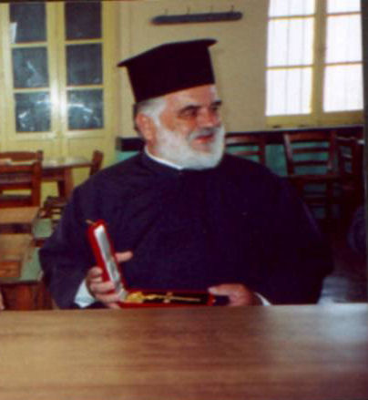
Father Zacharias Georgiou

Slide 37
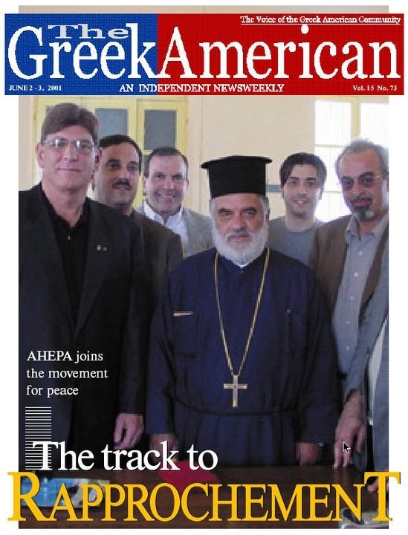

Slide 38
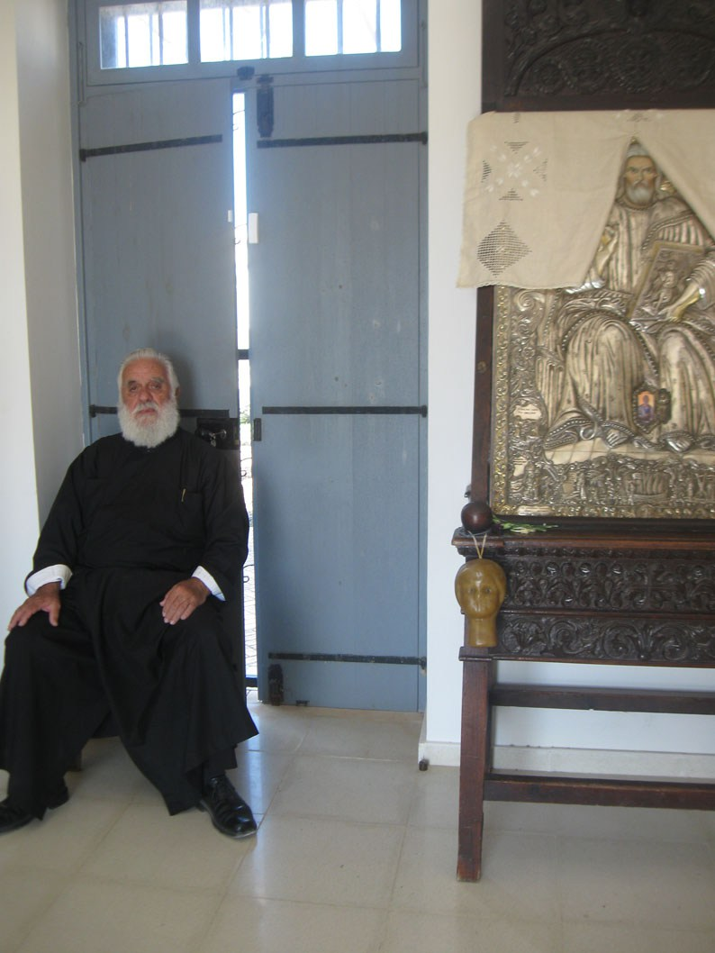
Father Zacharias Georgiou
(November, 2014 )

Slide 39
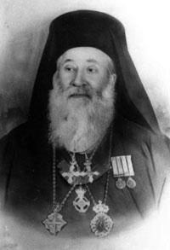
Metropolitan Chrysostomos of Zakynthos
During the 2nd world war, approximately 275 Jews lived on the Greek Island of Zakynthos
September 9, 1943, the Nazi commander demanded the Metropolitan give him the names of all Jews living there
The Metropolitan gave him a document stating: “Here is the list of Jews you required.”
There was only 1 name on the list
His

Slide 40
My 4 Questions For You
What are you willing to die for?
What are you willing to go to jail for?
What are you willing to advocate for?
What are you willing to do?

Slide 41
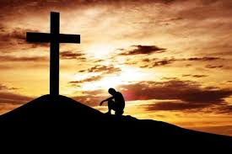
Part 2
Where Can We Fight The Battle For Religious Freedom Now?

Slide 42
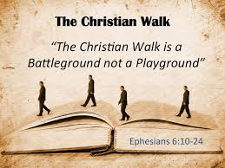
Some Battlegrounds
The home
The churches
The schools
The media
The legislatures
The public places
The work places
The courtroom
The boardroom
The bathroom
Everywhere

Slide 43
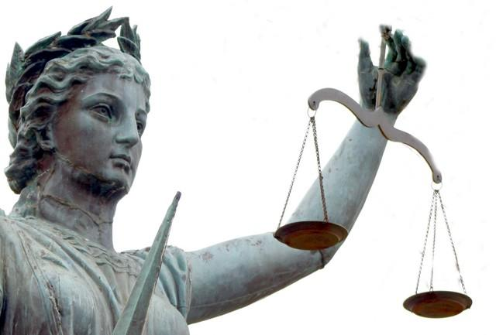
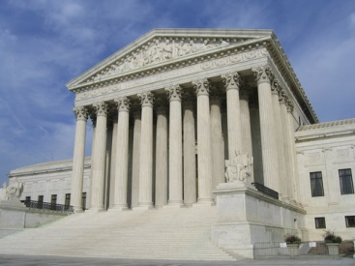
One Front Line

Slide 44
Episcopal Cases Greek Orthodox Amicus Briefs
Rector, Wardens, Vestrymen of Christ Church v. Bishop of Episcopal Diocese 718 S.E.2d 237, 244 (Ga. 2011)
“To avoid First Amendment concerns, Georgia courts apply ‘neutral principles of law’ to determine whether the local congregation or the parent, or general, church in a hierarchical denomination like the Episcopal Church has the right to control local church property, while avoiding any inquiry into religious doctrine. See Jones, 443 U.S. at 602-606, 99 S.Ct. 3020…”
“Like the trial court and the Court of Appeals, we conclude that neutral principles of law demonstrate that an implied trust in favor of the Episcopal Church exists on the property of Christ Church.”

Slide 45
Episcopal Cases Greek Orthodox Amicus Briefs
The Episcopal Church, et. al. v. The Episcopal Diocese of Forth Worth
FROM OUR AMICUS BRIEF: “The Greek Orthodox Church joins the Episcopal Church as an amicus because the outcome of this case affects the Greek Orthodox Church’s freedom promised by the First Amendment to arrange its internal affairs as it wishes without interference by the courts. While the Greek Orthodox Church and the Episcopal Church differ in significant and well-known ways, including in their structure and doctrine, they share a common concern: by interpreting this Court’s so-called neutral-principles approach to presuppose congregational autonomy, well-meaning courts are interfering with hierarchical churches ’ ability to arrange their own internal affairs.”

Slide 46
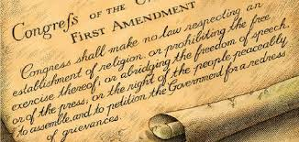
First Amendment to the United States Constitution
“Congress shall make no law respecting an establishment of religion, or prohibiting the free exercise thereof; or abridging the freedom of speech, or of the press; or the right of the people peaceably to assemble, and to petition the Government for a redress of grievances.”

Slide 47
First Amendment to the United States Constitution
The 2 Relevant Parts of the 1st Amendment:
The “Establishment Clause” (really the non-establishment clause)
The “Free Exercise Clause”
“Congress shall make no law respecting an establishment of religion, or prohibiting the free exercise thereof…”

Slide 48
The “Separation of Church and State”
Thomas Jefferson’s 1802 letter to the Danbury Baptists (a religious minority in Connecticut):
“Believing with you that religion is a matter which lies solely between Man and his God, that he owes account to none other for his faith or his worship, that the legitimate powers of government reach actions only, and not opinions… I contemplate… that act of the whole American people which declared that their legislature should "make no law respecting an establishment of religion, or prohibiting the free exercise thereof," thus building a wall of separation between Church and State.

Slide 49
The “Separation of Church and State”
Reynolds v. United States (1878) is credited with first introducing this principle.
In Everson v. Board of Education (1947), Justice Hugo Black of the U.S. Supreme Court wrote:
“The ‘establishment of religion’ clause of the First Amendment means at least this: Neither a state nor the Federal Government can set up a church. Neither can pass laws which aid one religion, aid all religions, or prefer one religion to another . . . in the words of Jefferson, the [First Amendment] … was intended to erect 'a wall of separation between church and State' . . . That wall must be kept high and impregnable. We could not approve the slightest breach.”

Slide 50
How’s This For The “Separation of Church and State”
"Of all the dispositions and habits which lead to political prosperity, religion and morality are indispensable supports. In vain would that man claim the tribute of patriotism, who should labor to subvert these great pillars of human happiness…
Let it simply be asked: Where is the security for property, for reputation, for life, if the sense of religious obligation desert the oaths which are the instruments of investigation in courts of justice ? …
Whatever may be conceded to the influence of refined education on minds of peculiar structure, reason and experience both forbid us to expect that national morality can prevail in exclusion of religious principle.”
George Washington

Slide 51
How’s This For The “Separation of Church and State”
“ …we have grown in numbers, wealth and power as no nation has ever grown. But we have forgotten God.”
President Abraham Lincoln (March, 1862)
“I do therefore invite my fellow citizens in every part of the United States, and also those who are at sea and those who are sojourning in foreign lands, to set apart and observe the last Thursday of November next, as a day of Thanksgiving and Praise to our beneficent Father who dwelleth in the Heavens.”
President Abraham Lincoln (November, 1863)

Slide 52
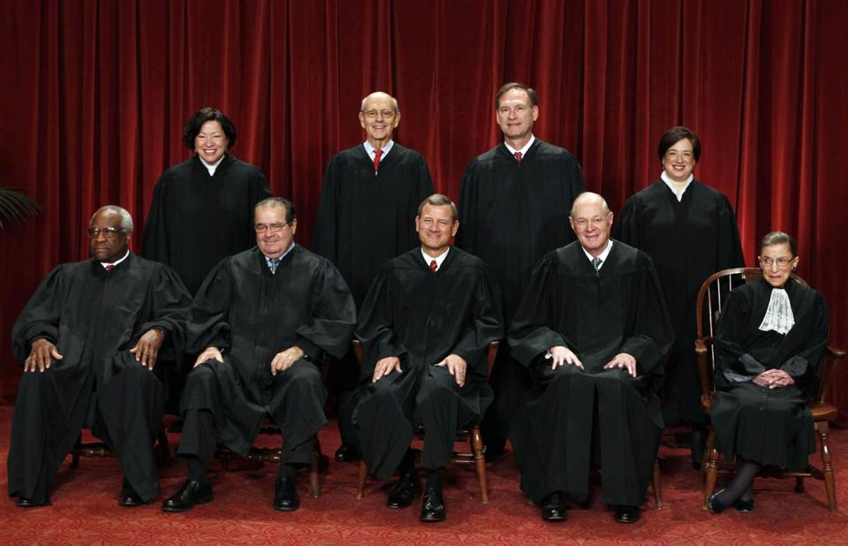
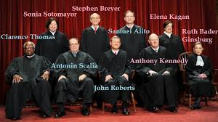
Obergefell v. Hodges
Our Supreme Court

Slide 53
What Might
Obergefell v. Hodges Mean
The States lost the right to define marriage. The majority said:
“These considerations lead to the conclusion that the right to marry is a fundamental right inherent in the liberty of the person, and under the Due Process and Equal Protection Clauses of the Fourteenth Amendment couples of the same-sex may not be deprived of that right and liberty.”

Slide 54
What Might
Obergefell v. Hodges Mean
The Majority did not affirm the “free exercise” part of the 1st Amendment
They merely made a casual reference to the “free speech” part of the 1st Amendment:
“Finally, it must be emphasized that religions, and those who adhere to religious doctrines, may continue to advocate with utmost, sincere conviction that, by divine precepts, same-sex marriage should not be condoned. The First Amendment ensures that religious organizations and persons are given proper protection as they seek to teach the principles that are so fulfilling and so central to their lives and faiths…”

Slide 55
What Might
Obergefell v. Hodges Mean
  Chief Justice Roberts’ dissent:
  “If you are among the many Americans - of whatever sexual orientation - who favor expanding same-sex marriage, by all means celebrate today’s decisions. Celebrate the achievement of a desired goal. Celebrate the opportunity for a new expression of commitment to a partner. Celebrate the availability of new benefits. But do not celebrate the Constitution. It had nothing to do with it.
  I respectfully dissent”

Slide 56
What Might
Obergefell v. Hodges Mean
  Chief Justice Roberts’ dissent:
  “The Constitution itself says nothing about marriage, and the Framers thereby entrusted the States with ‘the whole subject of the domestic relations of husband and wife’” In re Burrus, 136 U.S. 586, 593-594 (1890)
  (b) “Those who founded our country would not recognize the majority’s conception of the judicial role.”
  (c) “Indeed, the Solicitor General candidly acknowledged that the tax exemptions of some religious institutions would be in question if they opposed same-sex marriage”

Slide 57
What Might
Obergefell v. Hodges Mean
  Justice Scalia’s dissent:
  “With each decision of ours that takes from the People a question properly left to them – with each decision that is unabashedly based not on law, but on ‘reasoned judgment’ of a bare majority of this Court – we move one step closer to being reminded of our impotence.”

Slide 58
What Might
Obergefell v. Hodges Mean
  Justice Thomas’ dissent:
  “ Numerous amici… have cautioned the Court that its decision here will have ‘unavoidable and wide-ranging implications for religious liberty.’ In our society, marriage is not simply a governmental institution; it is a religious institution as well. Today’s decision might change the former, but it cannot change the later.
  It appears all but inevitable that the two will come into conflict, particularly as individuals and churches are confronted with demands to participate in and endorse civil marriages between same-sex couples.”

Slide 59
What Might
Obergefell v. Hodges Mean
  Justice Thomas’ dissent:
  “ Religious liberty is about more than just the protection for ‘religious organizations and persons …as they seek to teach the principles that are so fulfilling and so central to their lives and faith.’
  Religious liberty is about freedom of action in matters of religion generally, and the scope of that liberty is directly correlated to the civil restraints placed upon religious practice”

Slide 60
Some Possible Next
Battle Grounds
  Can a Christian church deny:
    a ceremony inconsistent with its core beliefs in its sanctuary?
    a ceremony inconsistent with its core beliefs in its rental hall?
    a reception/banquet inconsistent with its core beliefs in its rental hall?
    employment to individuals who publicly express views completely contrary to its core beliefs?
    insurance or benefits completely contrary to its core beliefs
    participation in sacraments to those living inconsistently with its core beliefs

Slide 61
Some Possible Next
Battle Grounds
  What does it take to eliminate a church’s:
    FEDERAL tax exemption
    STATE tax exemption
    favorable tax treatment for clergy
    special zoning and licenses
  Can a government subpoena/obtain
    what is disclosed in confession
    discussions of the Holy Synod
    the Sunday school teaching curriculum
    the church’s financial records
    the sermons of clergy (outside of Houston)

Slide 62

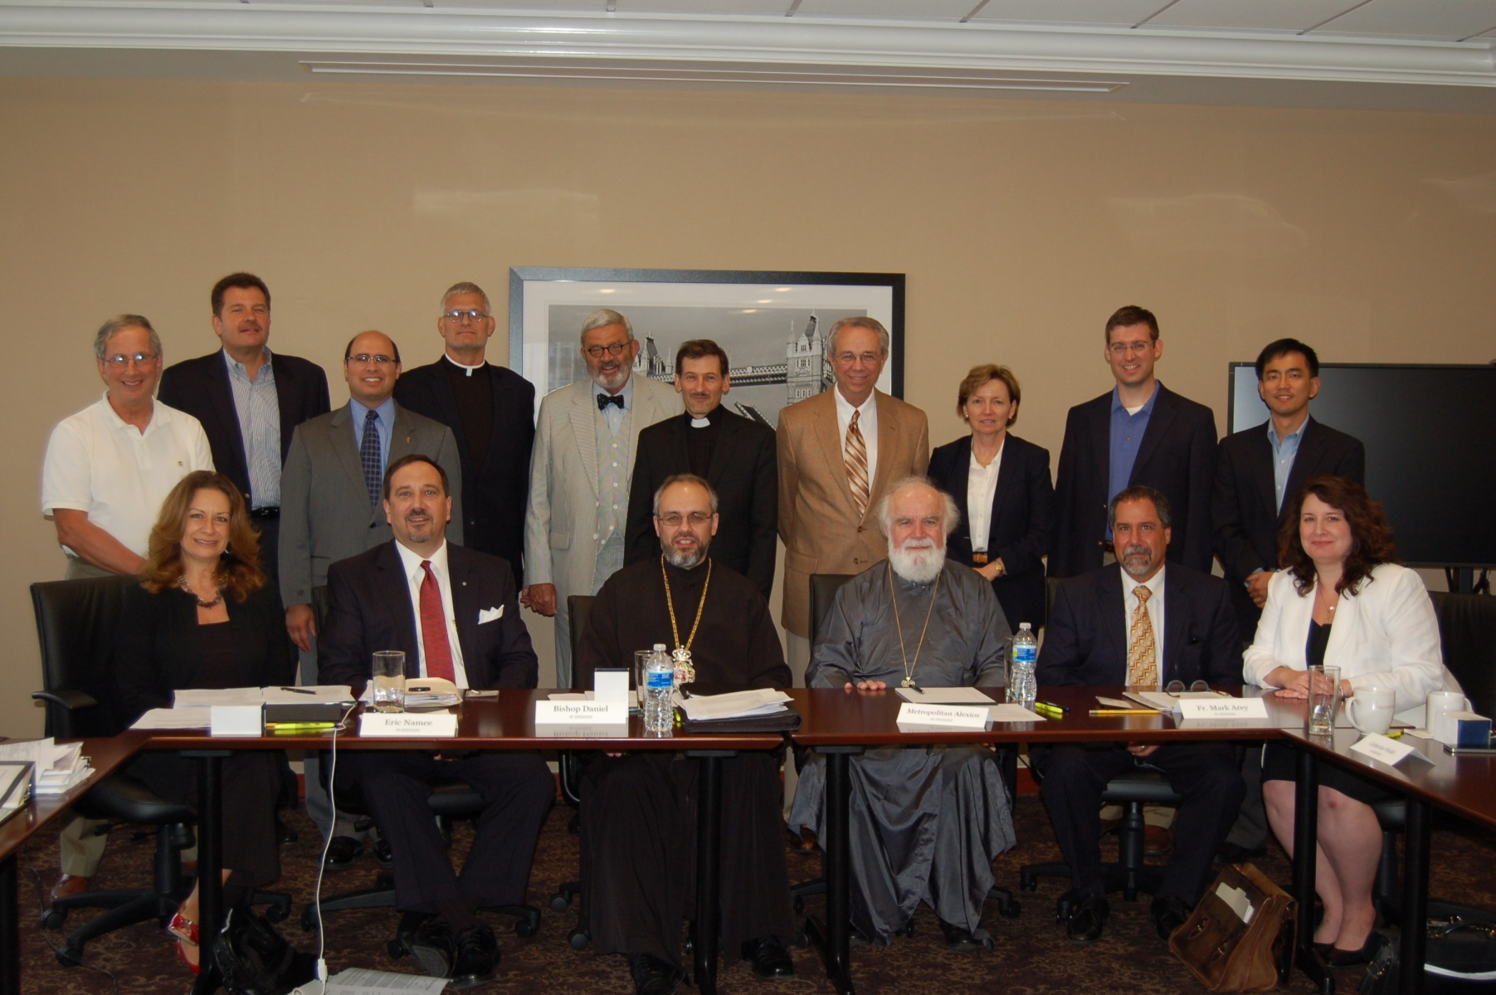
“V.O.L.F.”
Virtual Orthodox Law Firm

Slide 63
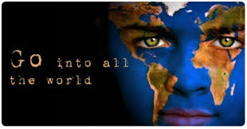
Part 3
What Can You Do To Become A Disciple Of Jesus Christ
In Your Jerusalem?

Slide 64
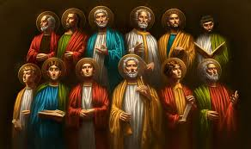
What Did Jesus Christ
Call His Followers?

Slide 65
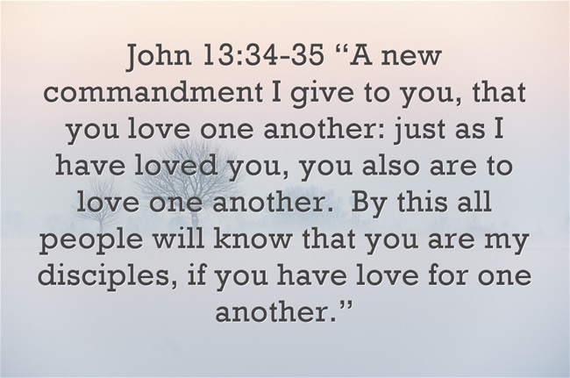

Slide 66
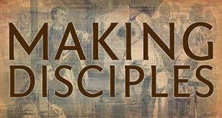
What Instructions Did Jesus Christ Give His Followers?

Slide 67
The Great Commission
Matthew 28:18-20
“And Jesus came up and spoke to them, saying, ‘All authority has been given to Me in heaven and on earth.
‘Go therefore and make disciples of all the nations
…baptizing them in the name of the Father and the Son and the Holy Spirit, teaching them to observe all that I commanded you… "

Slide 68
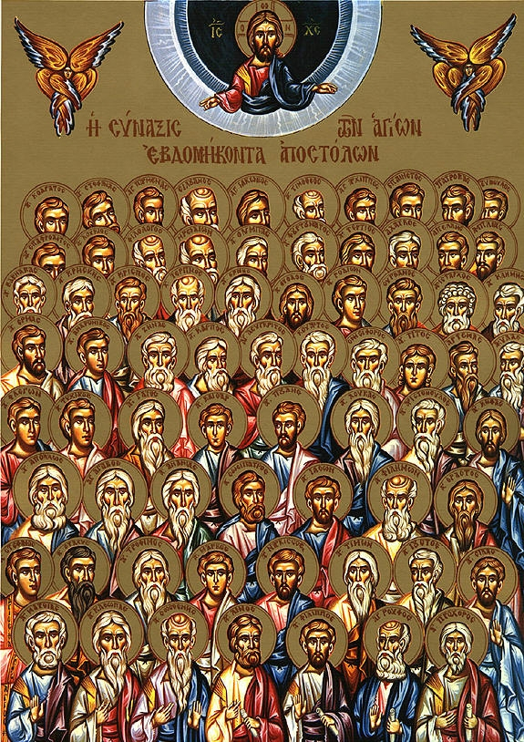
Christ modeled perfect leadership by picking and training the Apostles, and teaching them to “train the trainers”
(i.e., the 70 Disciples in Luke 10:1)

Slide 69

The Disciple Multiplier Effect
You can only do = x
Each disciple your recruit can only do = X
If you do it all yourself, you can only do = 1x
If you recruit 10 disciples, you can do = 11x
Your leadership reach is 100% correlated with the number of disciples you recruit

Slide 70

The Disciple Multiplier Effect
“None of us can do as much as all of us can do together.”
“None of us is as smart as all of us are.”

Slide 71

Christ’s Holy Commission
“… and you shall be witnesses to Me in Jerusalem, and in all of Judea and Samaria, and to the end of the earth.”
Acts 1:8

Slide 72
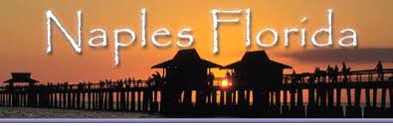
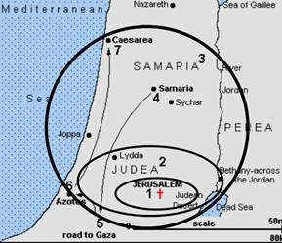
The Ends of the Earth
Judea
Jerusalem

Slide 73
Your Jerusalem
Your Church’s Jerusalem
83% of U.S. Christians are willing to travel 25 minutes or less to attend church services¹
Your Jerusalem is a 25-minute radius around your church
How well are you doing at making Disciples of everyone in your Jerusalem?
25 min
25 min
Your
Church
25 min
25 min
¹The Nuts and Bolts of Church Planning, Aubrey Malphurs summarizing research from Dr. Win Arn

Slide 74




A Provocative Thought About
Your Personal Jerusalem
What if YOUR Jerusalem is wherever YOU are ?
How are YOU doing to make Disciples of everyone in YOUR Jerusalem?
Work
Friends
Family
Community

Slide 75
My 4 Questions For You
What are you willing to die for?
What are you willing to go to jail for?
What are you willing to advocate for?
What are you willing to do?

Slide 76
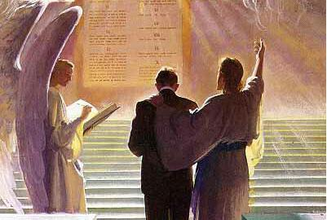
So how are you doing at creating for yourself:
“a good account before the awesome judgment seat of Christ”?

Slide 77
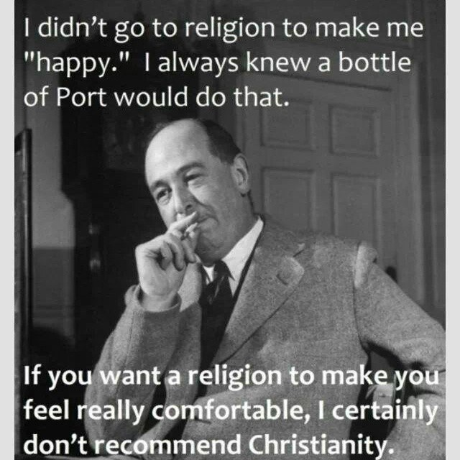
j
C. S. Lewis

Slide 78
“And whoever does not bear his cross and come after Me cannot be My disciple.”
Luke 14:27

Slide 79
Today’s Goal

Slide 80
It’s Time To Get Busy
“Then he said to his disciples, ‘The harvest is plentiful but the workers are few. Ask the Lord of the harvest, therefore, to send out workers into his harvest field.’ ”
Matthew 9:37-38

Slide 81
Make Something Happen!

Slide 82
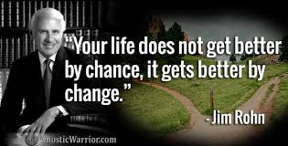

Slide 83
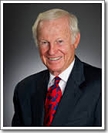
“A dream is just a dream.
A goal is a dream with a plan and a deadline.”
Harvey Mackay

Slide 84
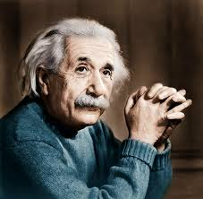
“Logic will get you from A to B.
Imagination will take you everywhere.
Imagination is more important than knowledge.”
Albert Einstein

Slide 85
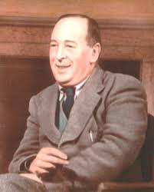
“Christianity, if false, is of no importance, and if true, of infinite importance. The only thing it cannot be is moderately important.”
C. S. Lewis

Slide 86
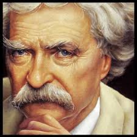
The 2 most important days of your life are:
First, the day you were born, and
Second, the day you figure out why

Slide 87
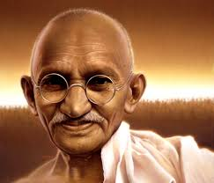
“You must be the change you wish to see in the world.”
Mahatma Gandhi

Slide 88

“The best time to plant a tree was 20 years ago.
The second best time is today.”
Old Chinese Proverb

Slide 89
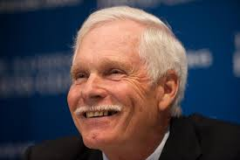
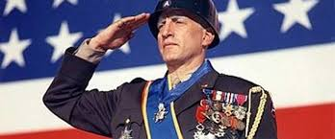
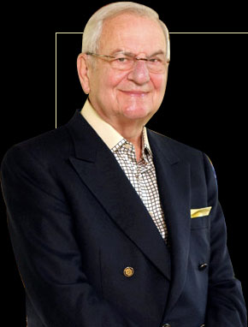


“Either lead, follow
or get out of the way.”
- Ted Turner
- General George S. Patton - Lee A. Iacocca
- Thomas Paine
- Bill Marianes

Slide 90
This entire presentation and other resources and content in the areas of personal and church calling, stewardship and strategic planning is available to download at the always free resource:
www.stewardshipcalling.com
This presentation is under the Spiritual - Leadership Retreats tab
Bill Marianes: Bill@stewardshipcalling.com (404) 443-5700

Slide 91

Albert's Insight
What was Albert Einstein’s greatest contribution?
E=mc²
“NOTHING HAPPENS UNTIL SOMETHING MOVES”

Slide 92

The Marianes Corollary
“NOTHING HAPPENS UNTIL SOMEBODY MOVES”

Slide 93
You have now been called as one of the 70 Disciples
Luke 10:1

Slide 94


