Slide 1
Selected Church
Facts and Stats
~ ~ ~ ~ ~ ~ ~ ~ ~ ~ ~ ~ ~ ~ ~ ~ ~ ~
“You cannot master what you do not measure”
~ ~ ~ ~ ~ ~ ~ ~ ~ ~ ~ ~ ~ ~ ~ ~ ~ ~
Bill Marianes – May, 2020
www.stewardshipcalling.com Bill@stewardshipcalling.com

Slide 2
Please note that all of the following data is believed to be accurate from reliable sources as of the date as indicated, and from the source where indicated.
It may not represent the absolute latest available data.
Do your homework!

Slide 3
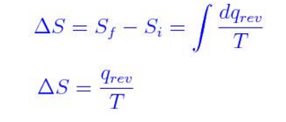
What Is Your Church’s Biggest Challenge?
Entropy =
Everything in the universe eventually moves from order to disorder (entropy measures that change)
If you don’t make positive changes you will get negative changes

Slide 4
How Is Our World Changing?

Slide 5
We are living in exponential times…
… the speed of change is unimaginable and accelerating
¹The following is based on the pioneering YouTube video “Did You Know?” (with certain updated statistics).
Did You Know? is licensed by Karl Fisch, Scott McLeod, and XPLANE under a Creative Commons Attribution Non-Commercial Share-Alike license. You are free to copy, distribute, remix and transmit the presentation as long as you give proper attribution to the original creators and share the resulting work under the same license. You may not use Did You Know? for commercial purposes without permission from the creators. (Selected statistics have been updated, as much as reasonably possible, from available sources.)

Slide 6
Years it took to reach 50 million users:
Telephone – 75 years
Radio – 38 years
TV – 13 years
Internet – 4 years
Google Plus – 88 days
Angry Birds – 35 days
Pokémon GO – 19 days

Slide 7
Modern Smart phones have much more computing power when compared to Apollo mission computers that NASA used to go to the moon in the 1960s.

Slide 8
We are living in exponential times…

Slide 9
More video content
was uploaded to in the last 2 months…
Than the amount of content that would be aired if all three major networks broadcast content
24 hours per day for 62 years

Slide 10
60 hours of video are uploaded to every minute
1 hour of video is uploaded to every second

Slide 11
Facebook started about 16.5 years ago in October 2003.
It now has over 2.45 Billion active monthly users.
It is has over 1.62 Billion active daily users.

Slide 12
If Facebook were a country . . .
. . .it would be the 2nd largest country in the world
. . . behind only China.
Slightly larger than India and 5.5 times bigger than the U.S.

Slide 13
We are living in exponential times…

Slide 14
There are over 3.5 BILLION Google internet searches per DAY
~ 1.2 TRILLION per year
~ 40,000 every second

Slide 15
To whom were those questions directed B.G.?
(Before Google)

Slide 16
There are over
1.77 Billion websites on the
world wide web

Slide 17
There are over 200 BILLION tweets per year
~ 500 million per day
~ 350,000 every second

Slide 18
E-mail Facts
3.7 Billion email users worldwide
269 Billion daily worldwide emails
98.2 Trillion yearly worldwide emails
1.5 Billion Gmail active users globally
57% of all email is treated as SPAM

Slide 19
We are living in exponential times…

Slide 20
In 2014 in the U.S. alone there were an estimated
8.5 BILLION text messages…
… PER DAY

Slide 21
~ 97% of American adults text.
~ Text messages have a 98% open rate versus only 20% for email.
~ 95% of all text messages are read in under 3 minutes.

Slide 22
Over 22% of couples married in the U.S. in 2009 . . .
. . .met online
By 2017, over 40% of couples in the U.S.
met online

Slide 23
We are living in exponential times…
So what does all this mean for your Parish and parishioners?

Slide 24
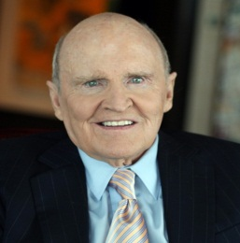
Jack Welch
Chairman & CEO - General Electric
~ ~ ~ ~ ~ ~ ~ ~ ~ ~ ~ ~ ~ ~ ~ ~ ~ ~ ~ ~
“If the rate of change on the outside exceeds the rate of change on the inside, the end is near.”
~ ~ ~ ~ ~ ~ ~ ~ ~ ~ ~ ~ ~ ~ ~ ~ ~ ~ ~ ~ ~
“Change before you have to.”

Slide 25
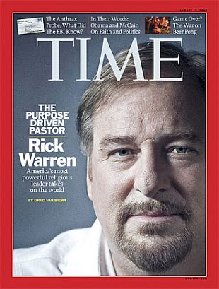
“Leaders of a Church will either be risk takers, caretakers or undertakers.”
Pastor Rick Warren

Slide 26
Selected “Spirituality” Challenge Facts

Slide 27
Laity Spirituality Challenges¹
“Regular Bible reading dropped over the last decade from 45% to 37%.
Volunteering at church declined from 27% to 20% over the same decade.
40% of Christians do not attend church or read the Bible in a typical week
70% of Christians are not involved in a small group that meets for spiritual purposes
There are more than 10 million Christians who are “un-churched”
¹ State of the Church report by the Barna Research Group (BRG) from a nationwide study of the country's faith practices and perspectives

Slide 28
We Lost Our Adults
~ 47% of adults who were raised in the Orthodox Church have left the Church¹
¹ 2015 U.S. Religious Landscape Study - Pew Research Center

Slide 29
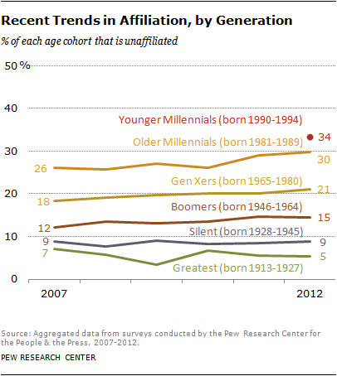
We Can
“Kiss Our Youth Goodbye”
~ Millennials (aged 18-29) are over 2.5 times more likely than their adult parents to be unaffiliated with the Church²
² Religion in the Millennial Generation (2010) and U.S. Religious Landscape Survey (2007), Pew Forum on Religion & Public Life of the Pew Research Center.

Slide 30
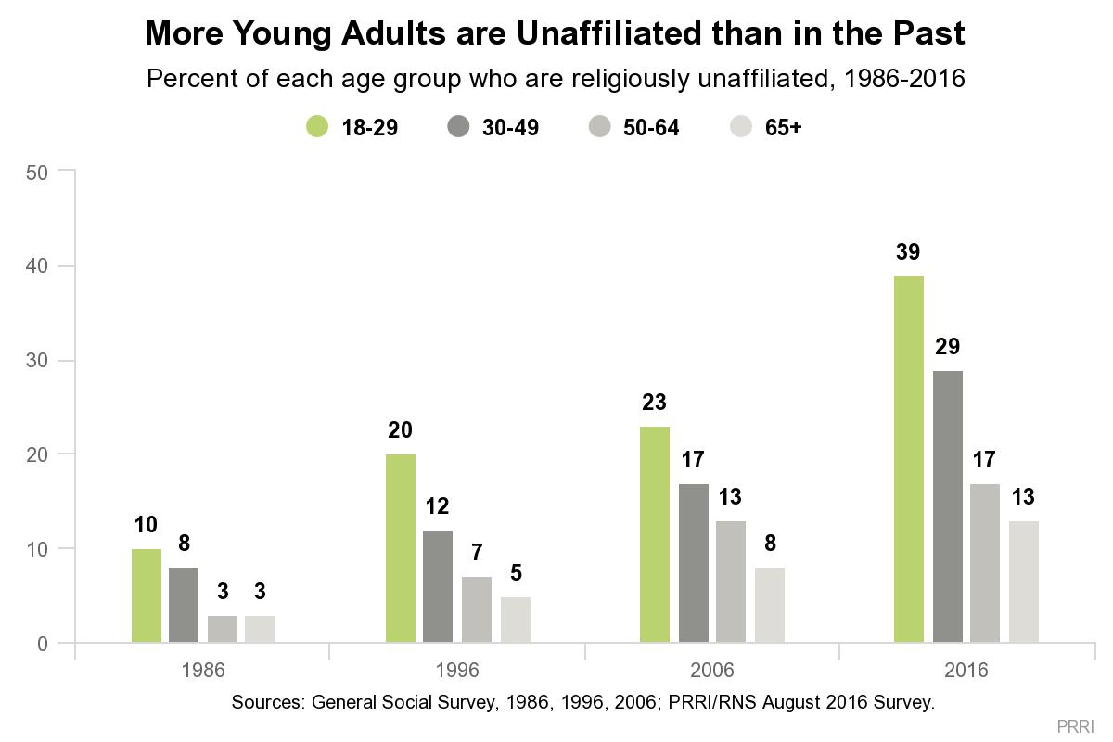
4X Increase in NONES
~ The nonprofit, nonpartisan Public Religion Research Institute data is worse reporting 39% Millennial youth are “NONEs”

Slide 31
Church Attendance Data
~ Only 26% of all Orthodox adherents attend church services regularly on a weekly basis.¹
P.S. It averages only
21% in the GOA parishes;
22 % in Serbian parishes;
37% in Antiochian parishes;
40% in OCA parishes; and
48% in Carpatho Russian parishes
¹ Eight Facts about Church Attendance in US Orthodox Christian Churches (2010) Assembly of Canonical Orthodox Bishops of North and Central America.

Slide 32
Church Attentiveness Data
~ Our minds wander and we are distracted between 70% to 80% of the time during Orthodox church services (excluding the sermon/homily)¹
¹ Personal survey data acquired from interviews of hundreds of Orthodox Christians by Stewardship Calling

Slide 33
The Orthodox Church Demographic Makeup Has Changed Significantly Over The Last 15 Years
The Stewardship Calling Model of the 4 Kinds of Orthodox Christians in America

Slide 34
4 Kinds of Orthodox Christians
Intentional
Cradle
Orthodox
Intentional
Orthodox
Convert
Passion for the Faith
Incidental
Cradle
Orthodox
Incidental
Orthodox
Convert
Accident of Birth
Born Orthodox
Born Non-Orthodox

Slide 35
4 Kinds of Orthodox Christians
Intentional
Cradle
Orthodox
Intentional
Orthodox
Convert
Passion for the Faith
Incidental
Cradle
Orthodox
Incidental
Orthodox
Convert
Every Cradle Orthodox Enters here
Accident of Birth
Born Orthodox
Born Non-Orthodox

Slide 36
4 Kinds of Orthodox Christians
Few Cradle Orthodox move here
Intentional
Cradle
Orthodox
Intentional
Orthodox
Convert
Passion for the Faith
Incidental
Cradle
Orthodox
Incidental
Orthodox
Convert
Accident of Birth
Born Orthodox
Born Non-Orthodox

Slide 37
4 Kinds of Orthodox Christians
Intentional
Cradle
Orthodox
Intentional
Orthodox
Convert
Passion for the Faith
Nominal Convert Orthodox enter here
Incidental
Cradle
Orthodox
Incidental
Orthodox
Convert
Accident of Birth
Born Orthodox
Born Non-Orthodox

Slide 38
4 Kinds of Orthodox Christians
True Convert Orthodox Seekers end up here
Intentional
Cradle
Orthodox
Intentional
Orthodox
Convert
Passion for the Faith
Incidental
Cradle
Orthodox
Incidental
Orthodox
Convert
Accident of Birth
Born Orthodox
Born Non-Orthodox

Slide 39
4 Kinds of Orthodox Christians
~ You need different strategies for each of the 4 categories of Orthodox Christians
Intentional
Cradle
Orthodox
Intentional
Orthodox
Convert
Passion for the Faith
Incidental
Cradle
Orthodox
Incidental
Orthodox
Convert
Accident of Birth
Born Orthodox
Born Non-Orthodox

Slide 40
Selected “Income” Financial Stewardship Challenge Facts

Slide 41
The Giving Facts
~People are giving a lower percentage of income to churches in the 2000’s than they did either during the Great Depression or the 1920’s
~ 37% of church goers give $0 to the church
¹ Christian Stewardship Association; Barna Research Group; Empty Tomb; Giving USA Foundation

Slide 42
The Giving Facts¹
~ Orthodox Christians in the U.S. are in the
(a) top third of annual income
(b) bottom third of giving to their churches in the form of annual financial stewardship
¹ Pew Forum income data compared with analysis of several hindered Orthodox Parish financial statements (mostly in GOA) by Stewardship Calling

Slide 43
U.S. Christian Charitable PER PERSON Giving Statistics¹
Group | $
U.S. Christian average = | $880
U.S. Evangelical Protestant average = | $1,165
Average GOA Parishioner = | $275
¹ All numbers are per person - per year direct financial stewardship contributions

Slide 44
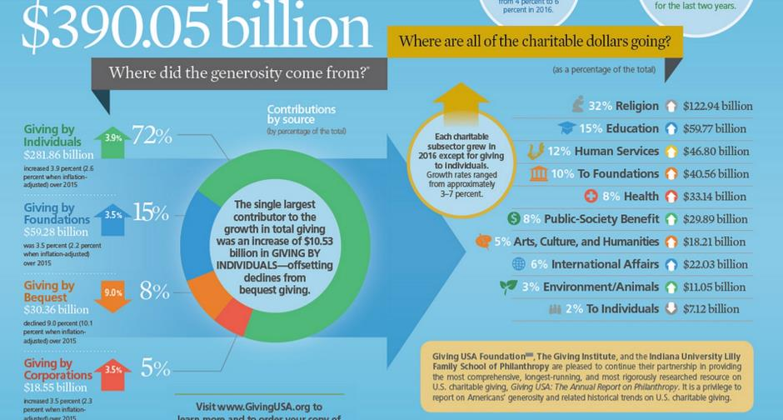
The Giving Facts - 2016
$390 Billion given away
Only 8% in wills
Only 32% to religious causes
¹ Giving USA Foundation - 2017 Annual Report

Slide 45
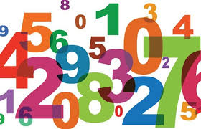
Selected “Numbers” Challenge Facts

Slide 46
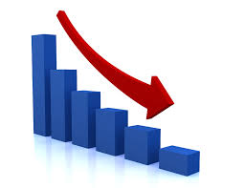
Major Denominations That Are Declining

Slide 47
“Top 25” Denominations Reporting One Year Membership Decreases
1. The Catholic Church (68.2 M members) down 0.44%
2. Southern Baptist Convention (16.1 M members) down 0.15%
3. The United Methodist Church (7.6 M members) down 1.22%
7. Evangelical Lutheran Church in America (4.2 M members) down 5.9%
10. Presbyterian Church U.S.A. (2.6 M members) down 3.42%
13. The Lutheran Church – Missouri Synod (2.2 M members) down 1.45 %
14. The Episcopal Church (1.9 M members) down 2.71 %
19. American Baptist Churches in the U.S.A. (1.3 M members)down 0.19%
21. United Church of Christ (1 M members) down 2.02%
¹ National Council of Churches' 2012 Yearbook of American & Canadian Churches (NOTE: ALL BUT ONE OF THESE DENOMINATIONS HAD DECREASES IN MEMBERSHIP IN THE PRIOR YEAR ALSO )

Slide 48
But Some Major Denominations Are Increasing

Slide 49
“Top 25” Denominations Reporting One Year Membership Increases
(2012) (prior year)
4. Church of Jesus Christ of Latter-day Saints
(Mormon Church) (6.1 M members) up 1.6% up 1.4%
9. Assemblies of God (3 M members) up 3.9% up 0.5%
20. Jehovah’s Witnesses (1.1 M members) up 1.9% up 4.4%
24. Seventh-Day Adventist Church (1 M members) up 1.6% up 4.3%
¹ National Council of Churches' 2012 Yearbook of American & Canadian Churches

Slide 50
10 Largest Christian Church Parishes in USA ¹
Rank | Church | Location | Lead Pastor | Size | Founded
#1 | Lakewood Church | Houston, TX | Joel Osteen | 43,500 | 1959
#2 | North Point Ministries | Alpharetta, GA | Andy Stanley | 39,056 | 1995
#3 | Church of the Highlands | Birmingham, AL | Chris Hodges | 38,346 | 2001
#4 | New Spring Church | Anderson, SC | Vacant | 33,761 | 2000
#5 | Gateway Church | Southlake, TX | Robert Morris | 28,399 | 2000
#6 | Saddleback Church | Lake Forest, CA | Rick Warren | 25,612 | 1980
#7 | Willow Creek Community Church | South Barrington, IL | Bill Hybels | 25,371 | 1975
#8 | Christ’s Church of the Valley | Peoria, AZ | Don Wilson | 24,108 | 1982
#9 | Christ Fellowship Church | Palm Beach Gardens, FL | Todd Mullins | 23,845 | 1984
#10 | Southeast Christian Church | Louisville, KY | Dave Stone | 23,799 | 1962
¹ As of 2016 - Outreach Magazine

Slide 51
How Are We Doing?

Slide 52
Orthodox Christian Churches in the USA¹
Ortho #¹ Ortho %²
1. Greek Orthodox Archdiocese of America 476,900 58.8%
2. Orthodox Church in America 84,900 10.4%
3. Antiochian Orthodox Christian Archdiocese 74,600 9.1%
4. Serbian Orthodox Church in North America 68,800 8.4%
5. Russian Orthodox Church Outside of Russia 27,700 3.4%
6. Ukrainian Orthodox Church of the USA 22,400 2.7%
7. Patriarchal Parishes of the Moscow Patriarchate 12,400 1.3%
8. Romanian Orthodox Archdiocese 11,200 1.4%
9. American Carpatho Russian Orthodox Diocese 10,400 1.3%
10. Vicariate for the Palestinian / Jordanian
Orthodox Christian Communities 6,800 .08%
Top 10 Orthodox Jurisdictions Total² = 796,100 97.2%
15 ORTHODOX JURISDICTIONS TOTAL² = 815,951 100%
US Christians = 227,590,000 15 Orthodox = 0.36% GOA = 0.2%
¹ 2010 Atlas of American Orthodox Christian Churches, Assembly of Bishops - by Alexei Krindatch
²These are the 15 Jurisdictions in communion and does not include the 226,349 Oriental Orthodox

Slide 53
GOA Baptisms Are Generally Declining

Slide 54
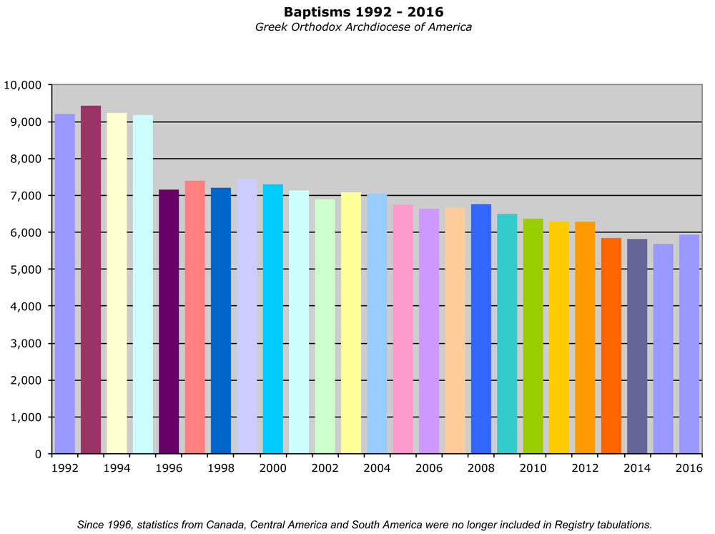

Slide 55
GOA Chrismations Are Generally Declining

Slide 56
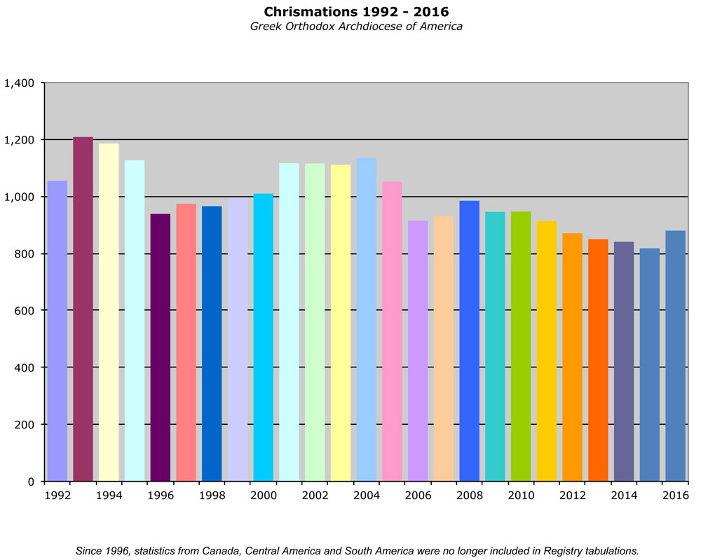

Slide 57
GOA Weddings Are Generally Declining

Slide 59
And Finally, Something That is Generally Growing...

Slide 62
OCA Reported Census Data (2015-2017)¹
 | 2017 | 2016 | 2015 | # Δ '16 to 17 | % Δ '16 to '17 | # Δ '15 to 17 | % Δ '15 to '17
Membership | 60,498 | 50,502 | 44,546 | 9,996 | 20% | 15,952 | 36%
Baptisms | 2,064 | 2,221 | 1,310 | -157 | -7% | 754 | 58%
Chrismations | 541 | 571 | 579 | -30 | -5% | -38 | -7%
Weddings | 405 | 367 | 317 | 38 | 10% | 88 | 28%
Funerals | 1,003 | 973 | 887 | 30 | 3% | 116 | 13%
Net Adds | 1602 | 1819 | 1002 | -217 | -12% | 600 | 60%
¹ OCA Official census reports (difference between 84,900 members reported in 2010 Atlas of American Orthodox Christian Churches, Assembly of Canonical Orthodox Bishops to be reviewed
² Net Adds = (Baptisms + Chrismations – Funerals)

Slide 63
Coptic Orthodox Christians
in the USA¹
~ According to the American Coptic Association, there are approximately 350,000 - 420,000 Copts in the U.S. (many ethnic Copts listed themselves in the 2011 U.S. Census mistakenly as either Egyptians, Sudanese, Libyans or Americans thus reducing the ethnic Coptic population in the United States to not be even included within the 2011 U.S. Census.) ¹
~ According to the Atlas of America Orthodox Churches², in 2010 there were only 92,100 Coptic Orthodox adherents in the United States
N Y Times Archived 2011-08-21 at the Wayback Machine"Archived copy". Archived from the original on 2009-03-19. Retrieved 2009-06-21.
2010 Atlas of American Orthodox Christian Churches, Assembly of Canonical Orthodox Bishops

Slide 64
Orthodox Christian Churches in the USA¹
Number¹
1. Greek Orthodox Archdiocese of America 476,900
2. Orthodox Church in America 84,900
3. Antiochian Orthodox Christian Archdiocese 74,600
4. Serbian Orthodox Church in North America 68,800
5. Russian Orthodox Church Outside of Russia 27,700
6. Ukrainian Orthodox Church of the USA 22,400
7. Patriarchal Parishes of the Moscow Patriarchate 12,400
8. Romanian Orthodox Archdiocese 11,200
9. American Carpatho Russian Orthodox Diocese 10,400
10. Vicariate for the Palestinian / Jordanian
Orthodox Christian Communities 6,800
Top 10 Orthodox Jurisdictions Total² = 796,100
15 Eastern Orthodox Jurisdictions = 815,951
All Oriental Orthodox Jurisdictions = 226,349
US Christians = 227,590,000 All Orthodox = 1,042,330 (0.46%)
¹ 2010 Atlas of American Orthodox Christian Churches, Assembly of Canonical Orthodox Bishops

Slide 65
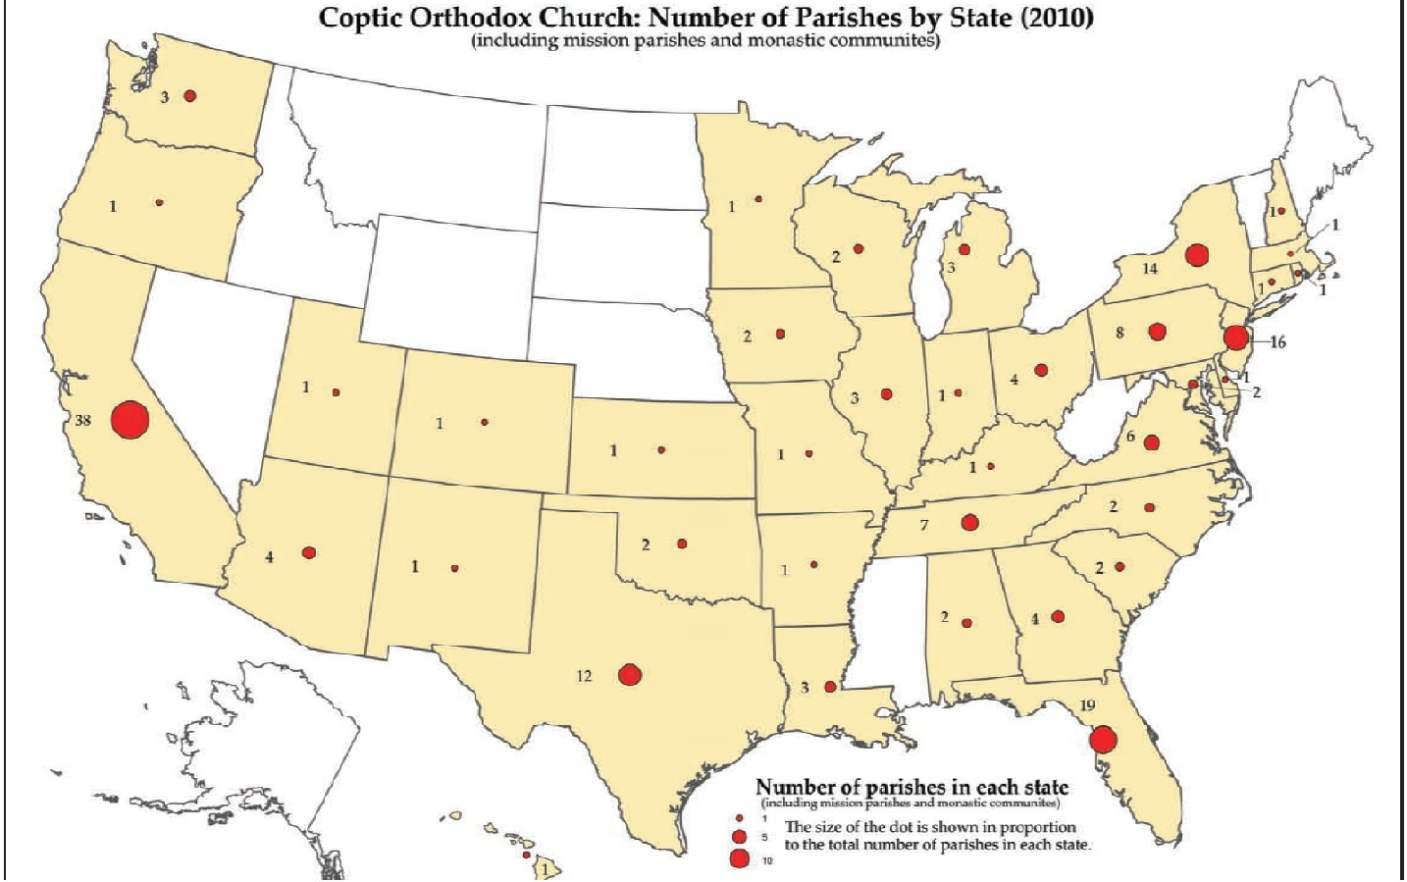
Copts Orthodox Christians in the USA¹

Slide 66
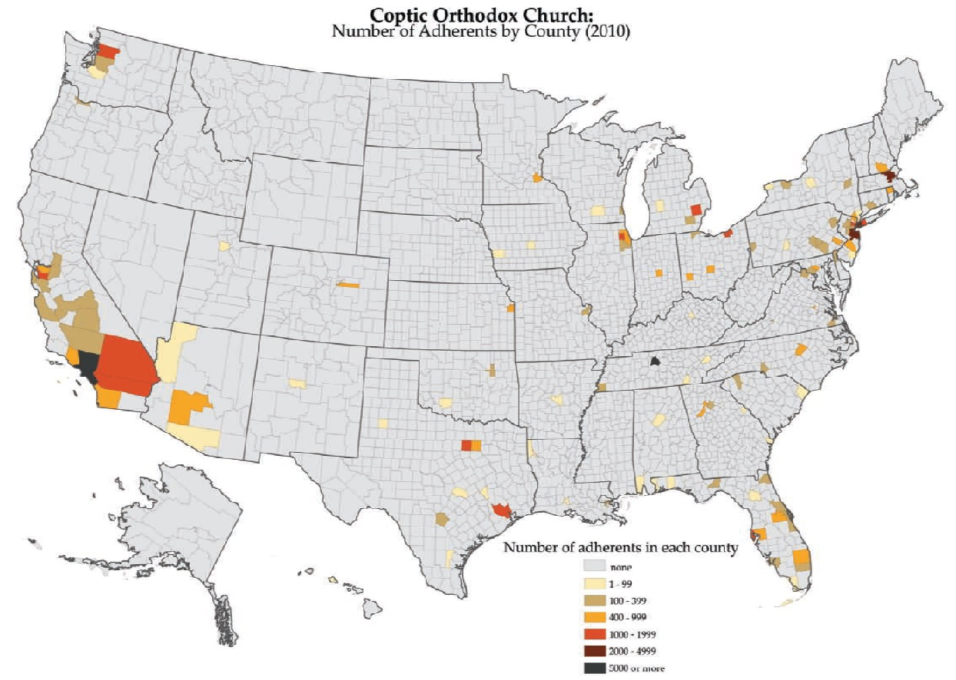
Copts Orthodox Christians in the USA

Slide 67
“Leaders of a Church will either be risk takers, caretakers or undertakers.”
Pastor Rick Warren

Slide 68
Be Courageous
Matthew 21:12 Mark 11:15
Luke 19:45 John 2:15

Slide 69
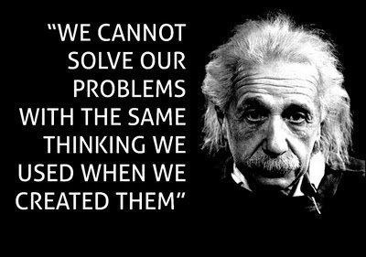

Slide 70
Selected Church
Facts and Stats
~ ~ ~ ~ ~ ~ ~ ~ ~ ~ ~ ~ ~ ~ ~ ~ ~ ~
“You cannot master what you do not measure”
~ ~ ~ ~ ~ ~ ~ ~ ~ ~ ~ ~ ~ ~ ~ ~ ~ ~
Bill Marianes – May, 2020
www.stewardshipcalling.com Bill@stewardshipcalling.com

