Slide 1
Strategic Plan Update
WHY, SWOT, Core Values,
Mission, Vision and
Wildly Important Goals
“For everyone to whom much is given, from him much will be required.” Luke 12:48
Bill Marianes (Bill@stewardshipcalling.com)

Slide 2
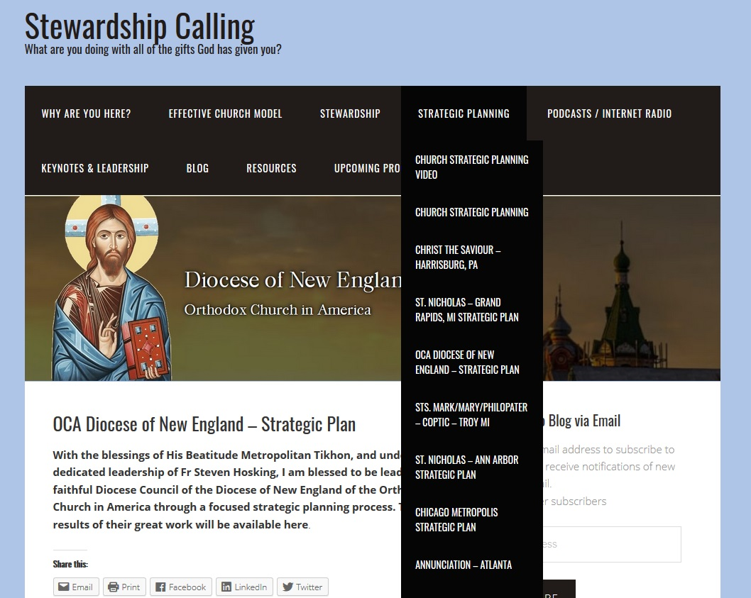
www.stewardshipcalling.com
This Presentation and Strategic Planning Content Is Here
You can download this presentation, all ongoing work product and videos under the Strategic Planning tab and the OCA Diocese of New England page
https://stewardshipcalling.com/oca-diocese-of-new-england-strategic-plan/
Send questions to: Bill@stewardshipcalling.com

Slide 3
Statement of WHY
To guide and support the New England parishes so that they help people glorify God by growing in life, faith and spiritual understanding.

Slide 4
Final Strengths
~ Laity
~ Financial Stability
~ Dogma, Traditions & Liturgical Practices
~ Clergy

Slide 5
Final Weaknesses
~ Clergy Needs (Too Few, Wellness, Overstretched, Bi-vocation)
~ Insufficient Diocese Staff & Support and Insufficient Parish Support
~ Lack of a Consensus Diocese Vision and Plan (and Resistance To Change)
~ Parish Misalignment & Density, Small Number and Small Size of Parishes & Great Distances
~ Stagnant Growth
~ Stewardship of Time, Talents and Treasures

Slide 6
Final Opportunities
~ Greater Numbers of People to Serve, including seekers, “nones”, youth and emerging adults, immigrants, poor and others living in New England
~ Technology / Social Media & Communications

Slide 7
Final Threats
~ Secularism, Hostility to Religion & Changing Culture
~ Economy / Economic Stress & Other External Disruptions and Crises

Slide 8
Christ-Centered Core Values
~ Love
~ Education
~ Stewardship
~ Evangelization
~ Glorification of God
~ Faithfulness to Sacred Tradition

Slide 9
Mission Statement
The mission of the Diocese of New England of the Orthodox Church in America is to proclaim the Gospel of Jesus Christ, to assist parishes and individuals to live the fullness of the Orthodox faith, and to reach out and care for others in God’s love.

Slide 10
Vision Statements
During the next 3 years, the OCA Diocese of New England will revitalize itself and support its parishes and institutions by:
Developing and staffing a Diocesan office
Increasing outreach, evangelization and missions
Optimizing comprehensive communication
Creating a vocational program
Expanding education
Supporting our Bishop and clergy more fully
Encouraging a Christ-centered life for all

Slide 11
Preliminary DWIGs and TWIGs
Ministries
Operations
Outreach & Evangelism
Stewardship
Vocation Recruitment & Development
Religious Education
Parish Ministry & Liturgical Life Engagement
Parish Health Assessment & Restructuring Optimization
Youth & Emerging Adults
Leadership Development
Communications
Hierarch Selection and Support with Restructured Office and Staff
Missions

Slide 12
Which Of The 11 Are Currently Actionable And Can Have the Greatest Impact on the Diocese and its Parishes? (the few things that can change everything
Ministries
Operations
Outreach & Evangelism
Stewardship
Vocation Recruitment & Development
Religious Education
Parish Ministry & Liturgical Life Engagement
Parish Health Assessment & Restructuring Optimization
Youth & Emerging Adults
Leadership Development
Communications
Hierarch Selection and Support with Restructured Office and Staff
Missions

Slide 13
Operations Team – WIG 3
Operations WIG 3
Parish Health Assessment & Restructuring Optimization
~ WIG wording = from X to Y by when
~ However, none of these exist, so there is no X or way to calibrate a realistic Y
~ X = “research & develop an effective parish
health assessment program and train the parish trainers”
~ Y = “complete a parish health assessment in at least 33% of the Diocese parishes”
~ BY = all within 24 months from start

Slide 14
Operations Wildly Important Goal 3
Develop and complete an effective parish health assessment process in at least 33% of the Diocese parishes within 24 months.

Slide 15
Prelim Lag Measures WIG 3
LAG 1: Research the most effective parish health assessment processes within 3 months
LAG 2: Develop the most effective parish assessment process within 4 months
LAG 3: Recruit and train the parish trainers within 3 months
LAG 4: Recruit, deliver and complete the health assessments in at least 33% of the Diocese parishes within 12 months
LAG 5: Compile the results of the parish health assessment process and provide a report within 2 months
Operations WIG 3:
“Develop and complete an effective parish health assessment process in at least 33% of the Diocese parishes within 24 months.”

Slide 16
Prelim Lead Measures WIG 3
LEAD 1:
A: recruit team
B: develop process plan
C: ID at least 5 assessment tools to consider
LEAD 2:
A: evaluate tools for effectiveness / validity
B: modify tool for utilization in our diocese
C: finalize tool for use
LEAD 3:
A: identify number and names of potential trainers
B: develop training program
C: implement training program
LEAD 4:
A: identify & recruit at least 9 parishes of various characteristics to complete a parish health assessment
B: assign trainers to respective parishes
C: schedule and complete a health assessment in all parishes
LEAD 5:
A: obtain data from parish health assessments
B: compile all data
C: finalize and deliver comprehensive parish health assessment report
LAG 1: Research the most effective parish health assessment processes within 3 months
LAG 2: Develop the most effective parish assessment process within 4 months
LAG 3: Recruit and train the parish trainers within 3 months
LAG 4: Recruit, deliver and complete the health assessments in at least 33% of the parishes within 12 months
LAG 5: Compile the results of the program and provide a comprehensive report within 2 months

Slide 17
Ministries Team – WIG 1
Parish Ministry & Liturgical Life Engagement
~ WIG wording = from X to Y by when
~ However, none of these exist, so there is no X or way to calibrate a realistic Y
~ X = “research & develop an effective parish
ministry & liturgical life engagement program and train the parish trainers”
~ Y = “deliver the parish ministry & liturgical life engagement program to at least ____% of the Diocese parishes”
~ BY = all within ___ months from start

Slide 18
Ministries Wildly Important Goal 1
Develop and implement an effective parish ministry & liturgical life engagement program in at least ___% of the Diocese parishes within __ months.

Slide 19
Prelim Lag Measures WIG 1
LAG 1: Research the most effective ministry & liturgical life engagement program within __ months
LAG 2: Develop the most effective ministry & liturgical life engagement program within __ months
LAG 3: Recruit and train the parish trainers within __ months
LAG 4: Recruit, deliver and implement the ministry & liturgical life engagement program in at least ___% of the Diocese parishes within ___ months
LAG 5: Compile the results of the parish health assessment process and provide a report within __ months
Ministries WIG1:
“Develop and implement an effective parish ministry & liturgical life engagement program in at least __% of the Diocese parishes within __ months.”

Slide 20
Prelim Lead Measures WIG 1
LEAD 1:
A: recruit team
B: develop process plan
C: ID at least 5 similar programs to consider
LEAD 2:
A: evaluate programs for effectiveness / validity
B: modify program for utilization in our diocese
C: finalize program for use
LEAD 3:
A: identify number and names of potential trainers
B: develop training program
C: implement training program
LEAD 4:
A: identify & recruit at least ___ parishes of various characteristics to implement the effective ministry & liturgical life engagement program
B: assign trainers to respective parishes
C: schedule and complete a parish implementation of program in all parishes
LEAD 5:
A: obtain data from parish implementation assessments
B: compile all data
C: finalize and deliver comprehensive parish health assessment report
LAG 1: Research the most effective ministry & liturgical life engagement program within __ months
LAG 2: Develop the most effective ministry & liturgical life engagement program within __ months
LAG 3: Recruit and train the parish trainers within __ months
LAG 4: Recruit, deliver and implement the ministry & liturgical life engagement program in at least ___% of the Diocese parishes within ___ months
LAG 5: Compile the results of the parish health assessment process and provide a report within __ months

Slide 21
Ministries Team – WIG 2
Leadership Development
~ WIG wording = from X to Y by when
~ However, none of these exist, so there is no X or way to calibrate a realistic Y
~ X = “research & develop an effective leadership training program and train the parish leadership”
~ Y = “deliver the leadership training program to at least ___% of the Diocese parishes”
~ BY = all within __ months from start

Slide 22
Ministries Wildly Important Goal 1
Develop and implement an effective leadership training program in at least ___% of the Diocese parishes within __ months.

Slide 23
Prelim Lag Measures WIG 2
LAG 1: Research the most effective leadership training program within __ months
LAG 2: Develop the most effective leadership training program within __ months
LAG 3: Recruit and train the parish trainers within __ months
LAG 4: Recruit, deliver and implement the leadership training program in at least ___% of the Diocese parishes within ___ months
LAG 5: Compile the results of the parish leadership training and provide a report within __ months
Ministries WIG2:
“Develop and implement an effective leadership training program in at least __% of the Diocese parishes within __ months.”

Slide 24
Prelim Lead Measures WIG 2
LEAD 1:
A: recruit team
B: develop process plan
C: ID at least 5 leadership programs to consider
LEAD 2:
A: evaluate programs for effectiveness / validity
B: modify program for utilization in our diocese
C: finalize program for use
LEAD 3:
A: identify number and names of potential trainers
B: develop training program
C: implement training program
LEAD 4:
A: identify & recruit at least ___ parishes of various characteristics to implement leadership development program
B: assign trainers to respective parishes
C: schedule and complete a parish implementation of leadership program in all parishes
LEAD 5:
A: obtain data from parish implementation assessments
B: compile all data
C: finalize and deliver comprehensive parish health assessment report
LAG 1: Research the most effective leadership training program within __ months
LAG 2: Develop the most effective leadership training program within __ months
LAG 3: Recruit and train the parish trainers within __ months
LAG 4: Recruit, deliver and implement the leadership training program in at least ___% of the Diocese parishes within ___ months
LAG 5: Compile the results of the parish leadership training and provide a report within __ months

Slide 25
REDO ONE FOR EACH OF THE TWO WIGS ONCE THEY ARE FINALIZED DETERMINED

Slide 26
Operations Wildly Important Goal 3
Develop and complete an effective parish health assessment process in at least 33% of the Diocese parishes within 24 months.

Slide 27
Operations Wildly Important Goal 3
Key Actions Necessary To Achieve Strategic WIG 3 | Responsible Party | Deadline Timetable | Completion Confirmation Test
1. Form Diocese of New England Wildly Important Goal Team 3 (Ops Team 3). | Strategic Planning Team and Goal co-Captains | Prior to Start Date | Ops Team 3 team members agree to serve
LAG 1: Research the most effective parish health assessment processes within 3 months
2. Develop research, development and roll out process plan and how success will be determined. | Ops Team 3 | 1 months after start date | Process plan completed
3. Identify at least 5 parish health assessment tools to evaluate and consider from both inside ad outside the Orthodox ecosystem). | Ops Team 3 | 2 months after step 2 | At least 5 parish health assessment tools are identified for study
LAG 2: Develop the most effective parish assessment process within 4 months
4. Evaluate all studies parish health assessment tools to determine their effectiveness and validity to DoNE parishes based on criteria of success determined in step 2. | Ops Team 3 | 2 months after step 3 | Evaluation of alternative parish health assessment tools is completed
5. Modify as necessary and finalize the creation of official DoNE “Parish Health Assessment Tool” for use. | Ops Team 3 | 2 months after step 4 | “Parish Health Assessment Tool” is finalized

Slide 28
Operations Wildly Important Goal 3
Key Actions Necessary To Achieve Strategic WIG 3 | Responsible Party | Deadline Timetable | Completion Confirmation Test
LAG 3: Recruit and train the parish trainers within 3 months
6. Identify the number and names of potential trainers (“Trainers”) who can implement the assessment tool in the parishes and recruit trainers. | Ops Team 3 | 1 month after step 5 | Trainers are recruited
7. Develop training program for Trainers and train the Trainers selected in step 6. | Ops Team 3 | 2 steps after step 6 | Trainers are trained in training program
LAG 4: Recruit, deliver and complete the health assessments in at least 33% of the Parishes within 12 months
8. Provide notice of availability of parish health assessment process to all parishes and recruit at least 9 parishes that all types and geographies and various demographics and characteristics to complete a parish health assessment and assign trainers to the respective parishes agreeing to be assessed (the “Parishes”). | Trainers and Ops Team 3 | 3 months after step 7 | At least 33% of DoNE Parishes agree to schedule a “Parish Health Assessment Tool”
9. Schedule and complete a parish health assessment in all Parishes. | Trainers | 9 months after step 8 | Parish Health Assessment is completed

Slide 29
Operations Wildly Important Goal 3
Key Actions Necessary To Achieve Strategic WIG 3 | Responsible Party | Deadline Timetable | Completion Confirmation Test
LAG 5: Compile the results of the Parish health assessment process and provide a report within 2 months
10. Obtain and compile data from all Parish health assessments. | Trainers and Ops Team 3 | 1 month after 9 | Parish health assessments are compiled
11. Finalize and deliver comprehensive Parish health assessment report to Hierarch and DoNE Diocese Council. | Ops Team 3 | 1 month after step 10 | Parish health assessment report is completed

