Slide 1
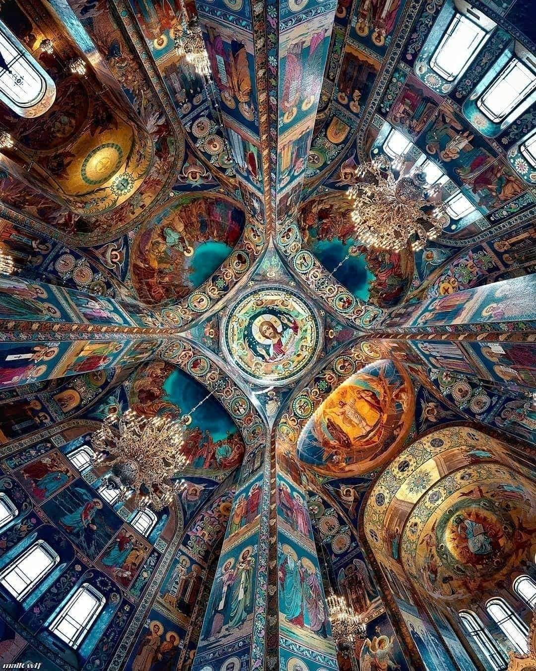
Orthodox Planned Giving 101
“If you’re going to live, leave a legacy.”

Slide 2
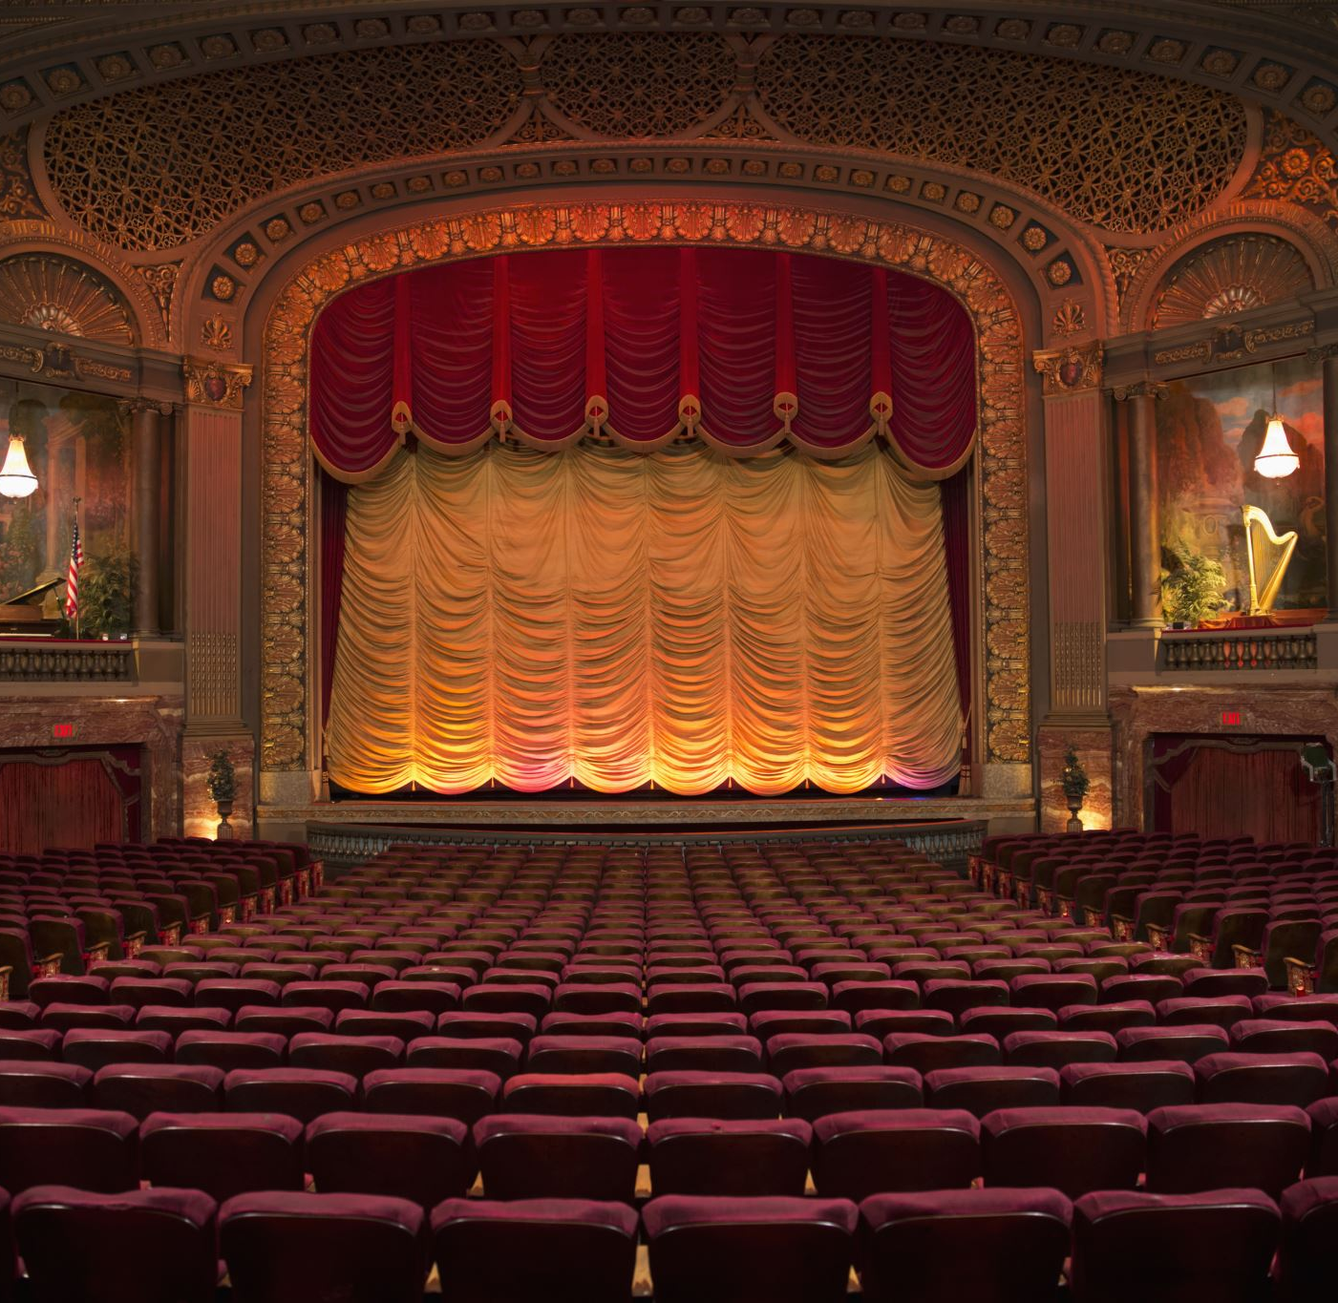
Setting The Stage The Planned Giving Opportunity
Bill Marianes
Stewardship Calling &
Orthodox Ministry Services

Slide 3
“A society grows great when old men and women plant trees in whose shade they shall never sit.”
Greek Proverb

Slide 4
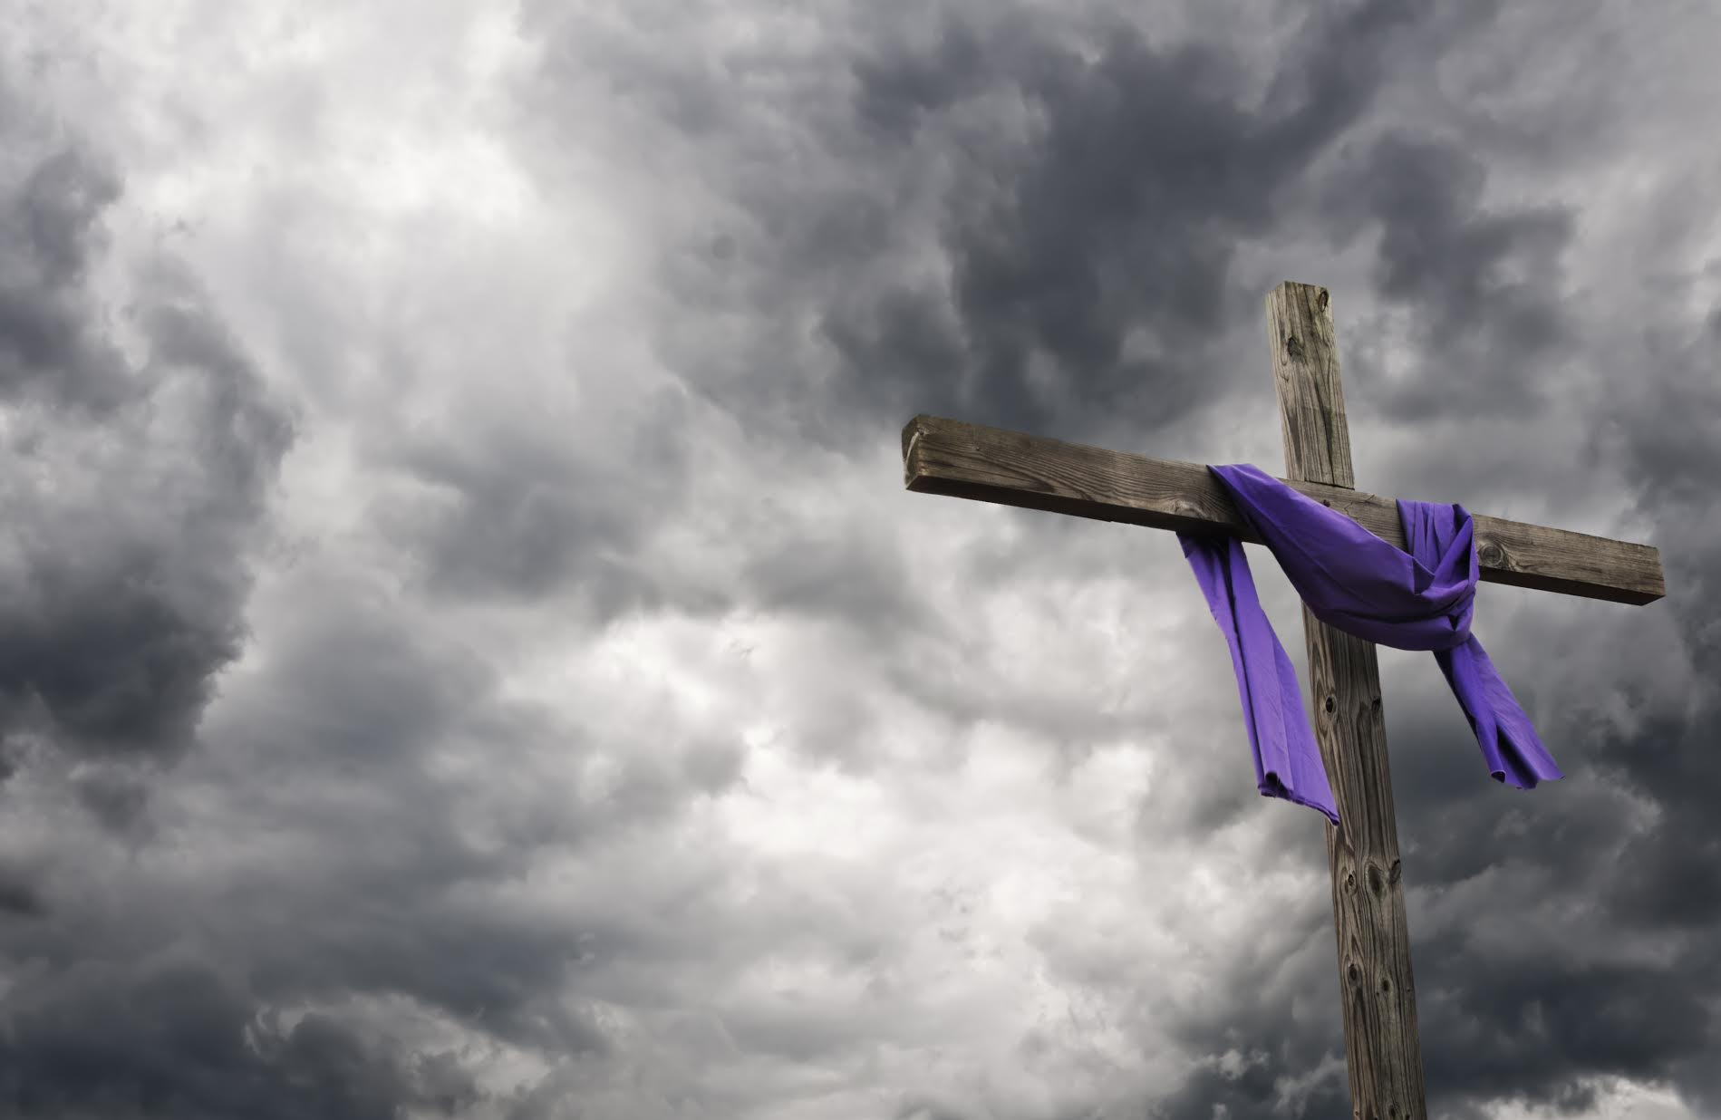
“We make a living by what we get.
We make a life by what we give.”
Sir Winston Churchill

Slide 5
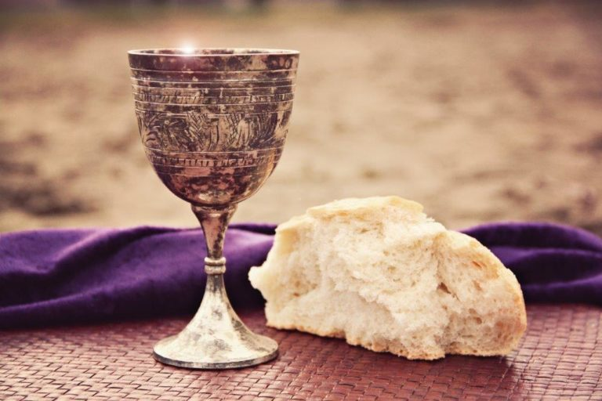
“That the end of our lives may be Christian, without pain, blameless and peaceful,
and for a
GOOD ACCOUNT before the AWESOME JUDGMENT SEAT of CHRIST.”
2 Corinthians 5:10
Orthodox Divine Liturgy

Slide 6
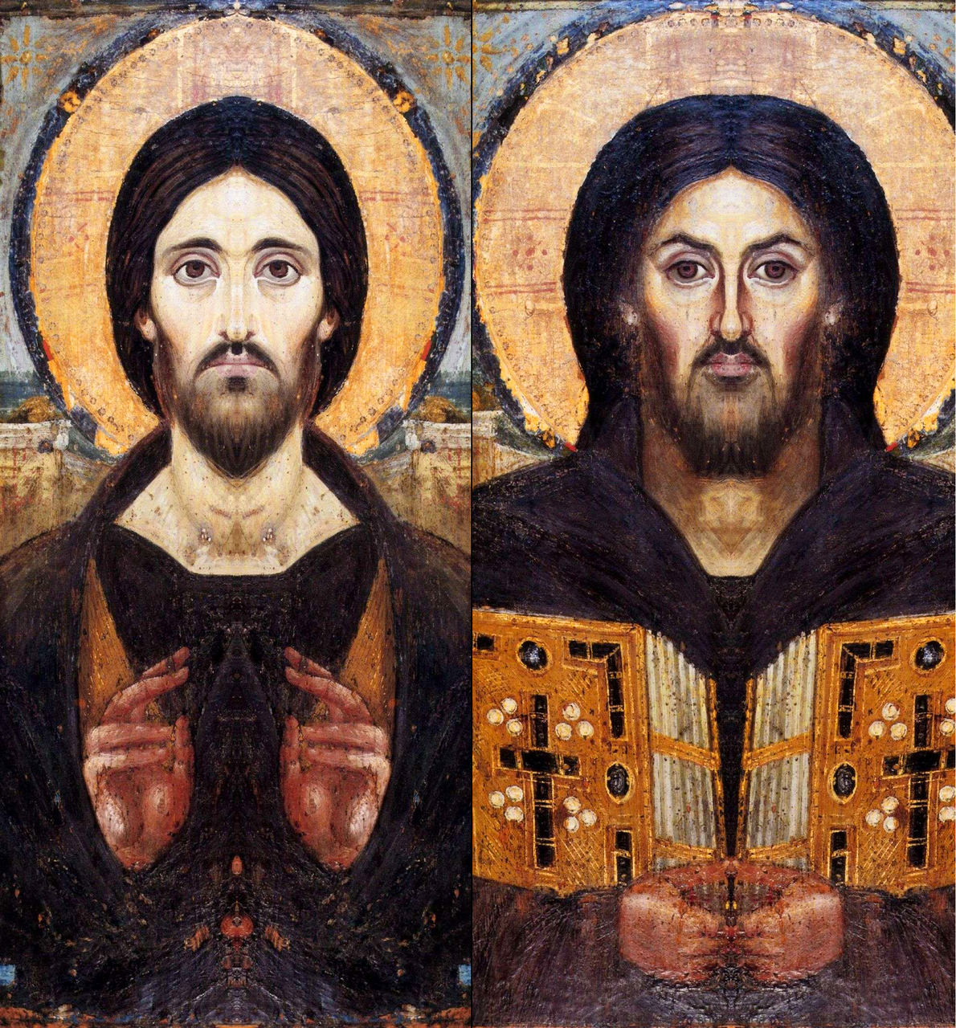
Christ’s possible very difficult question to you

Slide 7
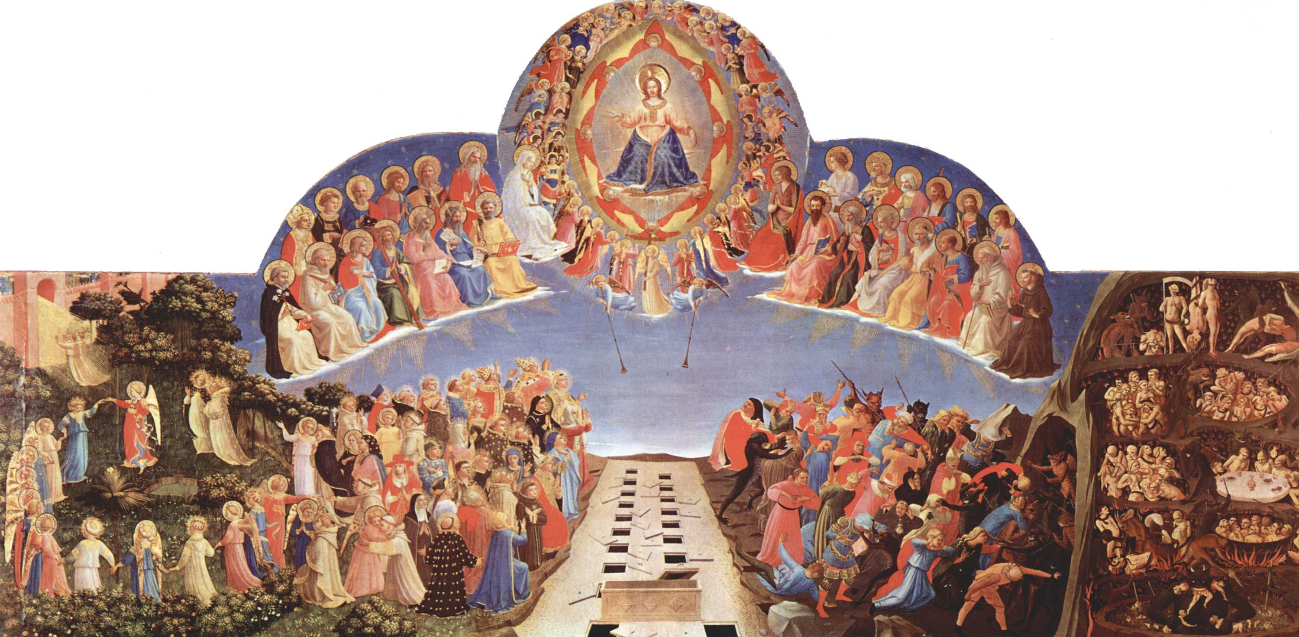
What did you do for My church,
under your watch, given all the gifts I gave you ?

Slide 8
The Opportunity
$30 Trillion will be transferred by Baby Boomers (those born between 1944 - 64) over the next several years.¹
$68 Trillion will be transferred within the next 25 years. ²
¹ The Greatest Wealth Transfer In History: What’s Happening And What Are The Implications - Forbes Magazine 11-11-19 (https://www.forbes.com/sites/markhall/2019/11/11/the-greatest-wealth-transfer-in-history-whats-happening-and-what-are-the-implications/#64c33e834090)
² What The Coming $68 Trillion Great Wealth Transfer Means For Financial Advisors – CNBC October 21, 2019 (Cerulli Associates is a research and consulting firm specializing in asset management and distribution trends worldwide) (https://www.cnbc.com/2019/10/21/what-the-68-trillion-great-wealth-transfer-means-for-advisors.htm)

Slide 9
What You Might Not Know
~ 67 % of people don’t know what “planned giving” means
~ Planned Giving is making a charitable gift during your life or in your Will / Estate Plan
~ The #1 reason donors made a major Planned Gift to a charity (church, school, hospital, etc.) is………?
“because they were asked”

Slide 10
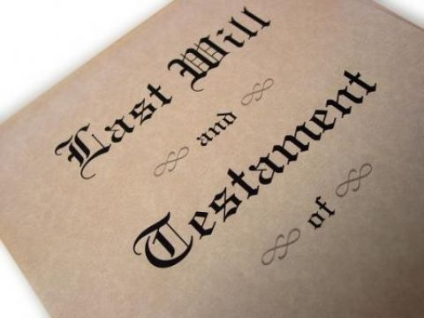
Why Have A Planned Giving Program? ¹
~ In 2017, 58% - 60% of Americans had NO Will or Estate Plan
~ By 2020, it grew to 68% of Americans
~ If you don’t have a Will, your State will decide how to allocate your assets when you die
¹ Haven’t Done A Will Yet? You’ve Got Company. Neither Have 6 In 10 U.S. Adults - AARP February 4, 2017 Caring.com 2020 Estate Planning and Wills Study https://www.caring.com/caregivers/estate-planning/wills-survey

Slide 11
Why Have A Planned Giving Program? ¹
~ Only 4.5% of Americans have made a charitable Planned Gift bequest
~ Which mean, 95.5% of your parishioners are your Planned Giving campaign opportunity
¹Survey of Wills Created by Everyday Donors Shows an Average Bequest of $78,630
August 28, 2019 Chronicle of Philanthropy

Slide 12
Why Have A Planned Giving Program? ¹
~ Top 4 reasons people don’t have Wills:
1. procrastination
2. think they don’t have enough assets
3. think they are too expensive
4. don’t know how to do it
~ Your Parish Planned Giving program helps your parishioners address all 4
¹ Caring.com 2020 Estate Planning and Wills Study https://www.caring.com/caregivers/estate-planning/wills-survey

Slide 13
Why Have A Planned Giving Program? ¹
~ 95% of people’s wealth is in stocks and property
~ Planned Giving of these assets doesn’t impact cash flow so that people of all income levels can do it
¹ “What’s The Big Deal About Planned Giving Anyway” - June 2, 2018 at PlannedGiving.com - https://plannedgiving.com/the-importance-of-planned-giving/

Slide 14
Why Have A Planned Giving Program? ¹
~ The typical Planned Gift is 200 times the size of a donor’s largest annual fund gift
~ People who make Planned Gifts in their Wills typically increase their annual giving
¹ “What’s The Big Deal About Planned Giving Anyway” - June 2, 2018 at PlannedGiving.com - https://plannedgiving.com/the-importance-of-planned-giving/

Slide 15
Why Have A Planned Giving Program? ¹
~ Average Will charitable bequest = $78,630 (20% of Wills have 2 such bequests)
~ Multiply your number of parishioners by $78,630 to estimate what your church can receive in time
= $7,863,000 200 = $15,726,000
300 = $23,589,000 400 = $31,452,000
¹Survey of Wills Created by Everyday Donors - August 28, 2019 Chronicle of Philanthropy

Slide 16
Why Have A Planned Giving Program? ¹
Multiply the number of your parishioners who died last year by $78,630 to estimate what your church could have received if it had an effective Planned Giving Program

Slide 17
The Four Types of Generosity All Parishioners Must Be Taught To Practice
1. Annual Stewardship Tithe - to fund parish operations
2. Periodic Capital Campaigns - to acquire, construct, or improve parish capital assets
3. Emergency Philanthropy - to address emergency needs
4. Planned Giving – to fund non-operating parish needs and opportunities
If established properly, with effective parishioner education, NONE of these will cannibalize any other generosity

Slide 18
A Theological Basis for Planned Giving
Fr Jim Kordaris
Director of Stewardship, Outreach & Evangelism

Slide 19
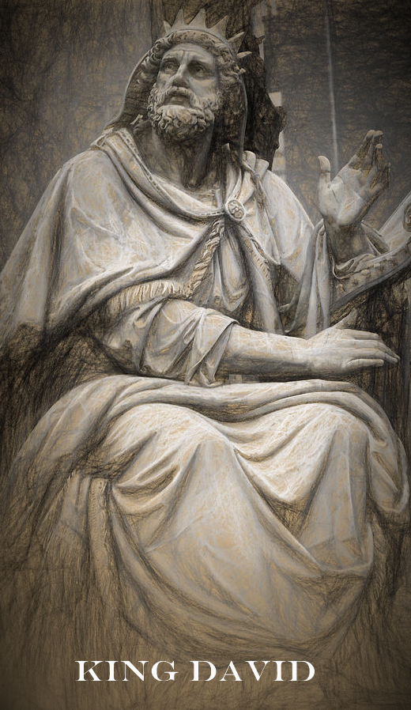
“Everything comes from you
and we have given you only what comes from your hand ....”
I Chronicles 29:14

Slide 20
Stewardship of Income
and
Stewardship of Wealth

Slide 21
As a wealthy and gifted people, we are called to invest in the kingdom yet to come.

Slide 22
Benefits of Endowments & the G.O.A. Endowment Guidelines
Elaine Allen
Senior Advisor to the Archbishop

Slide 24
Planned Giving Ministry of the Archdiocese
Proposed budgets for 2023 and 2024 include initial funding for a department of planned giving to assist parishes with the establishment of planned giving programs
Resources for parishes (toolkits on planned giving for parishioners)
Certified planned giving professional to assist Metropolises or parishes with implementing programs and act as a resource

Slide 25
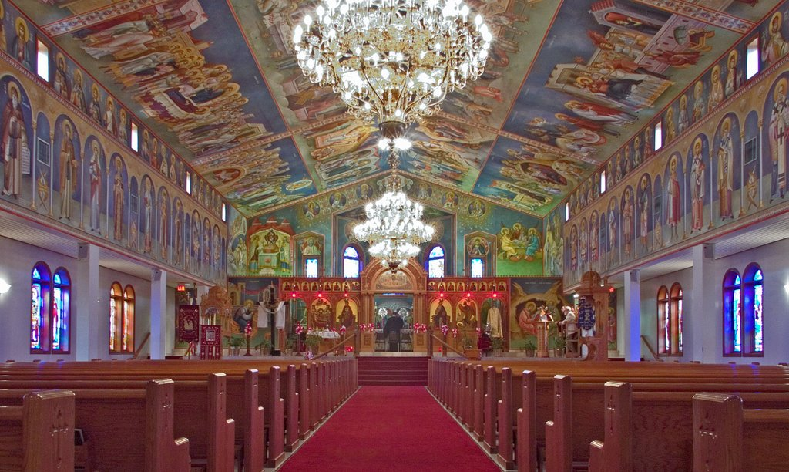
Archdiocese Endowment 8 Guidelines
Archdiocese Endowment 8 Guidelines
Parish Assembly approves Endowment Fund, Rules & Regulations, Investment Guidelines and any separate 501(c)(3) corporation.
Parish Endowments must be under the ultimate control of the Parish Council and Priest.
Endowment Boards & Committees are appointed by the Parish Council or elected by the Parishioners.
Endowment Boards & Committees provide financial statements and disbursement and investment reports to Parish Council, Parish Assembly, and all parishioners.

Slide 26
Archdiocese Endowment 8 Guidelines
Endowment funds must be held in the Parish’s name (however a Parish Endowment Corporation may hold assets in its name, as long as Parish Council has ultimate control).
Endowment investments and financial statements are subject to the oversight of the Parish Council and are audited by the Parish Auditors.
Parish Council ultimately approves all Endowment grants and transactions consistent with Endowment Rules & Regulations or applicable donor restrictions.
Endowment Charters, Rules and Bylaws must provide that on any liquidation, termination, or prolonged inactivity, all Endowment funds and accounts revert solely to the Parish (or its successor).

Slide 27
Integrating Planned Giving with Your Tax and Estate Planning Goals
William Kambas
Partner, Withersworldwide

Slide 28
Giving back … to the Greek Orthodox community
An introduction to charitable contributions and planned giving options
By: William J. Kambas

Slide 29
Who … gives?
All of us have something to give.
Ask yourself:
Do you want to give?
What do you want to give?
When do you want to give?
Conventional wisdom holds that people between 50 and 70 years in age make planned gifts.

Slide 30
What … To Calculate? Overview of Tax Considerations
US Estate Tax – top rate of 40% in 2022 (State Tax?)
After lifetime exemption is applied
Imposed on value of property at time of death
US Gift Tax – top rate of 40% in 2022 (State Tax?)
After lifetime exemption is applied
Imposed on value of property at time of gift
US Income Tax – on whom is it levied?
No US tax on transfers to US citizen spouses
No US tax on transfers to US charitable organizations

Slide 31
Where … does the gift go?
For example:
A General Fund
Serving our community
A Building Fund
Increased options for our community
An Endowment Fund
Core Fund
Specific Direction – Sports, Landscaping, etc.
Named Scholarship
each of which nourishes our community

Slide 32
How … is a gift given?
Meet with a qualified professional who can:
review your gifting ideas and
suggest options.
Gifts should be part of an overall plan
planned giving tools could be useful for income tax, estate tax, and Medicaid eligibility purposes.
For example: Should you consider annual “year-end” tax planning?

Slide 33
How .. .to make a gift?
“Outright” Donations
Gifts of Cash (deduction at 50% AGI limit)
Gifts of Securities (appreciated or depreciated values, deduction at 30% AGI limit)
Gifts of IRA Distributions (up to limits for RMDs)
Gifts of Property
Gifts of Real Estate

Slide 34
How .. .to make a gift?
“Split Interest” Donations
Remainder Interest in Real Property
Charitable Remainder Trust (“CRT”) (Trust distributes to beneficiary for fixed term; principal remaining at end of term to charity)
Charitable Lead Trust (“CLT”) (Trust donates to charity for fixed term; remainder passes to family beneficiary at end of term)
Charitable Gift Annuity (“CGA”) (a contract with a charity; donor makes lifetime gift of money or property to charity; charity promises to pay annuity to beneficiary for life; charity gets remainder)

Slide 35
Let’s Explore Ways to Create a Future Gift
Bequest in a Will
Option #2
Gift in a revocable or other living trust
Option #3
Retirement Account Beneficiary Designation
Option #1

Slide 36
Let’s Explore Gift Options
Payment of a Specific Annuity
Gift of a Specific Amount
Gift of a Percentage of the Trust/Estate
Gift of a Specific Asset

Slide 37
Let’s Explore … Some Questions That Typically Arise
Statement of intent?
Date declaring the gift?
Date gift made or annuity started?
Key persons involved?
Information needed (due diligence)?
Binding commitment (now or the future)?

Slide 38
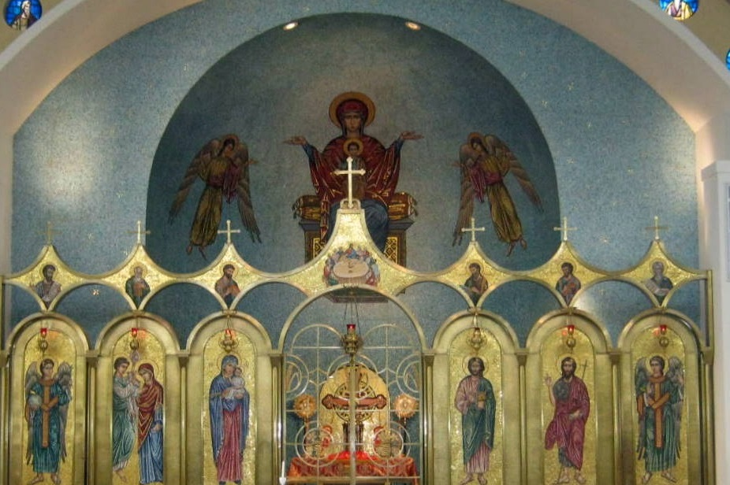
Thank you … for caring about our Greek Orthodox Community William J. Kambas

Slide 39
How to Begin a Parish Planned Giving Program
Bill Marianes
Stewardship Calling & Orthodox Ministry Services

Slide 40
~ Chuck Feeney co-founded the airport Duty Free Shops
~ Chuck amassed billions living frugally and said he wanted to die broke¹
~ Over 40 years, he anonymously donated over $8 Billion to various charities
¹ The Billionaire Who Wanted To Die Broke . . . Is Now Officially Broke- Forbes Magazine 9-15-20 (https://www.forbes.com/sites/stevenbertoni/2020/09/15/exclusive-the-billionaire-who-wanted-to-die-brokeis-now-officially-broke/#3261c49f3a2a)

Slide 41
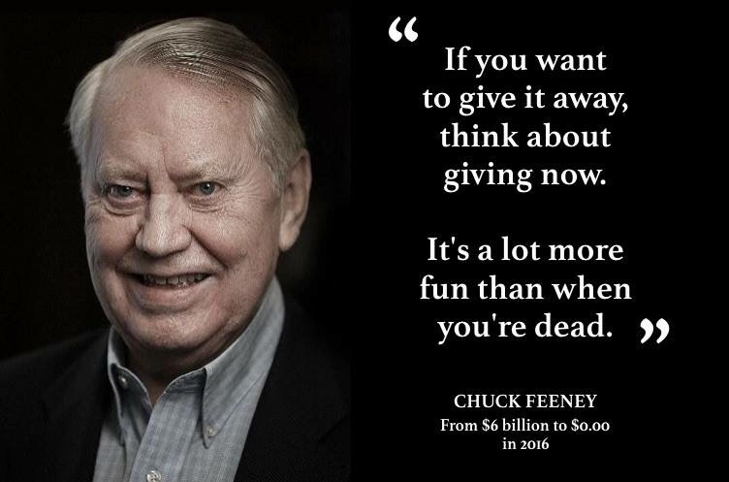

Slide 42
Who is the Chuck Feeney in your Parish?

Slide 43
5 STEPS TO CREATE A SUCCESSFUL PLANNED GIVING PROGRAM
WHY
Determine Your Planned Giving “WHY” and Who / What Receives the Benefits
TEAM
Recruit a Diverse Planned Giving Ministry Team
ENTITY
Create the Endowment Entity or Account That Will Receive The Funds
TEACH
Educate Why Everyone Should Help Achieve the Ministry WHY
ENGAGE
Engage Everyone Personally and Communicate At Least Monthly

Slide 44
5-STEP PLANNED GIVING CAMPAIGN
Publicize and announce the celebration event at least monthly
Promote the final deadline to be included in the celebration event
REPEAT AGAIN NEXT YEAR
1
2
3
4
5
Plan a fun event in ≈ 11 months for people who make a Planned Gift now or in their Will
Execute the Planned Giving education, follow-up, and communications campaign
Have a fun gratitude party, with a short uplifting message and unveil the recognition plaque

Slide 45
Planned Giving Thoughts
~ Naming your church as a life insurance policy beneficiary is an easy way to give (and perhaps get a tax deduction)
~ Planned Giving education and appeals must be a part of your stewardship campaign as well as having it own solicitation campaign
~ Many financial and legal professionals offer free education programs / services
~ The longer you wait, the more your church loses

Slide 46
Join the Eternal Light Society
“…but lay up for yourselves treasures in heaven….”
REMEMBER YOUR CHURCH THROUGH
PLANNED GIVING

Slide 47
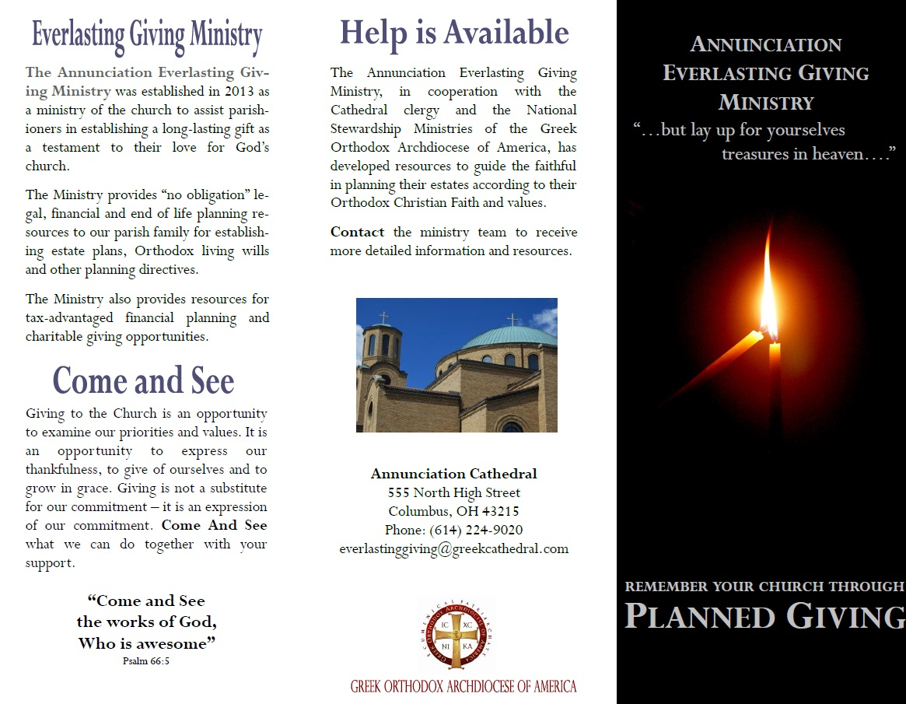
Annunciation Cathedral Everlasting Giving Ministry (front of trifold)

Slide 48
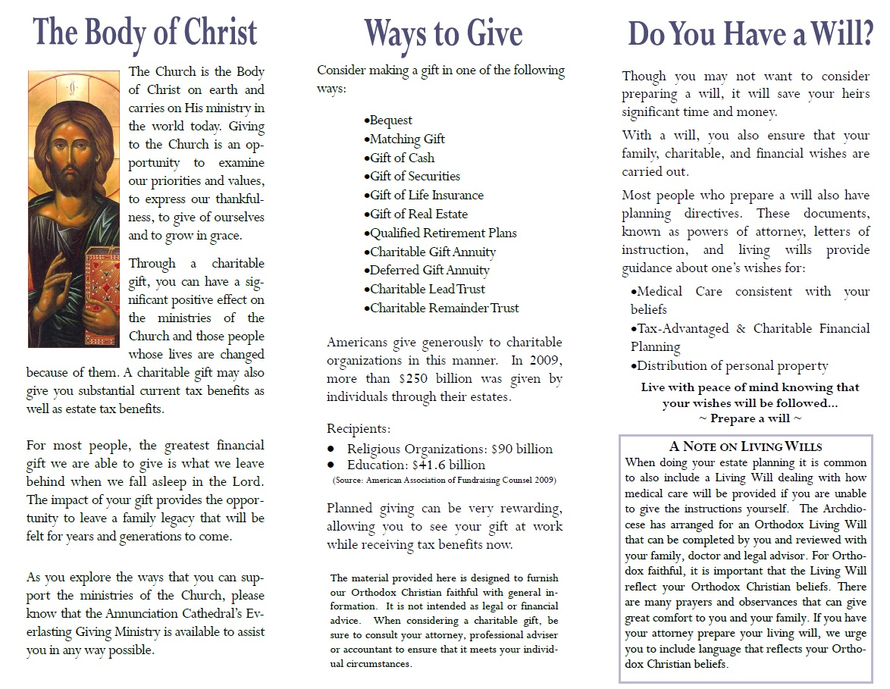
Annunciation Cathedral Everlasting Giving Ministry (back of trifold)

Slide 49
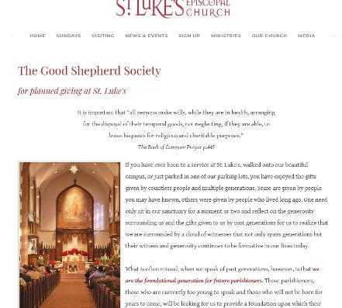
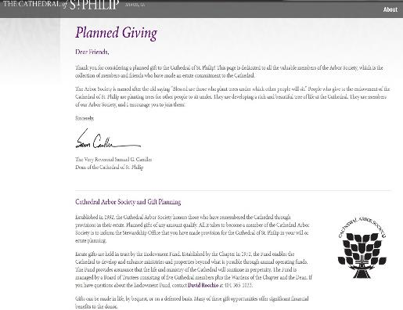
Very Successful Non-Orthodox Planned Giving Endowments
St. Luke’s
Cathedral of St. Philip
https://www.stlukesatlanta.org/good-shepherd-society.html
https://www.cathedralatl.org/community/giving/planned-giving/

Slide 51
“For everyone to whom much is given, from him much will be required; and to whom much has been committed, of him they will ask the more.” (Luke 12:48)

Slide 52
When you disappear from this world, what will your legacy be?

Slide 53
What would you do if you weren’t afraid?

Slide 54
Fortune Favors The Bold…
Now, Lord, look on their threats, and grant to Your servants that with all boldness they may speak Your word!
Acts 4:29

Slide 55
A Special Opportunity From
Orthodox Ministry
Services
GOA Stewardship Department
Leadership
100
A Free Orthodox Effective Parish Assessment
To participate, contact: billmarianes@gmail.com

Slide 56
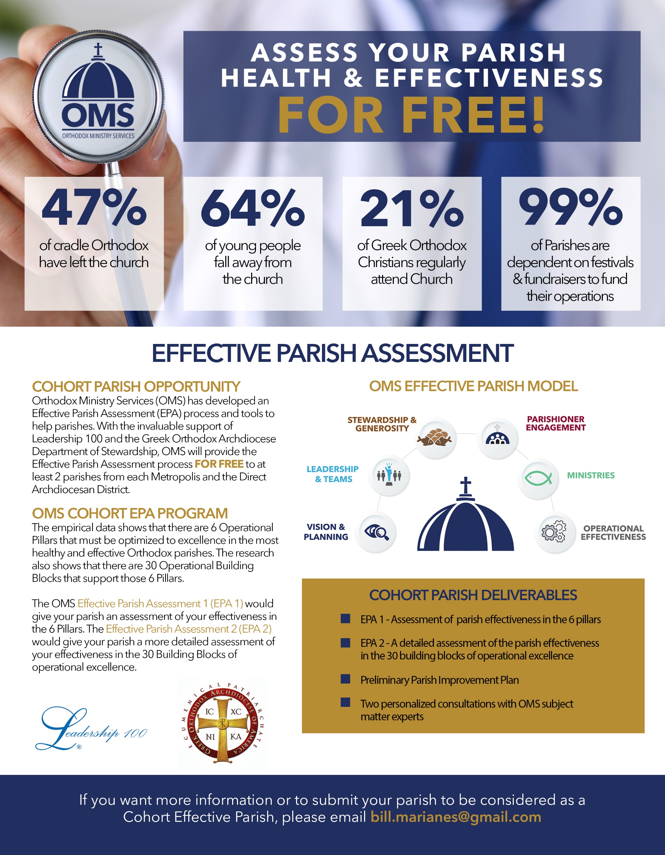
18 Selected GOA Parishes Will Receive for Free
Effective Parish Assessment 1 of the Parish’s operational effectiveness in the 6 Pillars of an Effective Parish
Effective Parish Assessment 2 of the Parish’s operational effectiveness in the 30 Building Blocks of an Effective Parish
Preliminary Parish Improvement Plan that provides a roadmap to address which of the 6 Pillars and 30 Building Blocks that need the most attention
Two ZOOM Consultations with subject matter experts to begin to craft a plan to address the Parish’s greatest needs and challenges.

Slide 57
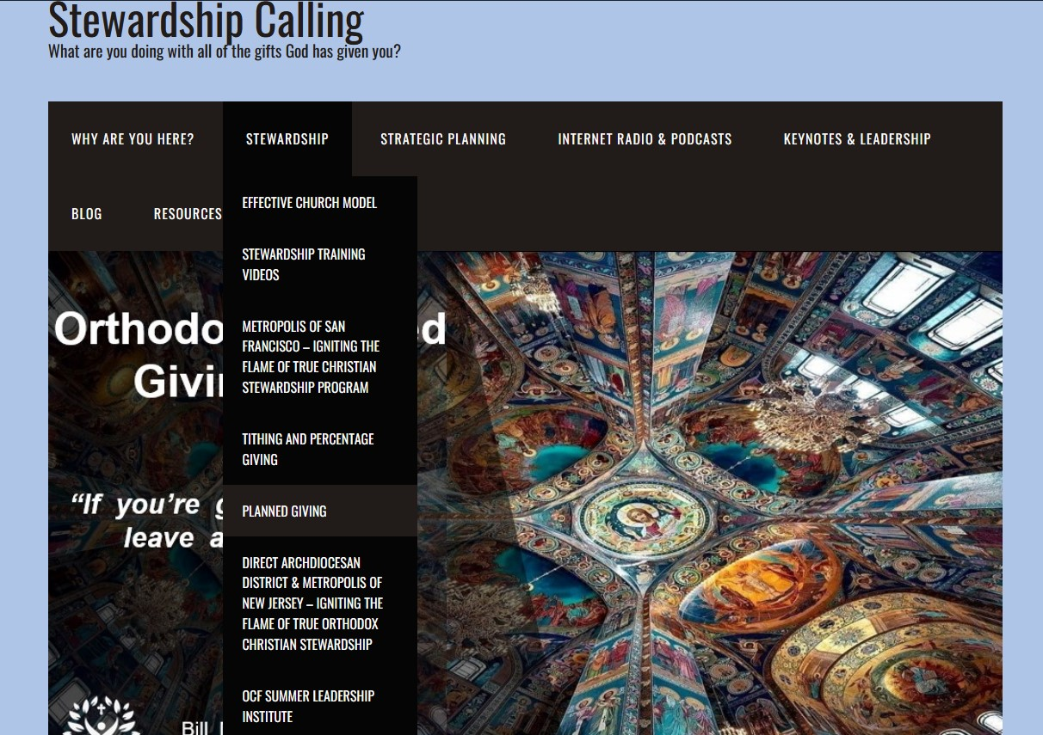
Download This Presentation:
StewardshipCalling.com
Stewardship Tab
Planned Giving Page
https://stewardshipcalling.com/planned-giving/

Slide 58
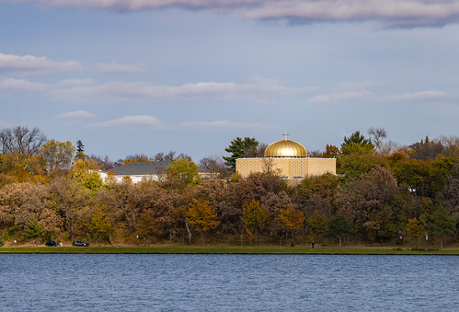
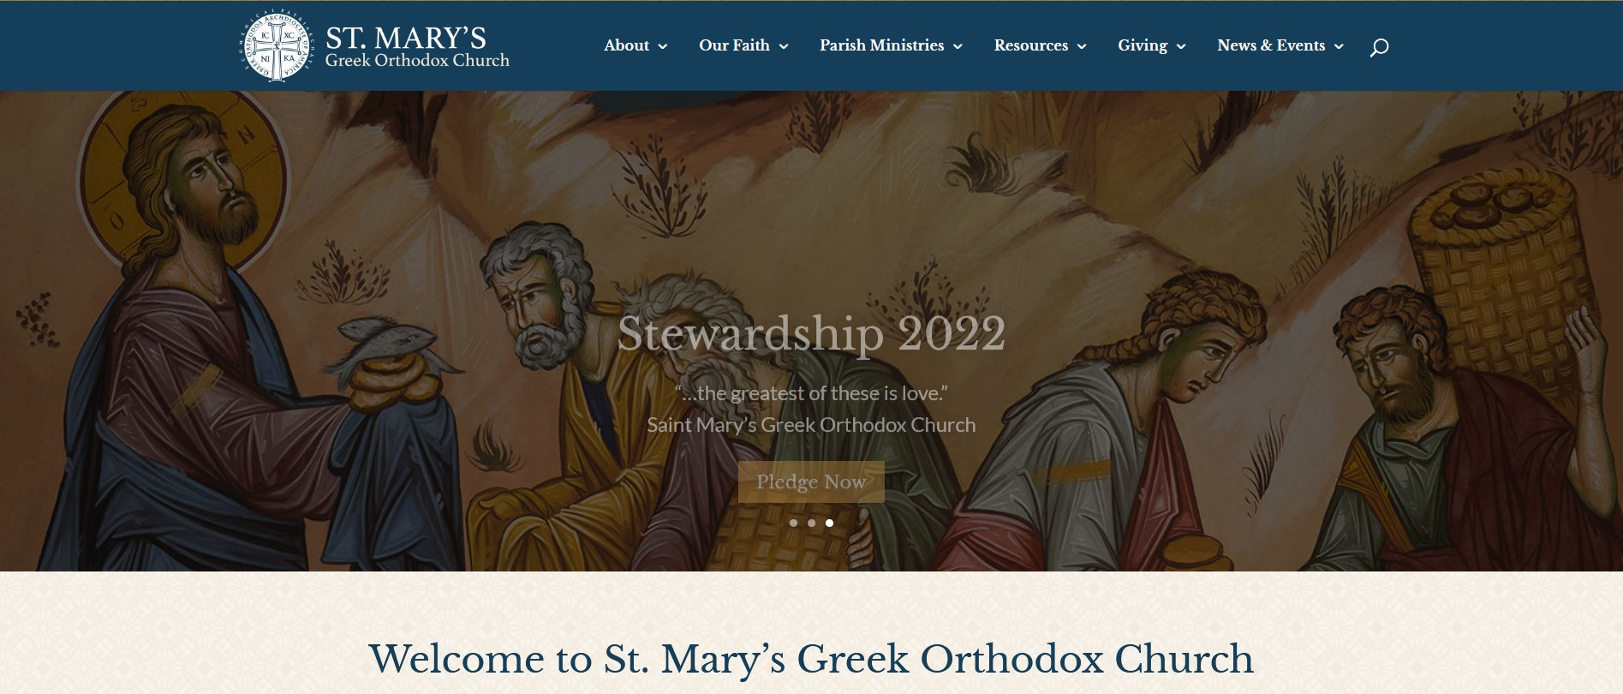
Parish Endowment Example
Saint Mary’s Greek Orthodox Church Minneapolis
https://stmarysgoc.org/

Slide 59
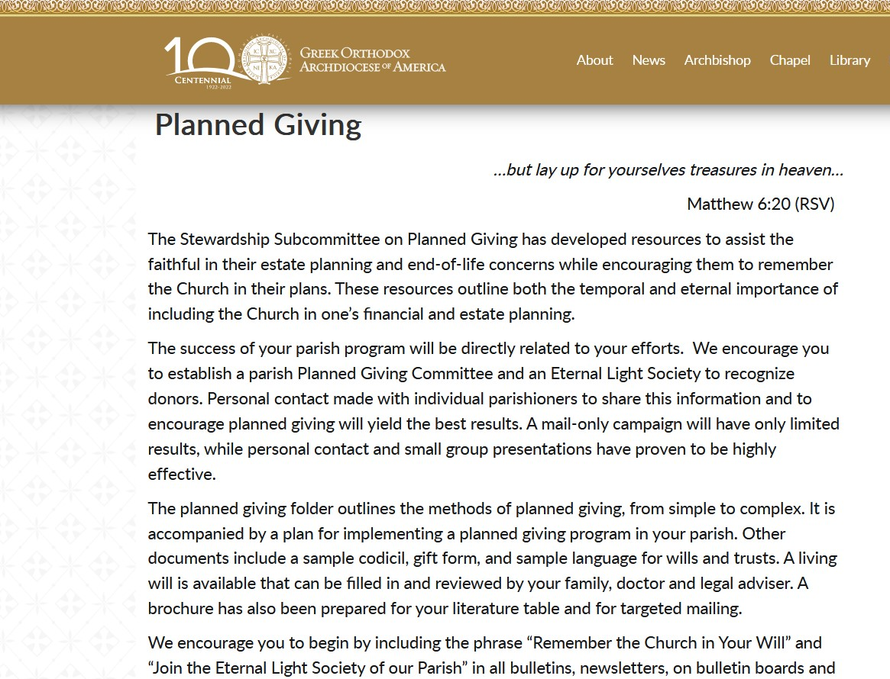
GOA Planned Giving Resources
www.goarch.org/-/planned-giving

Slide 60
Orthodox Planned Giving 101
“If you’re going to live, leave a legacy.”

