Slide 1



Strategic Planning Final Key Elements
“Where there is no vision, the people will perish”
(Proverbs 29:18)
Bill Marianes

Slide 2



“The domain of the Leader is the .
The work of the leader is change.”

Slide 3


Slide 4

A process to:
manage the “busyness” of our Church without turning our Church into a “business”
define our strategy to allocate our resources to achieve our vision

Slide 5
  Why do we exist?
  Where are we now?
  Where do we want to be?
  How will we get there?
Must answer 4 questions:

Slide 6


10 Strategic Plan Deliverables
SWOT Analysis
Statement of Why
Core Values
Mission Statement
S.M.A.R.T. Strategic Goals
Interim Goals & Interim Actions
Comprehensive Action Plan
Vision Statement
SMART Gap Implementation Process
Strategic Plan

Slide 7







EPA 2 RESULTS (58 responses)
Vision &
Planning
Leadership &
Teams
Stewardship
& Generosity
Parishioner
Engagement
Ministries
Operational
Effectiveness
Strategic Planning
Operational & Tactical Planning
Parishioner Involvement
Goal Achievement & Accountability
Christian Leadership
Leading & Coaching
Conflict Management
Effective Teams
Parish Council & Boards
Giving & Tithing
Stewardship Campaign
Capital Campaign
Planned Giving & Endowments
External Philanthropy
Transparency &
Accountability
Spiritual Education & Catechism
Liturgical & Sacramental Participation
Outreach
Evangelism
Welcoming & Fellowship
Defines Needs of Parishioners
Ministry Management
Ministry Engagement
Volunteer Management
Youth & Young Adult
Communication & Digital Strategies
Facilities & Technology
Financial Excellence
Safety & Security
Staff Management

Slide 8
Summary Results
(Six Pillars)
Footnotes
Favorable + Unfavorable + Neutral = 100% (does not include “I don’t know”)
“I don’t know” is separately shown as a % of total responses
Best score across all 6 pillars is darkest green, lowest is darkest red

Slide 9
Results – first 3 pillars

Slide 10
Results – final 3 pillars

Slide 11

2021-22 Stewardship Dashboard Results
PARISH | 2022 | 2021
Number of Stewards | 180 | 183
Total Stewardship Income | $145,956 | $146,620
% of Operating Expenses Paid By Stewardship | 40% | 45%
Median Stewardship Contribution | $400 | $495
Proxy Tithe Stewardship % | 0.49% | 0.60%
$ Invested in Charities/Ministries | $4,000 | $4,640
% Invested in Charities/Ministries | 1% | 2%
% Top 10 Stewards Contribution | 33% | 34%
% Top 20 Stewards Contribution | 46% | 47%

Slide 12

Final Strengths
1. Philoptochos
2. Priest/Bible Study
3.Talented/Dedicated Parishioners
4. Beauty: Services & Building/Grounds
5. Welcoming & Strongly Bonded Community

Slide 13
Final Weaknesses
1. Lingering Effects of Past Issues/Decisions
2. Relational Leadership
3. Declining Youth & Aging
4. Stewardship (Time, Talent, Treasure)
5. 20/80 Engagement

Slide 14
Final Opportunities
1. Community Outreach
2. Technology

Slide 15
Final Threats
1. Sunday NON-Church Activities
2. Orthodoxy & Contemporary Moral Issues
3. Apathy/Antagonism towards
Christianity/Religion

Slide 16

Final WHY Statement
To continuously build a community of Christian love
pursuing a path of salvation in Jesus Christ.

Slide 17

Final Core Values
1. Sharing the Faith
2. Serving Others
3. Education
4. Passion for Participation

Slide 18

Final Mission Statement
To proclaim the Good News of Salvation and God’s boundless love as we journey in the orthodox faith.

Slide 19

Final 3 Strategic Areas of Focus
Strategic Areas Of:
1. Relational Leadership
2. Theological & Spiritual Engagement and
Education
3. Stewardship: Time, Talents, Treasurers

Slide 20

Low Hanging Fruit
1. Communication: Email tracking/SMS, Website
Ministries (Diversify Ownership)
2. Staff Roles & Responsibilities
3. Welcoming Committee
4. Rideshare for Elderly
5. Red Book
6. Liturgical & Sacramental Participation Building Block

Slide 21
Strategic Areas of Focus #1
Relational Leadership
Strategic Areas Of:
Team Leader Names | Emails
Co-Chair | Peter Cokotis - pcokotis@isenberg.umass.edu
Co-Chair | Joe Dasco - joedasco@comcast.net
Secretary | Tony Antonopoulos - antonopouloshome@gmail.com
Other | Fr. Panteleimon Klostri - frpklostri@gmail.com Nicles Lefakis – nicklefakis1821@gmail.com

Slide 22
Strategic Areas of Focus #2
Theological & Spiritual Engagement and Education
Team Leader Names | Emails
Co-Chair | Tera Tamashaitis - ttamashaitis@hotmail.com
Co-Chair | Vaceleci (Bess) Zaharis - epirotes@gmail.com
Secretary | jlelas@yahoo.com
Other | Sarah Kirchner - whisper321@gmail.com Aristidis Zaharis - Aris.zaharis@gmail.com
Strategic Areas Of:

Slide 23
Strategic Areas of Focus #3
Stewardship: 3T’s
Team Leader Names | Emails
Co-Chair | Demetri Strange - demetrisemail@aol.com
Co-Chair | Ron Rookey – ronmar8@cox.net
Secretary | Joanna Strange - joannastrange@charter.net
Other | Assaad Hallak – ahallak@cox.net Harry Georgiades - hgeorgiades@comcast.net Leia Georgeopolus - lgeorge814@gmail.com Panagiotis Zaharis - panagiotis.zaharis@gmail.com
Strategic Areas Of:

Slide 24
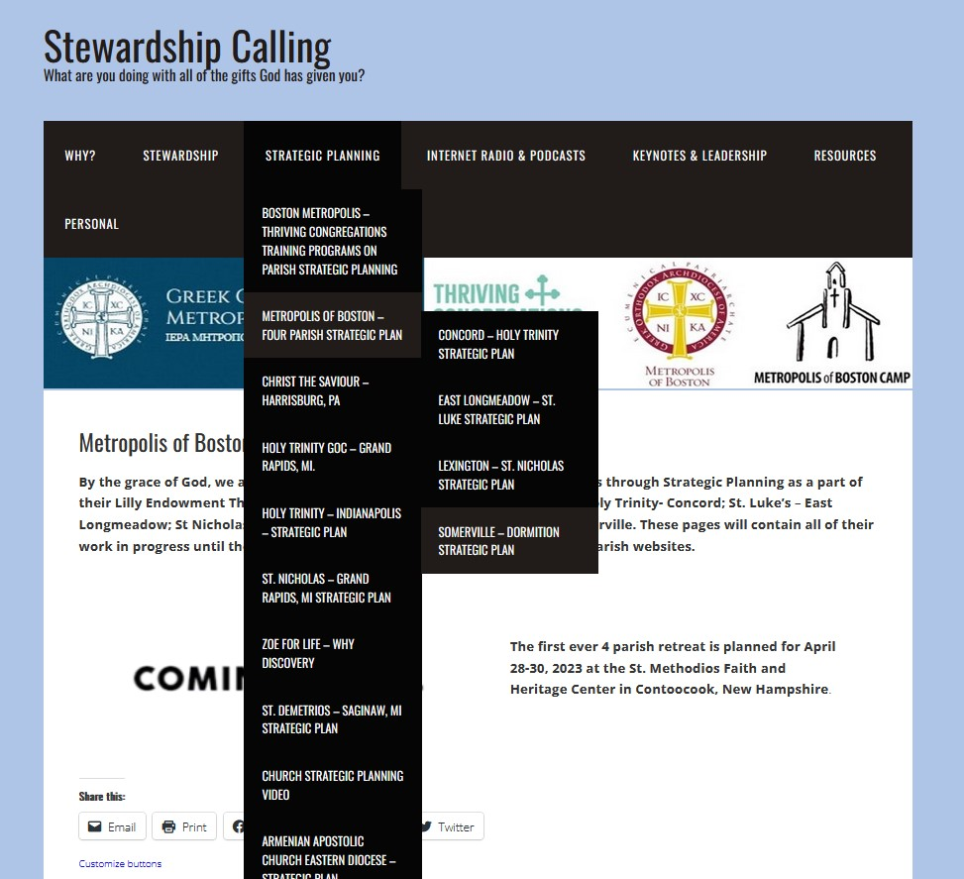
Your Strategic Planning Page
This presentation and all your ongoing work product can be found under the Strategic Planning tab at the page for: Metropolis of Boston Four Parish Strategic Plan
https://stewardshipcalling.com/east-longmeadow-st-luke-strategic-plan/
www.stewardshipcalling.com

Slide 25
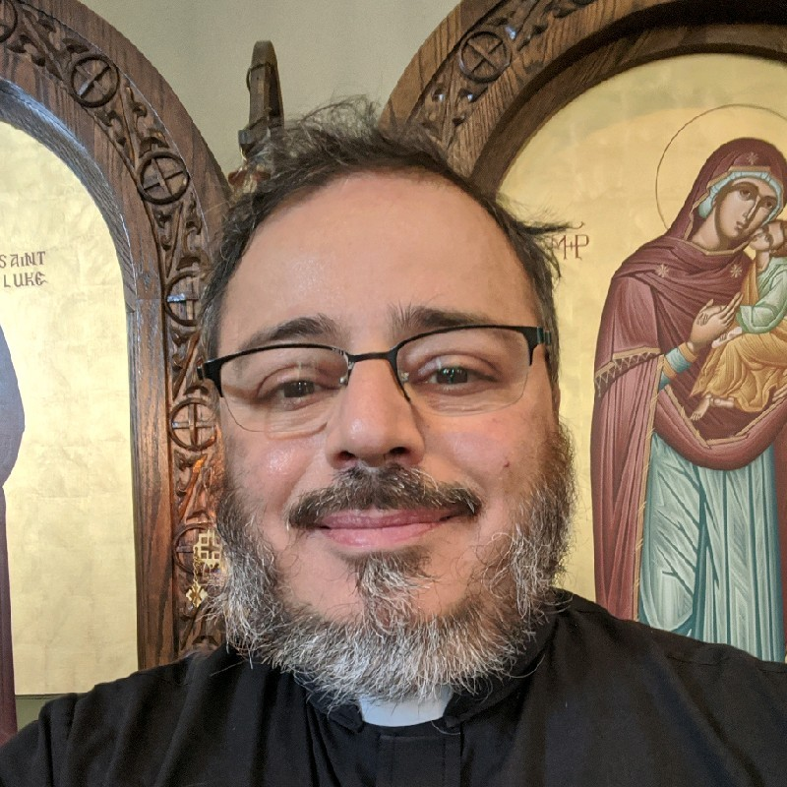

…to pick a Strategic Area of Focus Task Force to join to develop a S.M.A.R.T. Goal and Action Plan
~ Relational Leadership
~ Theological & Spiritual Engagement
and Education
~Stewardship

Slide 26



Any Questions?

Slide 27
Strategic Planning Final Key Elements
“Where there is no vision, the people will perish”
(Proverbs 29:18)
Bill Marianes

Slide 28
Stewardship & Engagement SMART Goal 2
We will research, develop, and implement a best practices, effective youth and adult Stewardship Ministry Engagement Program (the “Stewardship & Engagement Program”) that will achieve the following “Stewardship & Engagement Targets” within 35 months:
create a stewardship ministry that uses effective communications strategies and full transparency to personally reach and engage all youth and adult parishioners to invest their time and talents;
increase ministry engagement of parishioners by at least 33% though identifying and engaging the diverse talents of all parishioners;
increase the parishioner financial stewardship so that all parish operating expenses (including at least 10% of expenses given to parish-chosen external charities and philanthropies) are paid solely through parishioner stewardship;
(d) establish a parish benevolence fund to help parishioners in need with at least $15,000 available; and
(e) establish a planned giving program and endowment in which at least 5% of parishioners participate.

Slide 29
Stewardship & Engagement SMART Goal 2
We will research, develop, and implement a best practices, effective youth and adult Stewardship Ministry Engagement Program (the “Stewardship & Engagement Program”) that will achieve the following “Stewardship & Engagement Targets” within 35 months:
create a stewardship ministry that uses effective communications strategies and full transparency to personally reach and engage all youth and adult parishioners to invest their time and talents;
increase ministry engagement of parishioners by at least 33% though identifying and engaging the diverse talents of all parishioners;
increase the parishioner financial stewardship so that all parish operating expenses (including at least 10% of expenses given to parish-chosen external charities and philanthropies) are paid solely through parishioner stewardship;
(d) establish a parish benevolence fund to help parishioners in need with at least $15,000 available; and
(e) establish a planned giving program and endowment in which at least 5% of parishioners participate.

Slide 30
Stewardship & Engagement SMART Goal 2
We will research, develop, and implement a best practices, effective youth and adult Stewardship Ministry Engagement Program (the “Stewardship & Engagement Program”) that will achieve the following “Stewardship & Engagement Targets” within 35 months:
create a stewardship ministry that uses effective communications strategies and full transparency to personally reach and engage all youth and adult parishioners to invest their time and talents;
increase ministry engagement of parishioners by at least 33% though identifying and engaging the diverse talents of all parishioners;
increase the parishioner financial stewardship so that all parish operating expenses (including at least 10% of expenses given to parish-chosen external charities and philanthropies) are paid solely through parishioner stewardship;
(d) establish a parish benevolence fund to help parishioners in need with at least $15,000 available; and
(e) establish a planned giving program and endowment in which at least 5% of parishioners participate.

Slide 31
Stewardship & Engagement SMART Goal 2
We will research, develop, and implement a best practices, effective youth and adult Stewardship Ministry Engagement Program (the “Stewardship & Engagement Program”) that will achieve the following “Stewardship & Engagement Targets” within 35 months:
create a stewardship ministry that uses effective communications strategies and full transparency to personally reach and engage all youth and adult parishioners to invest their time and talents;
increase ministry engagement of parishioners by at least 33% though identifying and engaging the diverse talents of all parishioners;
increase the parishioner financial stewardship so that all parish operating expenses (including at least 10% of expenses given to parish-chosen external charities and philanthropies) are paid solely through parishioner stewardship;
(d) establish a parish benevolence fund to help parishioners in need with at least $15,000 available; and
(e) establish a planned giving program and endowment in which at least 5% of parishioners participate.

Slide 32
Stewardship & Engagement SMART Goal 2
We will research, develop, and implement a best practices, effective youth and adult Stewardship Ministry Engagement Program (the “Stewardship & Engagement Program”) that will achieve the following “Stewardship & Engagement Targets” within 35 months:
create a stewardship ministry that uses effective communications strategies and full transparency to personally reach and engage all youth and adult parishioners to invest their time and talents;
increase ministry engagement of parishioners by at least 33% though identifying and engaging the diverse talents of all parishioners;
increase the parishioner financial stewardship so that all parish operating expenses (including at least 10% of expenses given to parish-chosen external charities and philanthropies) are paid solely through parishioner stewardship;
(d) establish a parish benevolence fund to help parishioners in need with at least $15,000 available; and
(e) establish a planned giving program and endowment in which at least 5% of parishioners participate.

Slide 33
Stewardship & Engagement SMART Goal 2
We will research, develop, and implement a best practices, effective youth and adult Stewardship Ministry Engagement Program (the “Stewardship & Engagement Program”) that will achieve the following “Stewardship & Engagement Targets” within 35 months:
create a stewardship ministry that uses effective communications strategies and full transparency to personally reach and engage all youth and adult parishioners to invest their time and talents;
increase ministry engagement of parishioners by at least 33% though identifying and engaging the diverse talents of all parishioners;
increase the parishioner financial stewardship so that all parish operating expenses (including at least 10% of expenses given to parish-chosen external charities and philanthropies) are paid solely through parishioner stewardship;
(d) establish a parish benevolence fund to help parishioners in need with at least $15,000 available; and
(e) establish a planned giving program and endowment in which at least 5% of parishioners participate.

Slide 34
Stewardship & Engagement SMART Goal 2
We will research, develop, and implement a best practices, effective youth and adult Stewardship Ministry Engagement Program (the “Stewardship & Engagement Program”) that will achieve the following “Stewardship & Engagement Targets” within 35 months:
create a stewardship ministry that uses effective communications strategies and full transparency to personally reach and engage all youth and adult parishioners to invest their time and talents;
increase ministry engagement of parishioners by at least 33% though identifying and engaging the diverse talents of all parishioners;
increase the parishioner financial stewardship so that all parish operating expenses (including at least 10% of expenses given to parish-chosen external charities and philanthropies) are paid solely through parishioner stewardship;
(d) establish a parish benevolence fund to help parishioners in need with at least $15,000 available; and
(e) establish a planned giving program and endowment in which at least 5% of parishioners participate.

Slide 35
Stewardship & Engagement SMART Goal 2
Interim Goal 1: Research the most effective stewardship and engagement programs within 3 months
Interim Goal 2: Develop the most effective parish stewardship and engagement program the “Stewardship & Engagement Program” within 4 months
Interim Goal 3: Recruit and train the parish Stewardship & Engagement “Ambassadors” within 2 months
Interim Goal 4: Implement the Stewardship & Engagement Program to achieve the Stewardship & Engagement Targets within 24 months
Interim Goal 5: Compile and assess the results of the Stewardship & Engagement Program and make necessary improvements within 2 months

Slide 36
Stewardship & Engagement SMART Goal 2
Interim Goal 1: Research the most effective stewardship and engagement programs within 3 months
Interim Goal 2: Develop the most effective parish stewardship and engagement program the “Stewardship & Engagement Program” within 4 months
Interim Goal 3: Recruit and train the parish Stewardship & Engagement “Ambassadors” within 2 months
Interim Goal 4: Implement the Stewardship & Engagement Program to achieve the Stewardship & Engagement Targets within 24 months
Interim Goal 5: Compile and assess the results of the Stewardship & Engagement Program and make necessary improvements within 2 months

Slide 37
Stewardship & Engagement SMART Goal 2
Interim Goal 1: Research the most effective stewardship and engagement programs within 3 months
Interim Goal 2: Develop the most effective parish stewardship and engagement program the “Stewardship & Engagement Program” within 4 months
Interim Goal 3: Recruit and train the parish Stewardship & Engagement “Ambassadors” within 2 months
Interim Goal 4: Implement the Stewardship & Engagement Program to achieve the Stewardship & Engagement Targets within 24 months
Interim Goal 5: Compile and assess the results of the Stewardship & Engagement Program and make necessary improvements within 2 months

Slide 38
Stewardship & Engagement SMART Goal 2
Interim Goal 1: Research the most effective stewardship and engagement programs within 3 months
Interim Goal 2: Develop the most effective parish stewardship and engagement program the “Stewardship & Engagement Program” within 4 months
Interim Goal 3: Recruit and train the parish Stewardship & Engagement “Ambassadors” within 2 months
Interim Goal 4: Implement the Stewardship & Engagement Program to achieve the Stewardship & Engagement Targets within 24 months
Interim Goal 5: Compile and assess the results of the Stewardship & Engagement Program and make necessary improvements within 2 months

Slide 39
Stewardship & Engagement SMART Goal 2
Interim Goal 1: Research the most effective stewardship and engagement programs within 3 months
Interim Goal 2: Develop the most effective parish stewardship and engagement program the “Stewardship & Engagement Program” within 4 months
Interim Goal 3: Recruit and train the parish Stewardship & Engagement “Ambassadors” within 2 months
Interim Goal 4: Implement the Stewardship & Engagement Program to achieve the Stewardship & Engagement Targets within 24 months
Interim Goal 5: Compile and assess the results of the Stewardship & Engagement Program and make necessary improvements within 2 months

Slide 40
Stewardship & Engagement SMART Goal 2
Interim Goal 1: Research the most effective stewardship and engagement programs within 3 months
Interim Goal 2: Develop the most effective parish stewardship and engagement program the “Stewardship & Engagement Program” within 4 months
Interim Goal 3: Recruit and train the parish Stewardship & Engagement “Ambassadors” within 2 months
Interim Goal 4: Implement the Stewardship & Engagement Program to achieve the Stewardship & Engagement Targets within 24 months
Interim Goal 5: Compile and assess the results of the Stewardship & Engagement Program and make necessary improvements within 2 months

Slide 41
Stewardship & Engagement SMART Goal 2
INTERIM ACTIONS 1:
  A: recruit team
  B: determine stewardship and engagement key definitions and effectiveness metrics and timelines
  C: analyze the parish baseline on those key effectiveness metrics and identify parish impediments to success
  D: identify at least 3 stewardship and engagement, 3 endowment and 3 benevolence fund programs to consider
INTERIM ACTIONS 2:
  A: evaluate researched programs for effectiveness against key performance metrics and parish baselines
  B: modify or develop new stewardship and engagement programs for utilization at the parish (the “Stewardship & Engagement Program”)
  C: finalize parish Stewardship & Engagement Program and establish quarterly and/or monthly performance benchmarks
INTERIM ACTIONS 3:
  A: identify Stewardship & Engagement Program "Ambassadors" to deliver Stewardship & Engagement Program
  B: develop Ambassadors training programs
  C: train the Ambassadors
INTERIM ACTIONS 4:
  A: implement Stewardship & Engagement Program based on determined monthly and quarterly performance benchmarks
  B: continue Ambassadors’ follow-up with parishioners until Stewardship & Engagement Targets are achieved
INTERIM ACTIONS 5:
  A: obtain qualitative and quantitative data from Stewardship & Engagement Program Effectiveness
  B: analyze all data and finalize Stewardship & Engagement Program assessment and make all necessary improvements

Slide 42
Stewardship & Engagement SMART Goal 2
INTERIM ACTIONS 1:
  A: recruit team
  B: determine stewardship and engagement key definitions and effectiveness metrics and timelines
  C: analyze the parish baseline on those key effectiveness metrics and identify parish impediments to success
  D: identify at least 3 stewardship and engagement, 3 endowment and 3 benevolence fund programs to consider
INTERIM ACTIONS 2:
  A: evaluate researched programs for effectiveness against key performance metrics and parish baselines
  B: modify or develop new stewardship and engagement programs for utilization at the parish (the “Stewardship & Engagement Program”)
  C: finalize parish Stewardship & Engagement Program and establish quarterly and/or monthly performance benchmarks
INTERIM ACTIONS 3:
  A: identify Stewardship & Engagement Program "Ambassadors" to deliver Stewardship & Engagement Program
  B: develop Ambassadors training programs
  C: train the Ambassadors
INTERIM ACTIONS 4:
  A: implement Stewardship & Engagement Program based on determined monthly and quarterly performance benchmarks
  B: continue Ambassadors’ follow-up with parishioners until Stewardship & Engagement Targets are achieved
INTERIM ACTIONS 5:
  A: obtain qualitative and quantitative data from Stewardship & Engagement Program Effectiveness
  B: analyze all data and finalize Stewardship & Engagement Program assessment and make all necessary improvements

Slide 43
Stewardship & Engagement SMART Goal 2
INTERIM ACTIONS 1:
  A: recruit team
  B: determine stewardship and engagement key definitions and effectiveness metrics and timelines
  C: analyze the parish baseline on those key effectiveness metrics and identify parish impediments to success
  D: identify at least 3 stewardship and engagement, 3 endowment and 3 benevolence fund programs to consider
INTERIM ACTIONS 2:
  A: evaluate researched programs for effectiveness against key performance metrics and parish baselines
  B: modify or develop new stewardship and engagement programs for utilization at the parish (the “Stewardship & Engagement Program”)
  C: finalize parish Stewardship & Engagement Program and establish quarterly and/or monthly performance benchmarks
INTERIM ACTIONS 3:
  A: identify Stewardship & Engagement Program "Ambassadors" to deliver Stewardship & Engagement Program
  B: develop Ambassadors training programs
  C: train the Ambassadors
INTERIM ACTIONS 4:
  A: implement Stewardship & Engagement Program based on determined monthly and quarterly performance benchmarks
  B: continue Ambassadors’ follow-up with parishioners until Stewardship & Engagement Targets are achieved
INTERIM ACTIONS 5:
  A: obtain qualitative and quantitative data from Stewardship & Engagement Program Effectiveness
  B: analyze all data and finalize Stewardship & Engagement Program assessment and make all necessary improvements

Slide 44
Stewardship & Engagement SMART Goal 2
INTERIM ACTIONS 1:
  A: recruit team
  B: determine stewardship and engagement key definitions and effectiveness metrics and timelines
  C: analyze the parish baseline on those key effectiveness metrics and identify parish impediments to success
  D: identify at least 3 stewardship and engagement, 3 endowment and 3 benevolence fund programs to consider
INTERIM ACTIONS 2:
  A: evaluate researched programs for effectiveness against key performance metrics and parish baselines
  B: modify or develop new stewardship and engagement programs for utilization at the parish (the “Stewardship & Engagement Program”)
  C: finalize parish Stewardship & Engagement Program and establish quarterly and/or monthly performance benchmarks
INTERIM ACTIONS 3:
  A: identify Stewardship & Engagement Program "Ambassadors" to deliver Stewardship & Engagement Program
  B: develop Ambassadors training programs
  C: train the Ambassadors
INTERIM ACTIONS 4:
  A: implement Stewardship & Engagement Program based on determined monthly and quarterly performance benchmarks
  B: continue Ambassadors’ follow-up with parishioners until Stewardship & Engagement Targets are achieved
INTERIM ACTIONS 5:
  A: obtain qualitative and quantitative data from Stewardship & Engagement Program Effectiveness
  B: analyze all data and finalize Stewardship & Engagement Program assessment and make all necessary improvements

Slide 45
Stewardship & Engagement SMART Goal 2
INTERIM ACTIONS 1:
  A: recruit team
  B: determine stewardship and engagement key definitions and effectiveness metrics and timelines
  C: analyze the parish baseline on those key effectiveness metrics and identify parish impediments to success
  D: identify at least 3 stewardship and engagement, 3 endowment and 3 benevolence fund programs to consider
INTERIM ACTIONS 2:
  A: evaluate researched programs for effectiveness against key performance metrics and parish baselines
  B: modify or develop new stewardship and engagement programs for utilization at the parish (the “Stewardship & Engagement Program”)
  C: finalize parish Stewardship & Engagement Program and establish quarterly and/or monthly performance benchmarks
INTERIM ACTIONS 3:
  A: identify Stewardship & Engagement Program "Ambassadors" to deliver Stewardship & Engagement Program
  B: develop Ambassadors training programs
  C: train the Ambassadors
INTERIM ACTIONS 4:
  A: implement Stewardship & Engagement Program based on determined monthly and quarterly performance benchmarks
  B: continue Ambassadors’ follow-up with parishioners until Stewardship & Engagement Targets are achieved
INTERIM ACTIONS 5:
  A: obtain qualitative and quantitative data from Stewardship & Engagement Program Effectiveness
  B: analyze all data and finalize Stewardship & Engagement Program assessment and make all necessary improvements

Slide 46
Stewardship & Engagement SMART Goal 2
INTERIM ACTIONS 1:
  A: recruit team
  B: determine stewardship and engagement key definitions and effectiveness metrics and timelines
  C: analyze the parish baseline on those key effectiveness metrics and identify parish impediments to success
  D: identify at least 3 stewardship and engagement, 3 endowment and 3 benevolence fund programs to consider
INTERIM ACTIONS 2:
  A: evaluate researched programs for effectiveness against key performance metrics and parish baselines
  B: modify or develop new stewardship and engagement programs for utilization at the parish (the “Stewardship & Engagement Program”)
  C: finalize parish Stewardship & Engagement Program and establish quarterly and/or monthly performance benchmarks
INTERIM ACTIONS 3:
  A: identify Stewardship & Engagement Program "Ambassadors" to deliver Stewardship & Engagement Program
  B: develop Ambassadors training programs
  C: train the Ambassadors
INTERIM ACTIONS 4:
  A: implement Stewardship & Engagement Program based on determined monthly and quarterly performance benchmarks
  B: continue Ambassadors’ follow-up with parishioners until Stewardship & Engagement Targets are achieved
INTERIM ACTIONS 5:
  A: obtain qualitative and quantitative data from Stewardship & Engagement Program Effectiveness
  B: analyze all data and finalize Stewardship & Engagement Program assessment and make all necessary improvements

Slide 47
Stewardship & Engagement SMART Goal 2 Action Plan
Key Actions Necessary To Achieve SMART Goal 2 | Responsible Party | Deadline Timetable | Completion Confirmation Test
IG 1: Research the most effective stewardship and ministry engagement programs within 3 months
1. Form Parishioner SMART Goal Team 2 (“Stewardship & Engagement Program Team 2”). | Strategic Planning Team and Goal co-Captains | 1 month after Start Date | Stewardship & Engagement Program Team 2 members agree to serve
2. Determine stewardship and ministry engagement key definitions and effectiveness metrics. | Stewardship & Engagement Program Team 2 | 1 month after step 1 | Stewardship definitions and metrics determined
3. Analyze the parish baseline on those key stewardship and ministry engagement effectiveness metrics and survey/research parish impediments to achieving increased stewardship and ministry engagement success. | Stewardship & Engagement Program Team 2 | 1 months after step 2 | Parish baselines and parish impediments determination are finalized
4. Identify at 3 stewardship and engagement, 3 endowment, and 3 benevolence fund programs to consider from both inside and outside the Orthodox ecosystem. | Stewardship & Engagement Program Team 2 | Simultaneous with steps 2 & 3 | At least 3 stewardship and engagement, 3 endowment and 3 benevolence fund programs are examined

Slide 48
Stewardship & Engagement SMART Goal 2 Action Plan
Key Actions Necessary To Achieve SMART Goal 2 | Responsible Party | Deadline Timetable | Completion Confirmation Test
IG 1: Research the most effective stewardship and ministry engagement programs within 3 months
1. Form Parishioner SMART Goal Team 2 (“Stewardship & Engagement Program Team 2”). | Strategic Planning Team and Goal co-Captains | 1 month after Start Date | Stewardship & Engagement Program Team 2 members agree to serve
2. Determine stewardship and ministry engagement key definitions and effectiveness metrics. | Stewardship & Engagement Program Team 2 | 1 month after step 1 | Stewardship definitions and metrics determined
3. Analyze the parish baseline on those key stewardship and ministry engagement effectiveness metrics and survey/research parish impediments to achieving increased stewardship and ministry engagement success. | Stewardship & Engagement Program Team 2 | 1 months after step 2 | Parish baselines and parish impediments determination are finalized
4. Identify at 3 stewardship and engagement, 3 endowment, and 3 benevolence fund programs to consider from both inside and outside the Orthodox ecosystem. | Stewardship & Engagement Program Team 2 | Simultaneous with steps 2 & 3 | At least 3 stewardship and engagement, 3 endowment and 3 benevolence fund programs are examined

Slide 49
Stewardship & Engagement SMART Goal 2 Action Plan
Key Actions Necessary To Achieve SMART Goal 2 | Responsible Party | Deadline Timetable | Completion Confirmation Test
IG 2: Develop the most effective Stewardship Program within 4 months
5. Evaluate researched stewardship and engagement, endowment, and benevolence fund programs for effectiveness against key performance metrics and parish baselines based on criteria of effectiveness determined in step 2. | Stewardship & Engagement Program Team 2 | 2 months after step 4 | Evaluation of alternative stewardship and ministry engagement, endowment and benevolence fund programs is completed
6. Modify or develop new stewardship and engagement, endowment, and benevolence fund program for utilization at the parish (the “Stewardship & Engagement Program”) and finalize Stewardship & Engagement Program and establish monthly performance benchmarks. | Stewardship & Engagement Program Team 2 | 2 months after step 5 | Stewardship & Engagement Program is finalized, and monthly performance benchmarks are determined
IG 3: Recruit and train Ambassadors within 2 months
7. Identify and recruit the Stewardship & Engagement “Ambassadors” who can implement the Stewardship & Engagement Program. | Stewardship & Engagement Program Team 2 | 1 month after step 6 | Ambassadors are recruited
8. Train Ambassadors to implement the Stewardship & Engagement Program. | Stewardship & Engagement Program Team 2 | 1 month after step 7 | Ambassadors are trained

Slide 50
Stewardship & Engagement SMART Goal 2 Action Plan
Key Actions Necessary To Achieve SMART Goal 2 | Responsible Party | Deadline Timetable | Completion Confirmation Test
IG 4: Implement the Stewardship & Engagement Program to achieve the Stewardship & Engagement Targets within 24 months
9. Implement Stewardship & Engagement Program to achieve the Stewardship % Engagement Targets. | Ambassadors | 24 months after step 8 | Stewardship & Engagement Program is fully launched
10. Track and report on monthly performance benchmarks determined in step 6 and continue Ambassadors follow-up with parishioners until Stewardship & Engagement Targets are achieved | Ambassadors | Contemporaneous with step 9 | Established monthly Stewardship & Engagement Targets are achieved
IG 5: Compile and assess the results of the Stewardship Program and make necessary improvements within 2 months
11. Obtain and compile qualitative and quantitative data from Stewardship & Engagement Program and compile as to the effectiveness and success (based on criteria established in step 2) and identify areas for improvement. | Ambassadors and Stewardship & Engagement Program Team 2 | 1 month after step 10 | Stewardship & Engagement Program assessments are completed
12. Finalize and deliver Stewardship & Engagement Program assessment analysis report, and make all refinements necessary to make the Stewardship & Engagement Program more effective based on information identified in step 11. | Ambassadors and Stewardship & Engagement Program Team 2 | 1 month after step 11 | Stewardship & Engagement Program analysis is completed, and Stewardship & Engagement Program are refined accordingly

Slide 51
PAY CLOSE ATTENTION
5 Phases of Every S.M.A.R.T. Goal Action Plan
Research Phase
~ research how to measure success
~ research best practices
~ baseline your current program against best practices
2. Design and Development Phase
~ develop the solution based on research of best practices
3. Training
~ train your team on your program
4. Implementation Phase
~ Implement the new best practices solution
5. Evaluation and Improvement Phase
~ assess solution implementation and improve it for next roll out

