Slide 1
2. What IS stewardship according to the Orthodox Christian Faith

Slide 2
Stewardship Calling Stewardship Definition
S†ewardship…
…what you do with ALL the gifts God gave you

Slide 3
A Steward Is Someone Who…
is a temporary caretaker for another
joyfully gives with a heart of gratitude
3. never says “their” money
4. expects no recognition or benefit
5. only regrets not giving more
6. gives their “first fruits” before anything else
7. gives proportionally to their blessings
8. views giving as a walk of discipleship with Christ

Slide 4
Today’s Life Changing Idea
INY IG
It’s Not Yours It’s God’s
“You received without paying, give without pay.” Matthew 10:8

Slide 5
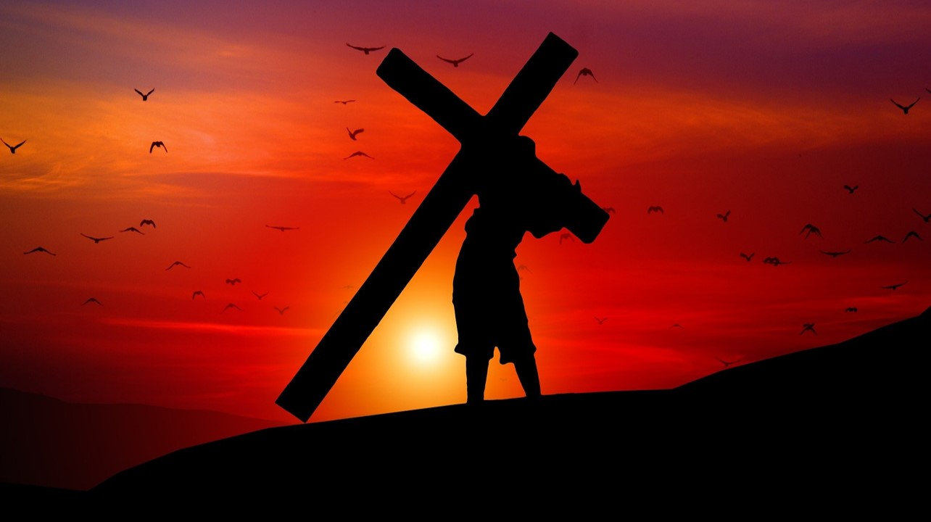
“For everyone to whom much is given, from him much will be and to whom much has been committed, of him they will ask the more.” (Luke 12:48)

Slide 6
“Every man shall give as he is able, according to the blessings the Lord your God gave you.”
Deuteronomy 16:17

Slide 7
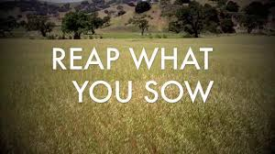
“But this I say, he who sows sparingly will also reap sparingly; and he who sows bountifully will also reap bountifully.”
2 Corinthians 9: 6-8

Slide 8
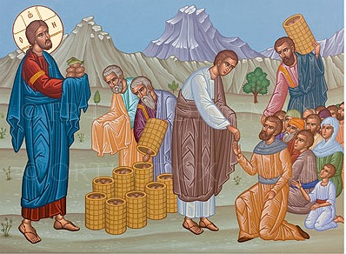
The Parable of Generosity Featured in all 4 Gospels
“There is a lad here who has five barley loaves and two small fish, but what are they among so many.”
John 6:9
Matthew 14:13 Mark 6:31
Luke 9:12 John 6:1-14

Slide 9
“Command those who are rich… not to be haughty, nor to trust in uncertain riches…
Let them do good, that they be rich in good works, ready to give, willing to share, storing up for themselves a good foundation for the time to come, that they may lay hold on eternal life.”
1 Timothy 6:17-19
Message:
Basis for link between stewardship, spiritual growth and ultimately salvation

Slide 10
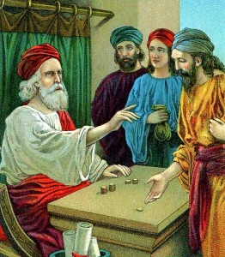
The Parable of the Talents
“Well done, good and faithful servant; you have been faithful over a little, I will set you over much.”
Matthew 25:14-30

Slide 11
The question Christ was asked: “What good deed must I do to have eternal life?”
“If you would be perfect, go, sell what you possess and give to the poor, and you will have treasure in heaven; and come follow me.”
Are you prepared to go ALL IN for the Lord?
Parable of the Rich Young Man
Matthew 19:16-26

Slide 12
“And if you are untrustworthy about worldly wealth,
…who will trust you with the true riches of heaven?”
Luke 16:11

Slide 13
3. What is NOT stewardship According to the Orthodox Christian faith– or what I call the heresies of stewardship so many of our American Orthosohere churches are practicing

Slide 15
Dictionary Definition of Dues:
“charges for membership in a club or organization”

Slide 16
Dues Vs. Stewardship
STEWARDSHIP:
~ Is what Christ taught
~ Is Biblical
~ Is what God practices with us
~ Avoids a “consumer transaction”
~ Focuses on more than just money (3 Ts)
~ The best path to increase ALL resources in your Parish

Slide 17
Most church budgets aren’t real church budgets!

Slide 18
Disguised Dues
Minimums or suggested donations
Donations based on age or demographic status
“Perks” given to “members”
“Family plans”
Dues set based on budget
“Pay a day” of church expenses
Anything other than the tithe and proportional percentage giving

Slide 19
The Problem With Dues?¹
Christ never taught dues
Christ explained our stewardship obligation
= 100% in the parable of the Rich Young Man (Matthew 19:16-22)
= 50% + 4x what was taken ≈ 100% in the parable of Zacchaeus (Luke 19:1-10)
¹ Thom Rainer https://churchanswers.com/blog/eight-differences-church-giving-church-dues/

Slide 20
The Problem With Dues?
3. Membership dues create entitlement benefits and are given with expectations because “it’s my money”
~ Payer gives for recognition and not out of gratitude and humility
~ Payer uses money to claim a “right” to determine all church spending
~ Payer withhold funds when they don’t get what they want (and tries to convince others to do likewise)
4. Funds are given from what’s left not “first fruits” and dues becomes the max

Slide 21
4. What is the root cause of our American Orthosphere stewardship problems

Slide 22
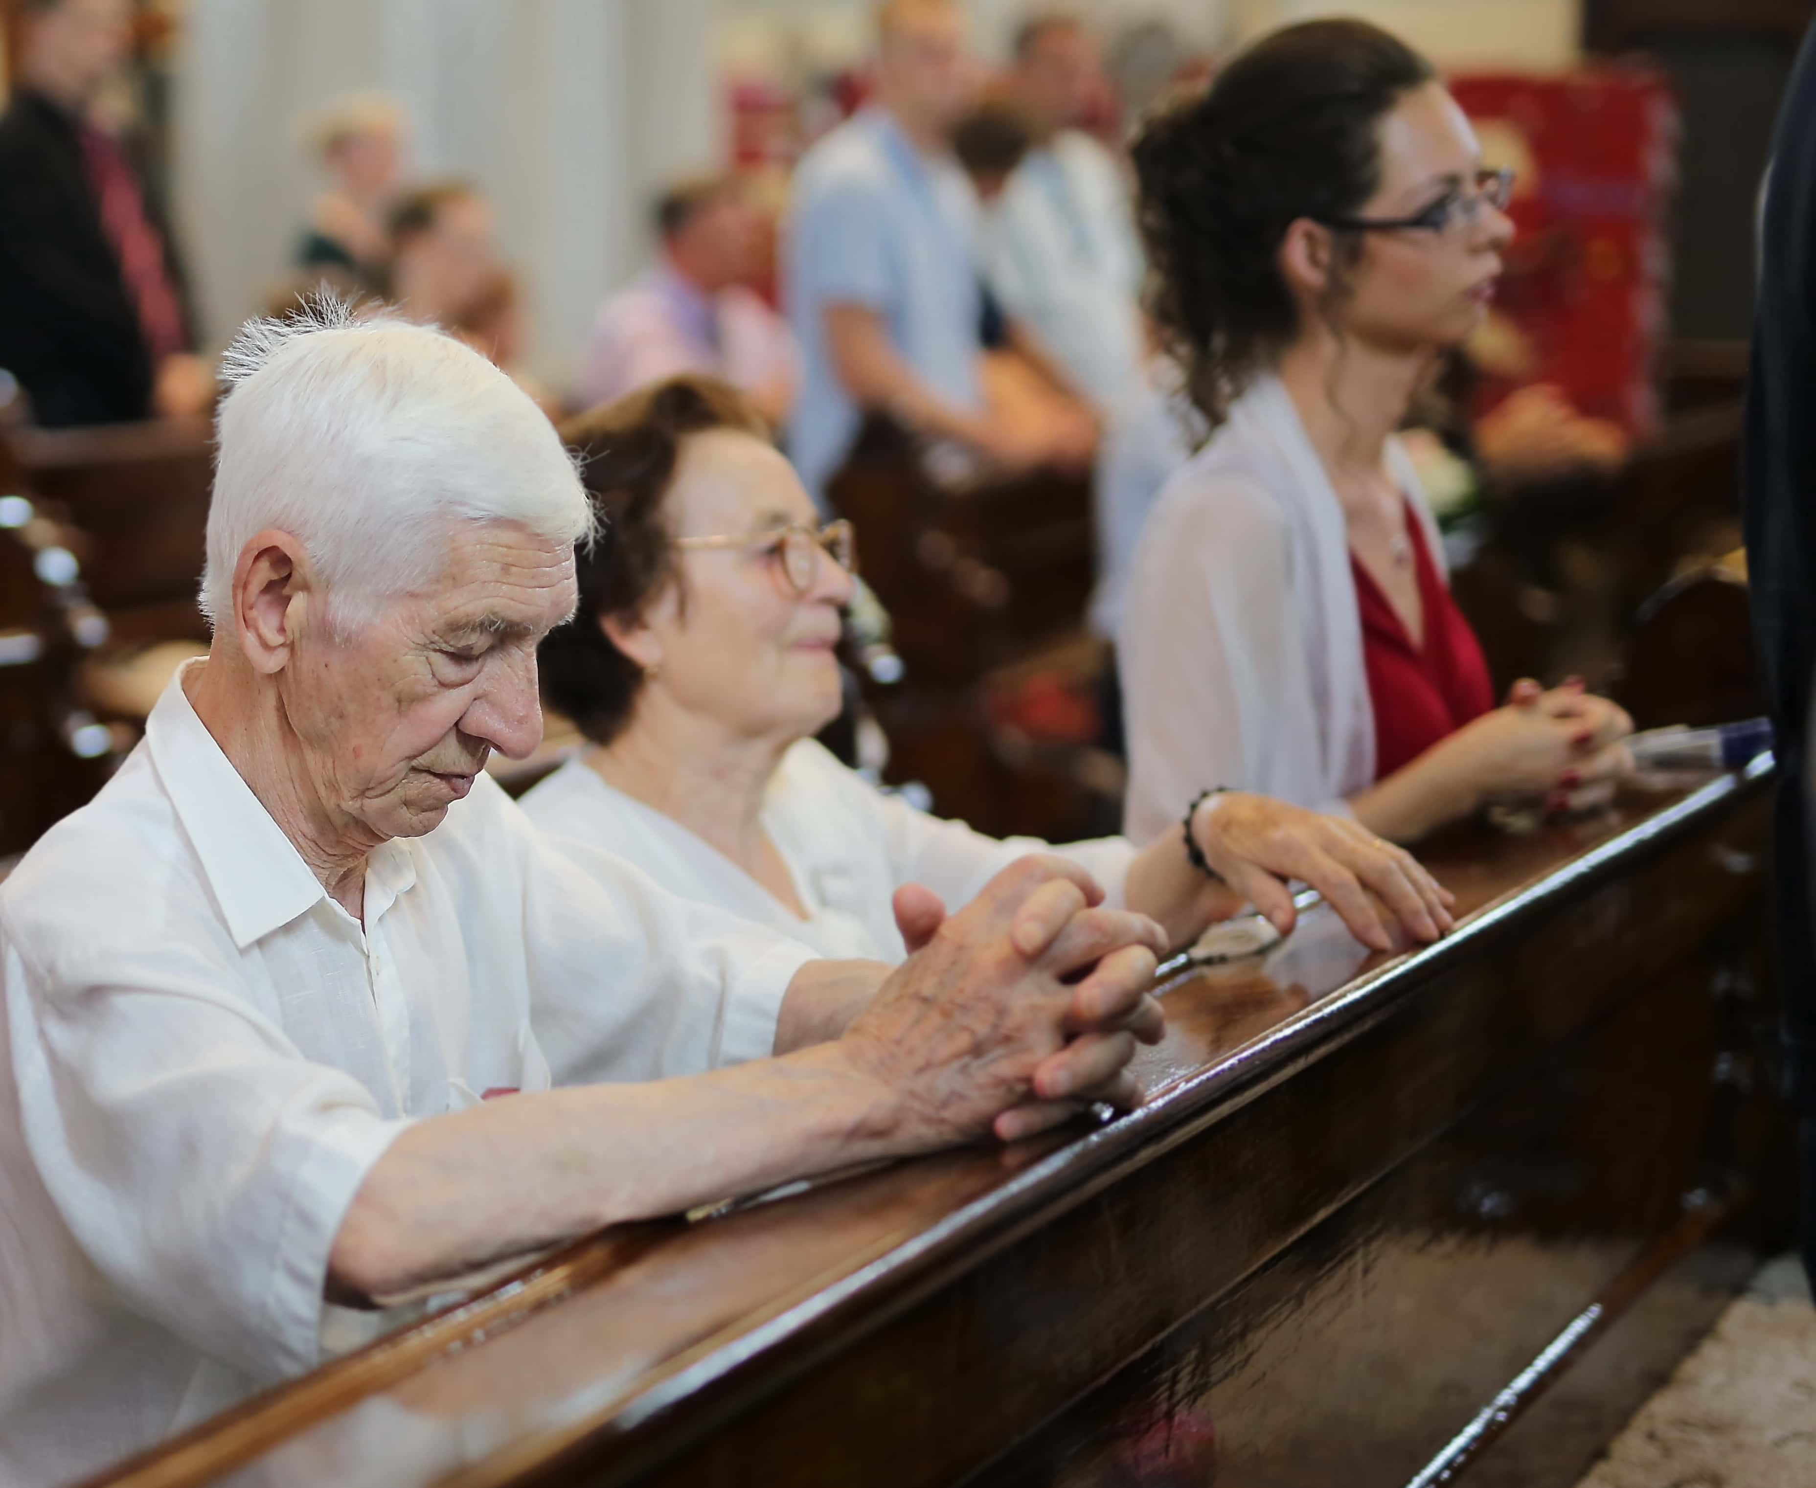
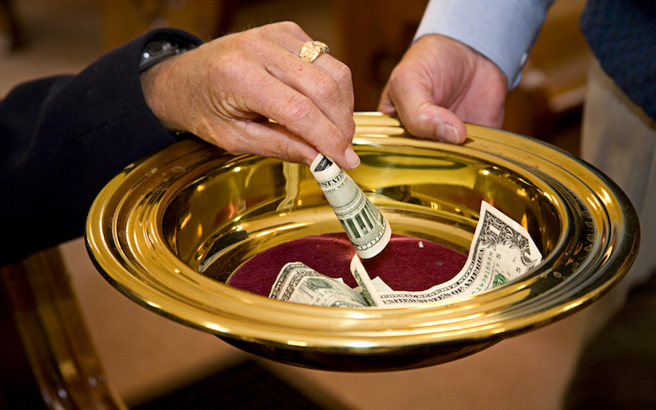
Why Do Orthodox Christians Pray
Orthodox Christians Don’t Tithe?
but…

Slide 23
The Big Question
What did our (immigrant) parents and grandparents know, and teach us, about being generous and giving to our churches?

Slide 24
2 Scientific Studies Involving Ethnic Immigrant Church Communities
1. “Immigrants in the United States are less likely to give to charitable organizations and also give less…” ¹
2. “U.S. citizens give more to religion than immigrants…” ²
¹ Osili UO, Du D. 2005. Immigrant Assimilation and charitable giving. New Directions for Philanthropic Fundraising 48:89-104
² Brown E, Ferris JM. 2007. Social Capital and Philanthropy: An Analysis of the Impact of Social Capital on Individual Giving and Volunteering. Nonprofit and Voluntary Sector Quarterly 36:85-99

Slide 25
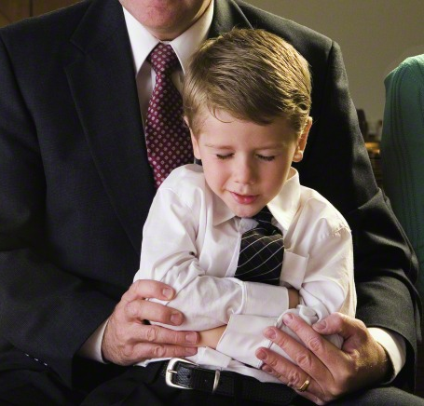
You do not do, what you never learned to do.
What have you taught your loved ones about stewardship?

Slide 26
5. What are most effective things you can do to transform the stewardship and generosity culture of your parish. Spoiler alert, it’s an effective annual campaign of becoming a percentage giving church on your way to being a tithing church

Slide 27
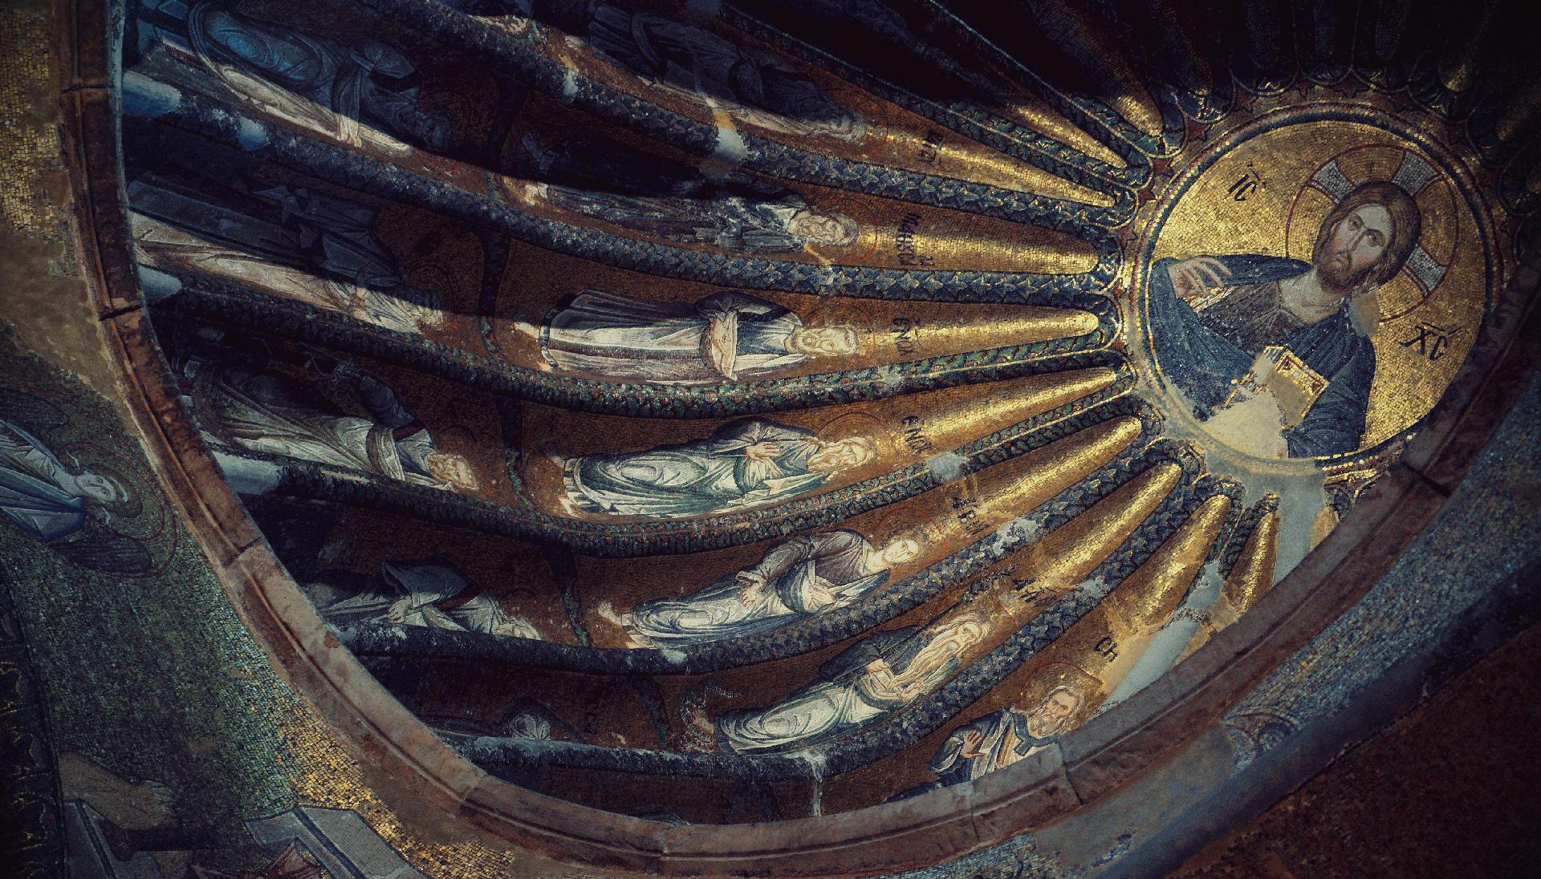
Tithing & Percentage Giving
Bill Marianes

Slide 28
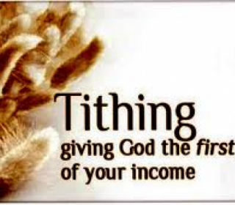
Tithing of all 3 Ts
Tithing (percentage giving) of Time, Talents and Treasures is called for by Holy Scripture and can make a significant positive difference

Slide 29
“Now all the tithe of the land, whether seed of the land or fruit of the tree, is the Lord’s. It is holy to the Lord.” Leviticus 27:30

Slide 30
“Bring the whole TITHE into the storehouse… Test Me in this says the Lord Almighty, and see if I will not throw open the floodgates of Heaven and pour out so much that you will not have enough room for it.” Malachi 3:10

Slide 31
The Didascaly Apostolorum ¹
In the instructions to the faithful:
“Set aside part-offerings and tithes and first fruits to Christ, the true High Priest, and to His ministers, even tithes of salvation to Him…”
¹ The Didascalia Apostolorum, is a Christian legal treatise belonging to the genre of the Church Orders. It presents itself as being written by the Twelve Apostles at the time of the Council of Jerusalem; however, scholars agree that it was actually a composition of the 3rd century, perhaps around 230 AD

Slide 32
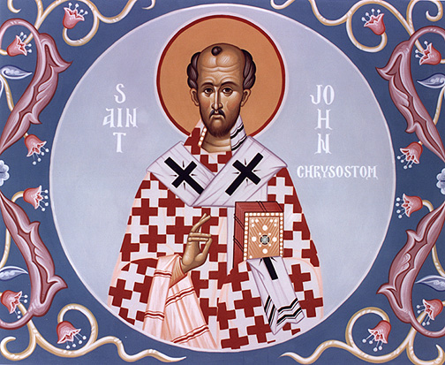
“If there was a danger then (during Old Testament times) in omitting tithes, think how great it must be now!”
St. John Chrysostom, Homily on Ephesians 2:10 - Nicene and Post-Nicene Fathers, Volume XIII First series, p.69

Slide 33
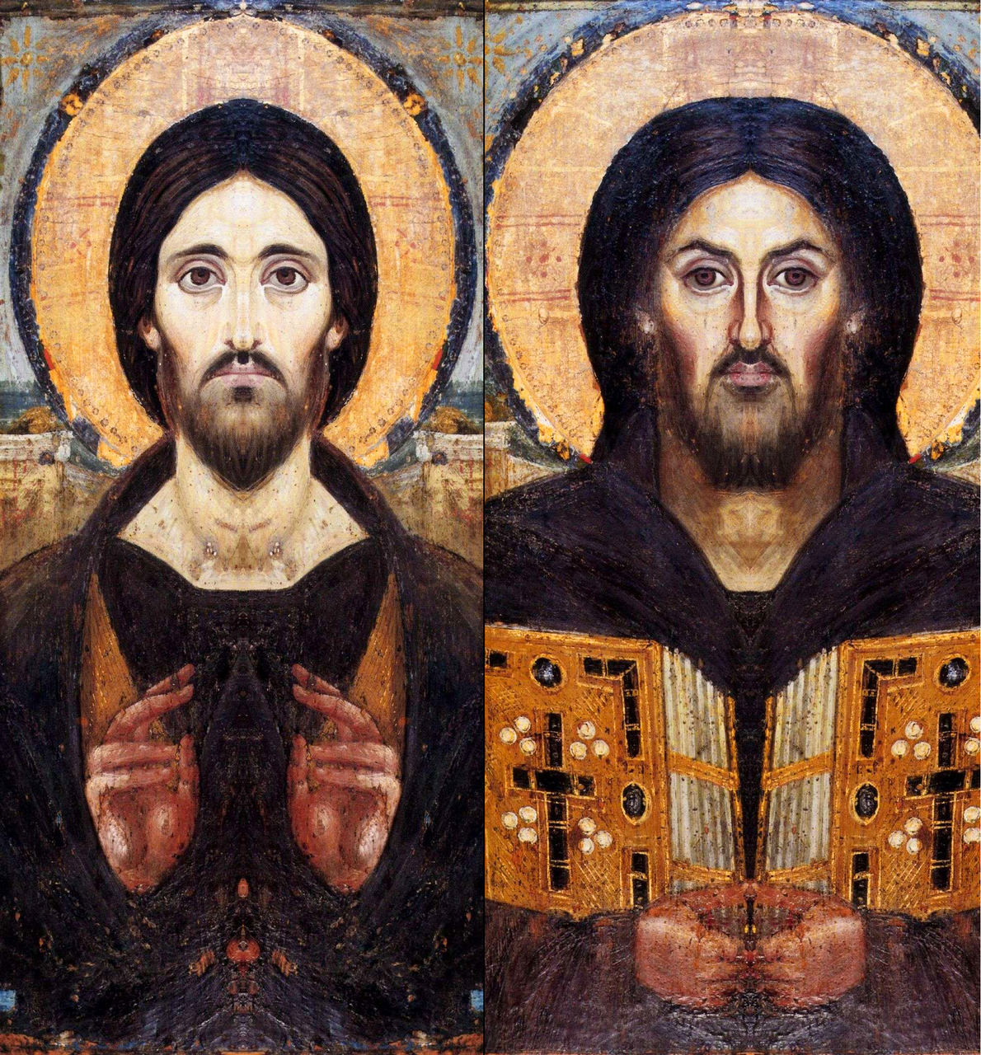
Tithing Is Not Just An Old Testament Thing
“Do not think that I have come to abolish the Law and Prophets. I did not come to destroy but to fulfill” (Matthew 5:17)
“Woe to you scribes and Pharisees, hypocrites! For you pay tithe of mint and anise and cummin, and have neglected the weightier matters of the law: justice and mercy and faith. These you ought to have done without leaving the others undone” (Matthew 23:23)

Slide 34
“Stewardship is recommended to be ten percent (10%) of one’s annual income as stated in Holy Scripture to help meet the financial obligations of the Parish, the Metropolis and the Archdiocese”
Uniform Parish Regulations
Article 18, Section 1 of the Regulations of the Greek Orthodox Archdiocese of America

Slide 35
Tithing should be your goal.
A minimum of 10% Time, Talent and Treasures.
(“You shall tithe…” Deuteronomy 14:22)

Slide 36
U.S. Tithing Data¹
~ GOA proxy median tithe analysis² shows we give ≈ 0.5 to 0.7% (rather than 10%)
~ 77% of tithers give more than 10%
~ 70% of tithers base it on their gross income
~ Churches accepting tithes online increase overall donations by 32%
¹ https://nonprofitssource.com/online-giving-statistics/church-giving/ https://www.vancopayments.com/egiving/church-giving-statistics-tithing
² Stewardship Analysis from 250+ Orthodox parishes by Stewardship Calling

Slide 37
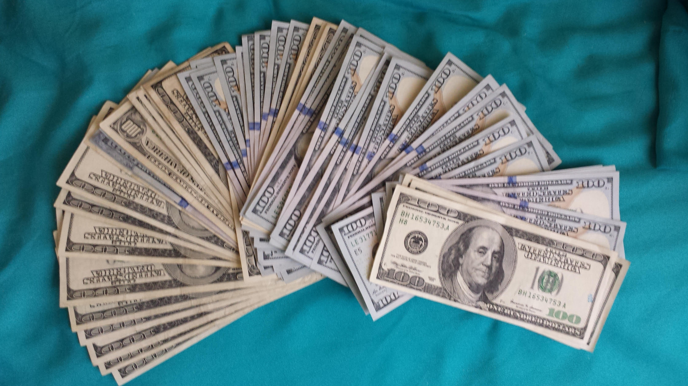
What ministries, services or charities could you fund if you had
in total annual stewardship
$2,500,000

Slide 38
Here’s How This Is Possible
Est. Median U.S. Orthodox Christians income = $81,750¹
($8,175 = a median Orthodox income tithe)
N = your number of Stewardship units/families
$8,175 x N = your new $teward$hip total
What could you do with $ X Million more?
100N = $817,500 200N = $1,635,000 300N = $2,452,500
400N = $3,270,000 500N = $4,087,500 600N = $4,905,000
¹ Median annual household income U.S. Census as reported 10-02-2020: Lebanese $87,099; Russian $85,989 - Greek $82,036; Romanian $81,878; Ukrainian $81,603; Serbian $81,452; Bulgarian $80, 626; Armenia $77,110. = MEDIAN INCOME OF AMERICANS FROM HISTORICALLY ORTHODOX COUNTRIES = $81,750

Slide 39
How To Start A Tithing Program
Teach tithing & % giving
2. Share the impact and lives improved
3. Leaders lead by example
4. Use the “ROUND-UP”

Slide 40
How To Start A Tithing Program
You must totally flip the parish culture and overcome generations of teaching deficiencies

Slide 41
How To Start A Tithing Program
Teach tithing & percentage giving
~ You have to teach the WHY and history of the tithe
~ You have to start teaching it monthly for at least a year
~ Teaching includes homilies, articles, Sunday School lessons, adult classes, stories and testimonials

Slide 42
How To Start A Tithing Program
2. Share the impact and lives improved
~ Provide specific examples of how tithes changed people’ lives
~ Actual stories of people helped and higher percentages of impact are most effective
~ Testimonials from recipients and tithers / percentage givers make a big impact

Slide 43
How To Start A Tithing Program
3. Leaders Lead By Example
~ “Your actions speak so loudly, I can’t hear what you’re saying.”
~ Clergy, Parish Council, and Ministry Leaders must show their leadership commitment
~ Tithing and percentage giving must become a criteria for selecting and promoting leaders (like church attendance)

Slide 44
How To Start A Tithing Program
4. Use The Roundup
~ Calculate the % of last year’s income you gave to your church to 1 decimal point (e.g., 0.5%)
~ This year, “round up” your gift to the next highest whole number percent of income (e.g., 1%)
~ Next year add 1% more
~ Add 1% a year until you reach 10% (or more)

Slide 45
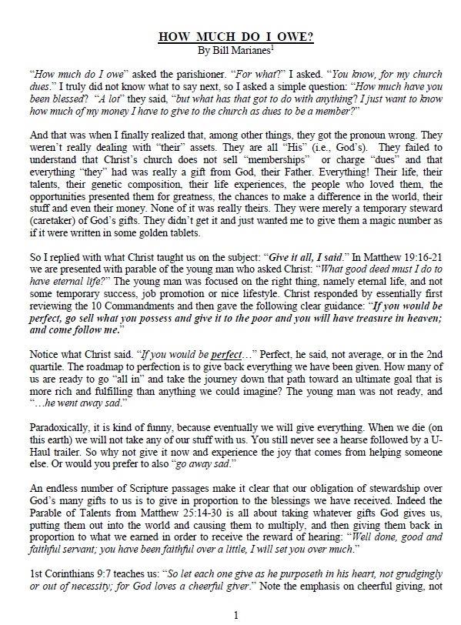
How Much Due I Owe?
StewardshipCalling.com https://stewardshipcalling.com/articles-2/

Slide 46
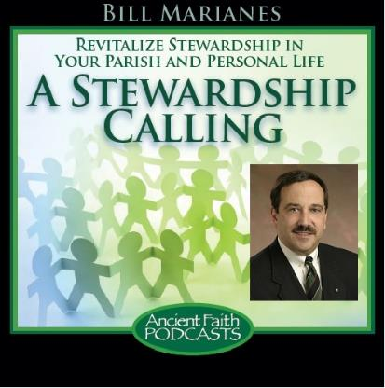
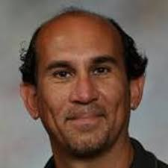
“The Tithe & Percentage Giving”
February 6, 2019
https://www.ancientfaith.com/podcasts/stewardshipcalling/the_joy_of_the_tithe
Nick Kasemeotes

Slide 48
ENGAGEMENT

Slide 49
W²
Own the Watch and you will own the Wallet
~ People who are asked to give of their time before they are asked to donate money ultimately give more money to the charity (49% more ~ ($36.44 rather than $24.46))¹
~ “…the likelihood of giving money to an organization is affected by an individual’s involvement with the organization as a volunteer… The amount of time spent volunteering is positively correlated with the amount of money that is given by individuals.” (Those who actively practiced a religion donated 92% more to charitable causes.)²
~ “…church involvement is the strongest single predictor of giving.” ³
¹ The Happiness of Giving: The Time-Ask Effect (May 1, 2008) – Center for Responsible Business - University of California, Berkley (Wendy Liu & Jennifer Aaker) Ask Donors First To Volunteer (June 9, 2008) – University of California, Berkley
² Helping Out: A National Survey of Volunteering and Charitable Giving (2006-07) - Institute for Volunteering Research, London, England
³ More Money, More Ministry, Dean R. Hoge and Mark A. Knoll (Eerdmans, 2000)

Slide 50
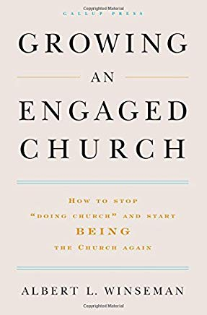
A Must Read For Every Priest and Church Leader
“…congregations with engaged members are:
spiritually healthier;
2. better able to:
carry out their missions,
attract more new people,
fund new ventures; and
3. have a higher percentage of spiritually committed individuals.”
By: Al Winseman, Global Practice Leader for Faith-Based Organizations for the Gallup Organization

Slide 51
A Must Read For Every Priest and Church Leader
“Spiritual commitment is usually a result of one big – and often overlooked – factor: congregational engagement.
Focus on improving engagement and increased commitment will follow.
How much members give financially, how many hours they volunteer in community service, and how often they invite others to their congregations are more dependent on engagement than on any other factor.”
By: Al Winseman, Global Practice Leader for Faith-Based Organizations for the Gallup Organization

Slide 52
A Must Read For Every Priest and Church Leader
“Your job as a leader is not to placate the actively disengaged. It is to create and grow disciples.
One reason United States congregations are in trouble is that they have a low percentage of engaged members.
“So, the very first thing you, as a leader, must do to ensure congregation effectiveness is to clarify ‘membership’ expectations.’ ”
By: Al Winseman, Global Practice Leader for Faith-Based Organizations for the Gallup Organization

Slide 53
A Must Read For Every Priest and Church Leader
“ … those who are engaged give more to their congregations than anyone else does…”
“Each year, engaged members give a median of 5% of their annual income…”
By: Al Winseman, Global Practice Leader for Faith-Based Organizations for the Gallup Organization

Slide 54
6. What are some of the best practices for stewardship campaigns
W squared – ask for time
Personal Visitations
Annual Campaign
Effective communications
Committed Team

Slide 55
6. What are some of the best practices for stewardship campaigns
W squared – ask for time
Personal Visitations
Annual Campaign
Effective communications
Committed Team

Slide 56
6. What are some of the best practices for stewardship campaigns
W squared – ask for time
Personal Visitations
Annual Campaign
Effective communications
Committed Team

Slide 57
Ingredients Of Effective Stewardship Ministry
If you don’t remember anything else, please know that to have a true, successful, and sustainable stewardship ministry you must
PERSONALLY INTERACT
with
EVERY PARISHIONER
Personal, in-home visitations are absolutely and unequivocally the most effective
(nothing else is even close)

Slide 58
Ingredients Of Effective Stewardship Engagement Process
Plan A - Personal In-Home Visitations
Each steward is personally visited in their home by a Stewardship Ambassador
Plan B - Small Group In-Home Gatherings
Each steward is invited to a small group gathering hosted at a Stewardship Ambassador’s house
Plan C - Personal Telephone Calls
Each steward is personally called at home by a Stewardship Ambassador

Slide 59
The wHoly-Engaged Personal Visitation Program

Slide 60
†
Follow Up
Home Visitations
Ambassadors Select Stewards
Train Ambassadors
Recruit Ambassadors
Ministry Handbook and Stewardship Materials
Council of Ministries
Mission-Vision-Strategic Objectives
P.P.S. - Priest, Parish Council and Stewardship Ministry Consensus
wHoly Engaged
9-Step Process
9
8
7
6
5
Interpersonal Steps
4
Foundational Steps
3
2
1

Slide 61
†
Follow Up
Home Visitations
Ambassadors Select Stewards
Train Ambassadors
Recruit Ambassadors
Ministry Handbook and Stewardship Materials
Council of Ministries
Mission-Vision-Strategic Objectives
P.P.S. - Priest, Parish Council and Stewardship Ministry Consensus
wHoly Engaged
9-Step Process
9
9
8
8
7
7
6
6
5
Interpersonal Team Steps
4
Foundational Steps
3
2
1

Slide 62
The wHoly-Engaged Personal Visitation Program
Personal, in-home visitations agenda
~ Opening prayer of thanksgiving
~ Discuss parish items of common interest (e.g., the top 3 things they like about parish)
~ Share the vision/ministries of the parish
~ Address any comments/concerns or promise to get back to them
~ Review Ministry handbook and stewardship forms
~ Explain you will follow up every 2 weeks until the church receives their competed forms
~ Thank them and end with a prayer

Slide 63
The wHoly-Engaged Group Visitation Program

Slide 64
The wHoly-Engaged Group Visitation Program
~ Opening prayer, welcome/ice breaker
~ Dinner and fellowship
~ Program
- the vision and ministries of the parish
- 2 or 3 testimonials
- present stewardship ministry handbook and stewardship commitment form
- explain next steps (including 2-week follow-ups), answers any questions and closing prayer

Slide 65
Stewardship Team
~ Recruit the number of “Ambassadors” that is a little over 10% of your number of steward units
~ Each Ambassador takes care of themselves and 9 other steward units (= 100% of parish)
~ All Parish Council members, Ministry Leaders and Clergy are Ambassadors
~ Train all Ambassadors on how and what to solicit (the focus is time and talents engagement)

Slide 66
6. What are some of the best practices for stewardship campaigns
W squared – ask for time
Personal Visitations
Annual Campaign
Effective communications
Committed Team

Slide 67
Stewardship Campaigns
Annual, year-long stewardship campaign
2. Monthly stewardship articles in ALL Parish publications (Scripture + testimonials)
3. At least quarterly stewardship presentations
a. clergy AND lay testimonials
b. focused on life changing ministries (not problems) “people give to mission and vision”
c. emphasize time and talents - ministry engagement
d. explain easy online giving options
e. emphasize tithing and % giving in each message
f. explain the incredible ministries that could be funded if everyone tithed

Slide 68
Sample Monthly Stewardship Schedule
~ January - Recruit Team – 1st Stewardship Homily
~ February - 1st Adult Lay Testimonial
~ March - Life-changing Ministry Presentation
~ April - 2nd Stewardship Homily
~ May - Youth Testimonial
~ June - Stewardship Materials Preparations
~ July - 3rd Stewardship Homily
~August - Young Adult Testimonial - Ministry Fair
~ September - Adult & Youth Campaign & Personal Visits
~ October - Follow-up Visits/Calls To Get To 100%
~ November - 4th Stewardship Homily - Results Reported
~ December - Thanks & celebrate

Slide 69
Specific stewardship campaign month (sometime in Sept - Nov)
~ Plan personal contacts
Plan A personal in-home visits
Plan B group gatherings
~ Hand deliver stewardship packets for return to confidential place
~ Conduct a separate youth stewardship campaign
~ Focus on Ministry information and recruitment
~ Host a “Ministry Fair” and have ministries share their great accomplishments and recruit
~ Personal follow up to reach 100% participation
~ Celebrate successes

Slide 70
Youth Stewardship
~ If you do not have a youth stewardship program that teaches true stewardship, you have determined your Parish’s unfortunate future
~ The Science of Generosity Studies remind us that it is critical to teach youth that stewardship over their gifts from God is a cradle to grave responsibility

Slide 71
Youth Stewardship
~ Different messages and solicitations change depending on their age
~ Use understandable examples and messages
~ Include ALL youth in annual Parish Stewardship Campaign (youth offer their own separate stewardship pledge)
~ Youth stewardship pledge must also include a pledge of time and talents and also their treasures

Slide 72
Youth Stewardship
~ Sponsor many different service opportunities (including mission trips)
~ Use creative processes to help youth start to discern their gifts and callings
~ Send monthly materials home for parents to reinforce the teaching and messaging in the Sunday School/Parish
~ Recognize youth who practice stewardship in the Parish bulletins and other media and in church (have them offer testimonials in church - their examples will inspire others)

Slide 73
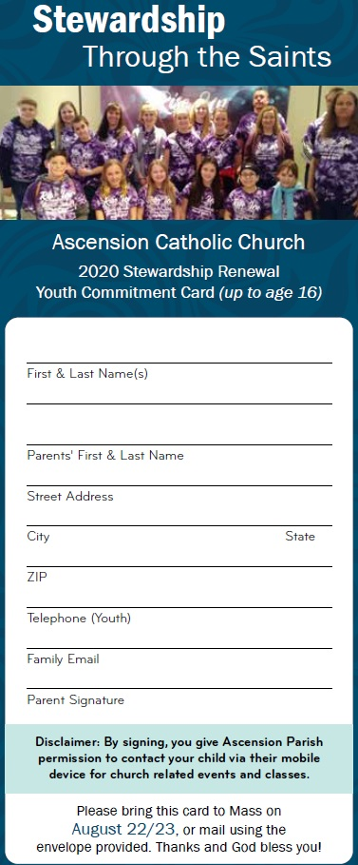
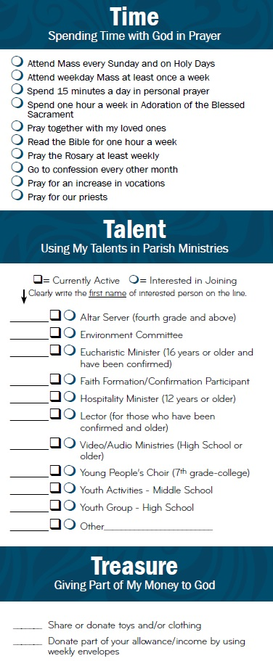
Youth Stewardship Card
Page 1 - Demographic Info
Page 2 - Time, Talents & Treasurers

Slide 74
6. What are some of the best practices for stewardship campaigns
W squared – ask for time
Personal Visitations
Annual Campaign
Effective communications
Committed Team

Slide 75
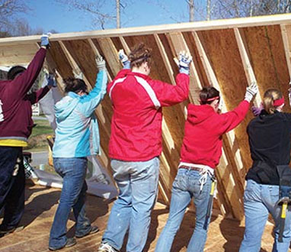
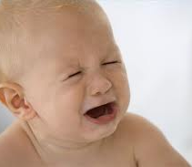
People give to Causes not Crying

Slide 77
Communications Matter!
Keep communications positive
Focus on mission/vision and life- changing ministries
Share stories of generosity and the abundance in your community
Communicate regularly and consistently
Describe the easy ways people can give
ASK! – (make a religious call to give)
Thank and celebrate
Stewardship Communications

Slide 78
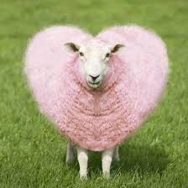
Church Websites Matter¹
~ What features do people say they use most (in order):
~ Listen and download sermons
~ Serving opportunities at the church
~ Finding service information
~ Forward content to others
~ Read visitor’s information
~ Good church websites “EWE”
Educate
Welcome
Engage
¹ https://network.crcna.org/church-web/church-website-statistics

Slide 79
Church Websites Matter¹
~ 53% of browsing is on smart phones / tablets
~ 80% of people stop engaging if it loads in less than 3 seconds
~ 62% of church websites don’t easily provide new visitor information
~ Users form an initial opinion of if they will stay or leave a website in ≈ 50 milliseconds (that’s 0.05 seconds)²
¹ An extensive case study that analyzed 1,008 church websites from 30+ different countries https://www.nucleus.church/blog/church-website-essentials/
² https://cxl.com/blog/first-impressions-matter-the-importance-of-great-visual-design/

Slide 80
Church Websites Matter¹
~ 97% of people search for churches online
~ 96.2% of churches fail the “first impression test”
focal point?
responsive design?
quick load time?
no stock photos of people’s faces
accessible new visitor information
~ The “feel” of a website is the main driver of first impressions (94% about the design and only 6% about the content)
¹ An extensive case study that analyzed 1,008 church websites from 30+ different countries https://www.nucleus.church/blog/church-website-essentials/
² https://cxl.com/blog/first-impressions-matter-the-importance-of-great-visual-design/

Slide 81
C. P. I.
People give to
Causes and
People with
Integrity

Slide 82
Causes + People + Integrity C. P. I. Motivates Donors To Give
Sell The Dream
Sell The Team
Sell The Scheme

Slide 83
Causes + People + Integrity C. P. I. Motivates Donors To Give
Sell The Dream
~ People give to Vision and Causes
~ 1-sized communications fits no one

Slide 84
Causes + People + Integrity C. P. I. Motivates Donors To Give
Sell The Team
~ People give to people
~ It’s all personal

Slide 85
Causes + People + Integrity C. P. I. Motivates Donors To Give
Sell The Scheme
~ Integrity, transparency and accountability is key

Slide 86
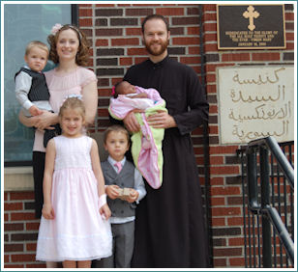
“Overcoming The Challenge of Donor Fatigue”
August 7, 2019
Fr. Aaron Warwick
St. Mary Antiochian Church - Wichita, KS
https://www.ancientfaith.com/podcasts/stewardshipcalling/donor_fatigue

Slide 87
Overcoming Donor Fatigue¹
~ Communicate key stewardship strategies
~ Focus on solutions instead of the problems
~ Talk about the proportion of victims helped
~ Stress similarities between victims and donors
~ Identify a single victim being helped
~Thank and celebrate
¹ “Overcoming Donor Fatigue” – Fr Aaron Warwick U. of Northern Iowa https://www.ancientfaith.com/podcasts/stewardshipcalling/donor_fatigue

Slide 88
6. What are some of the best practices for stewardship campaigns
W squared – ask for time
Personal Visitations
Annual Campaign
Effective communications
Committed Team

Slide 89
“It takes a group of people
working together with a
common purpose
in an atmosphere of
trust and collaboration
to get extraordinary things
done.”
Dr. James Kouzes

Slide 90
Optimal Stewardship Team
ADMINISTRATIVE
Ministry Team Leader
Stewardship Communications
Stewardship Data Analysis
TACTICAL
Stewardship Campaign
Planned Giving
Stewardship Ambassador Recruitment & Training
MINISTRY LIASON
Welcoming Ministry
Thanking Ministry
Youth Stewardship
Small Groups Ministry

Slide 91
Optimal Stewardship Team
ADMINISTRATIVE
Ministry Team Leader
~ Lead all ministry efforts
~ Regularly reports to Parish Council and General Assembly
Stewardship Communications
~ Produce and constantly places ALL communications in ALL parish media outlets
~ Coordinate testimonials and stewardship presentations
Stewardship Data Analysis
~ Confidentially maintain all stewardship data
~ Produce all stewardship reports, dashboards, and analyses

Slide 92
Optimal Stewardship Team
TACTICAL
Stewardship Campaign
~ Coordinate and manages year-round campaign
~ Lead Steward Engagement Process (SEP) to personally contact every steward each year
Planned Giving
~ Lead year-round Planned Giving Campaign
~ Coordinate Planned Giving Recognition Celebration
Stewardship Ambassador Recruitment & Training
~ Recruit team to personally contact all stewards
~ Work with Stewardship Campaign Chair to train Stewardship Ambassadors to effectively complete Steward Engagement Process

Slide 93
Optimal Stewardship Team
MINISTRY OR LIASON (assuming this ministry does not already exist)
7. Welcoming Ministry
~ Coordinate Sunday “Total Welcoming Experience”
~ Coordinate Follow-Up “Total Welcoming Experience”
8. Thanking Ministry
~ Coordinate all thanking communications with all stewards
~ Plan thanking and recognition celebrations
9. Youth Stewardship
~ Develop youth stewardship campaign and materials
~ Coordinate youth stewardship campaign
10. Small Group Ministry
~ Manage all aspects of Small Group Ministry
~ Recruit and trains Small Group Leaders
~ Facilitate parishioner sign-up for Small Group Ministries

Slide 94
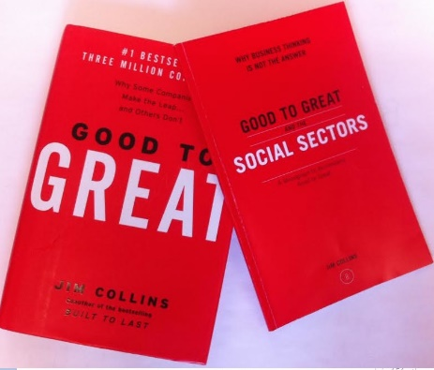
The Importance of Great Stewardship Ministry Leadership
~ Good To Great and Good To Great And the Social Sectors focused on the critical importance of Level 5 Leadership
~ “True leadership only exists if people follow when they have the freedom not to.”
~ Clarity of expectations around a consensus vision is a key

Slide 95
Romans 12:5
“So we, being many,
are one body in Christ,
and every one members
one of another.”

Slide 96
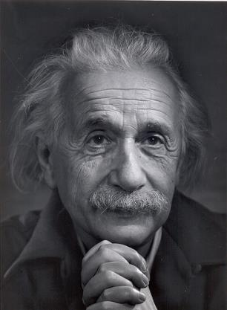
“The world as we have created it is a process of our thinking.
It cannot be changed without changing our thinking.”
Albert Einstein

Slide 97
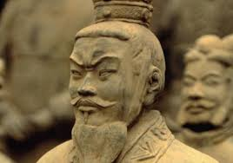
“Strategy without tactics is the slowest route to victory.
Tactics without strategy is the noise before defeat.”
Sun Tzu

Slide 98
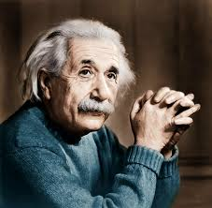
“Logic will get you from A to B.
Imagination will take you everywhere.
Imagination is more important than knowledge.”
Albert Einstein

Slide 99
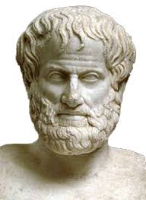
We are what we
repeatedly DO.
Excellence, then, is not an act, but a HABIT
Aristotle

Slide 100
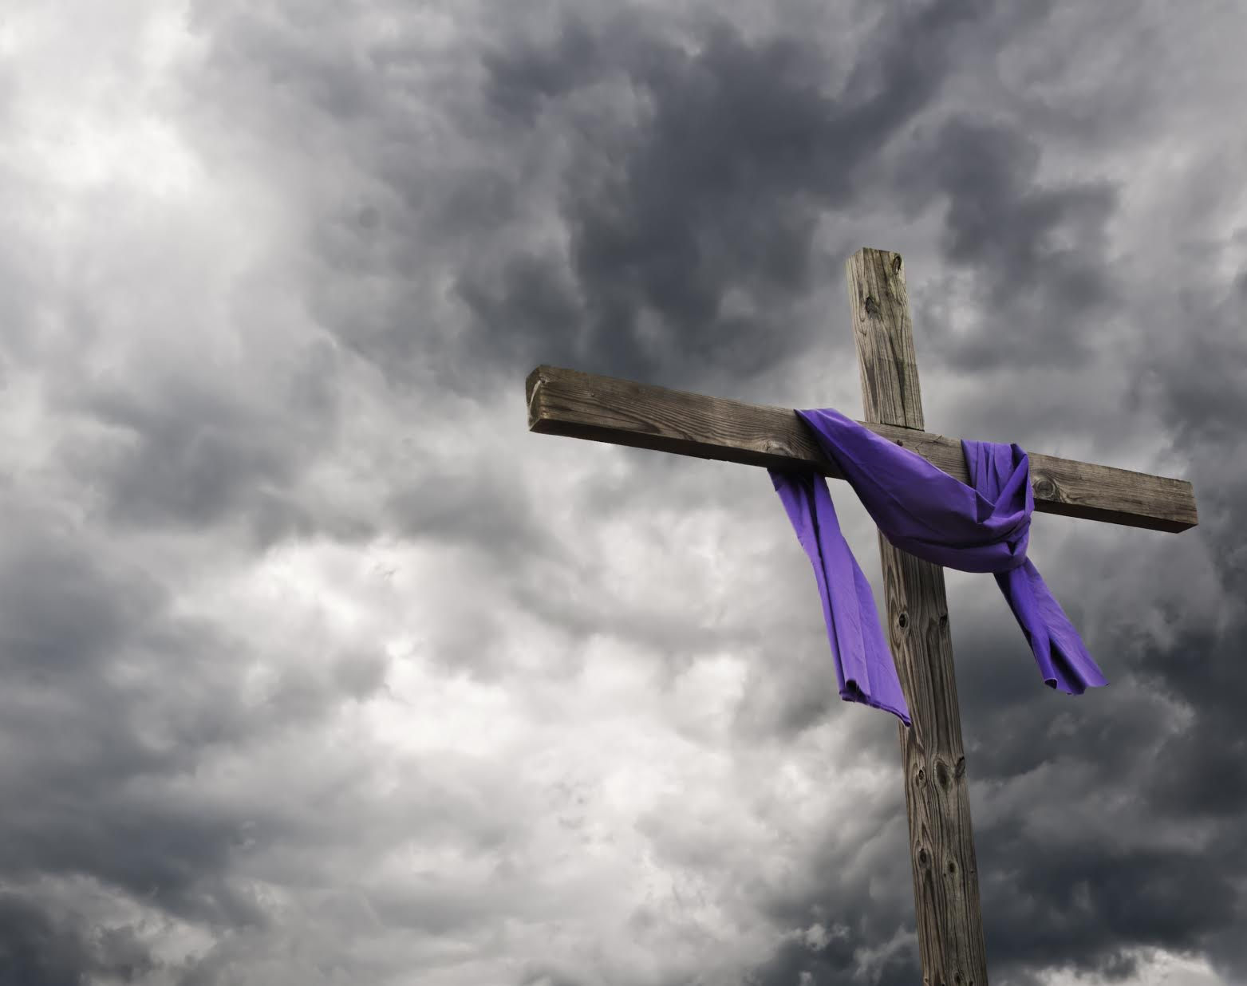
“We make a living by what we get.
We make a life by what we give.”
Sir Winston Churchill

Slide 101
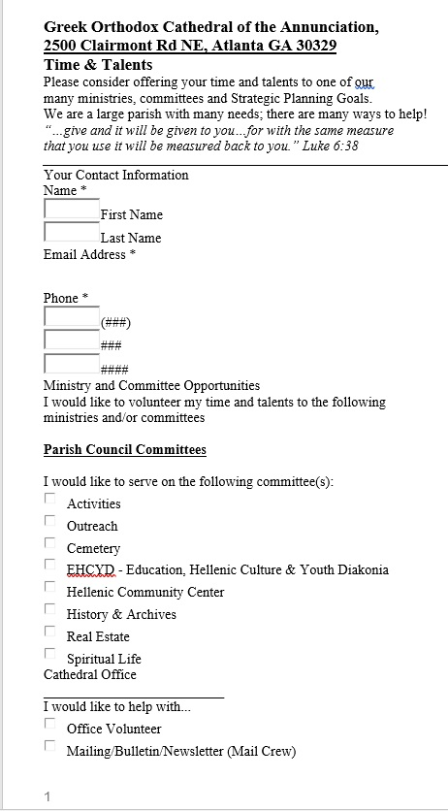
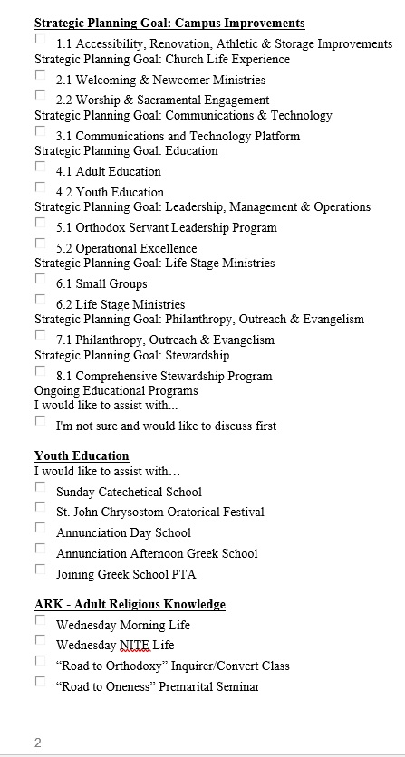
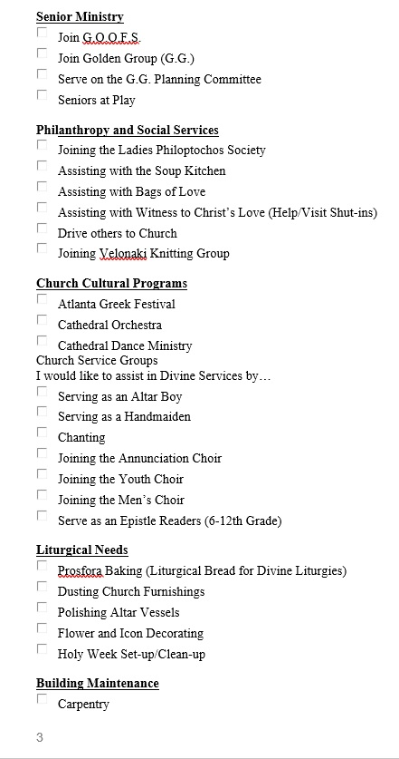
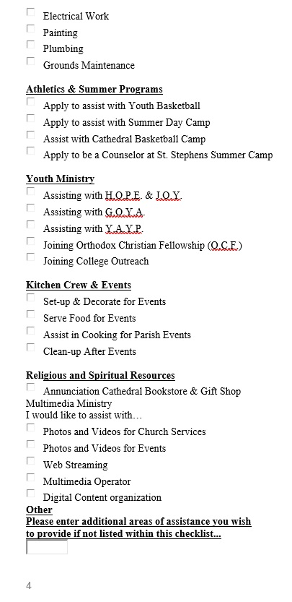
Effective Online Talents Form
https://www.atlgoc.org/time-and-talents

Slide 102
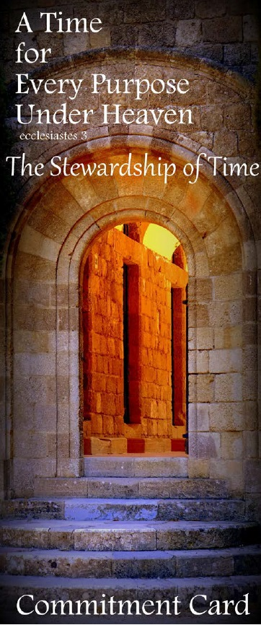
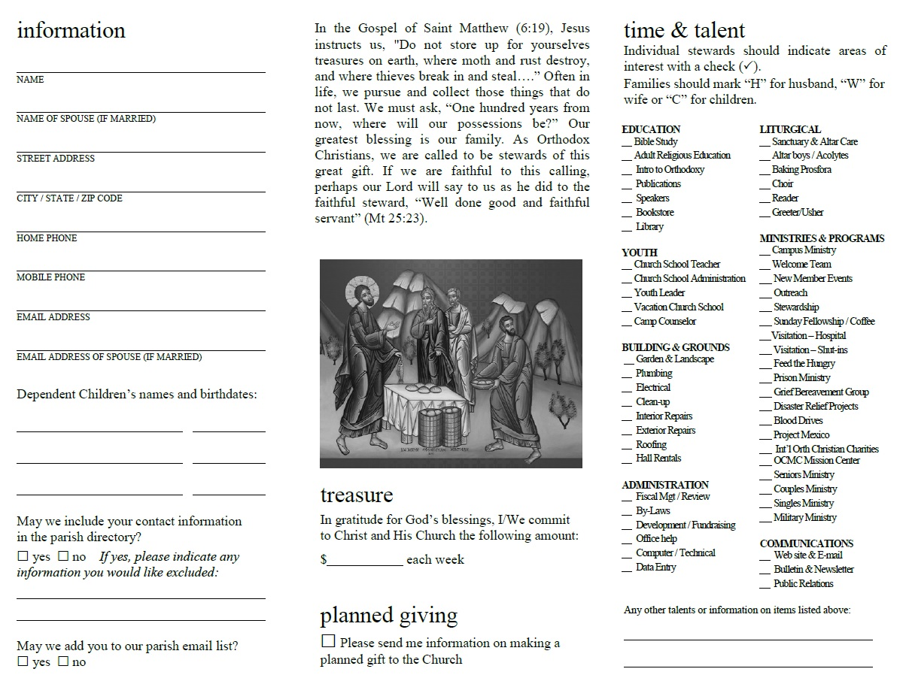
GOA Talents Pledge Form
https://www.goarch.org/-/2020-stewardship-campaign-resources?inheritRedirect=true

Slide 103
Adult Stewardship Serbian Orthodox Trifold - Inside

Slide 104
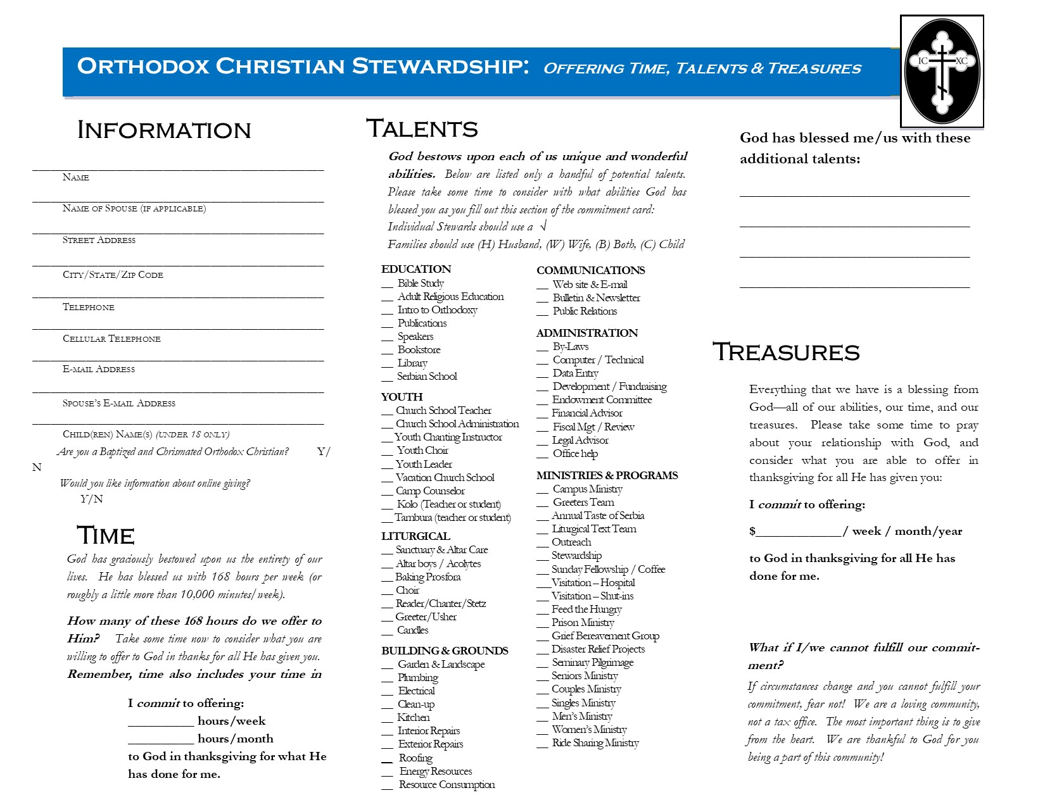
Adult Stewardship Serbian Orthodox Trifold - Outside

Slide 105
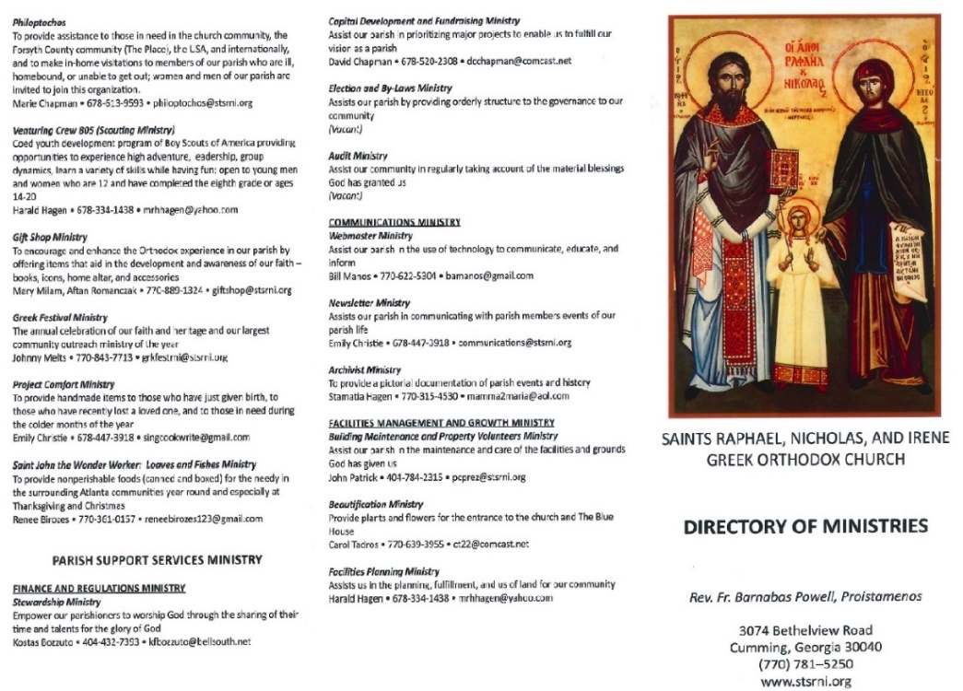
https://stewardshipcalling.com/stewardship-ministry-handbooks/
Parish Ministry Handbooks Examples
Notes:
105

