Slide 1
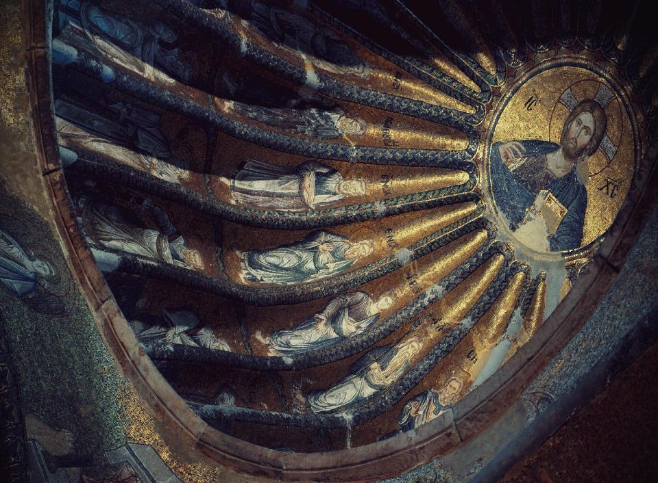
Saints Raphael, Nicholas & Irene Parish Council Strategic Foresight Leadership Workshop
“Where there is no vision, the people will perish”
Proverbs 29:18
Bill Marianes

Slide 2
WHY Does Exist?
To welcome all on a transformational journey to a life of purpose and salvation.
(Source: Sts. RNI Strategic Plan. (n.d.). Strategic plan of Saints Raphael, Nicholas & Irene Greek Orthodox Church.)
Notes:
It is always critical to start with why to understand the motivation of all work and ground the team in the ultimate objectives.
The comprehensive strategic planning process Sts. RNI conducted in 2022, resulted in this consensus Why Statement (Sts. RNI Strategic Plan, n.d.).
The strategic foresight techniques we will discuss and learn today and apply to one of the most critical issues facing Sts. RNI, will hopefully better prepare the parish to welcome all on a transformational journey to a life of purpose and salivation.

Slide 3
Retreat Agenda
Opening & why are we here?
What is Strategic Foresight
The Futures Wheel with S.T.E.E.P.L.E.
Debrief, evaluation, and next steps
Notes:
Here are the four steps of the agenda for today's workshop.

Slide 4
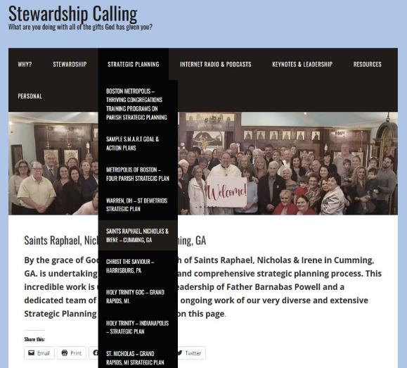
Download This Presentation:
StewardshipCalling.com
Strategic Planning Tab
Saints Raphael Nichols & Irene Page
https://stewardshipcalling.com/saints-raphael-nicholas-irene-cumming-ga/
Notes:
The PowerPoint deck and all other materials including the final After Action Report from this workshop can be found on your page on my Stewardship Calling website at https://stewardshipcalling.com/saints-raphael-nicholas-irene-cumming-ga/ (Stewardship Calling, n.d.a.)

Slide 5
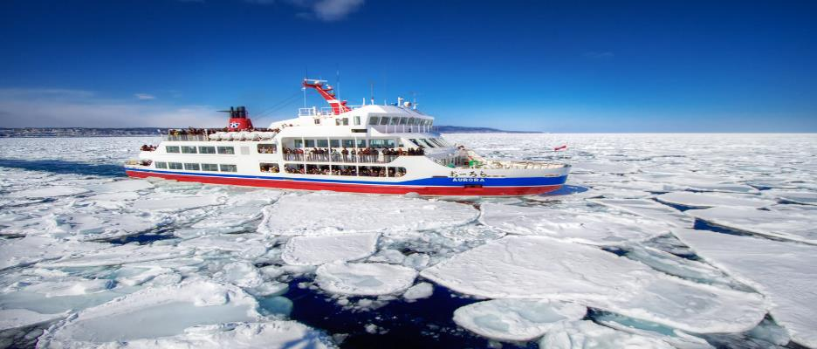
What is…
Your name
Your superpower (what you do best)
The one cause of your death for which we should suspect foul play (your biggest fear)
Notes:
While everyone knows each other, let’s have some fun digging deeper in learning about each other.
We’ll go around the room starting with me, and say your name, your superpower, and the cause of your death, which should it occur, we should immediately suspect foul play.
This will help us to get to know each other’s strengths (superpowers) and deepest fears (cause of foul play death).

Slide 6
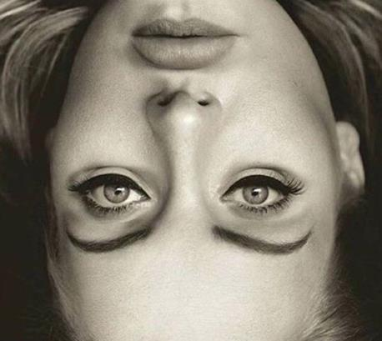
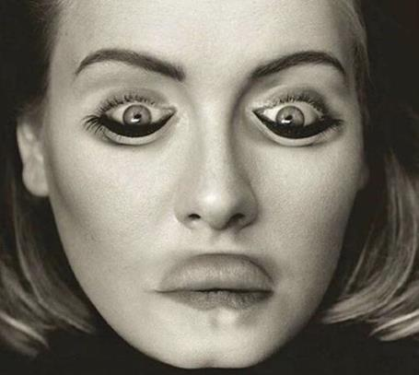
The Thatcher Effect
Perspective matters. Things often look differently when examined carefully from different perspectives.
(Source: Thompson, P. (1980). "Margaret Thatcher: a new illusion.)
Notes:
It is important to appreciate that perspective can change what one sees and their perception of reality.
You may remember my perspective lesson from taking my niece to the zoo we discussed at the strategic planning retreat.
However today I will click the mouse once and show you a picture that probably looks normal other than being upside-down.
Now let me click the mouse a second time to show you what the reality is with this photo, and we can discuss what this means and any other similar examples you want to share (Thompson, 1980).

Slide 7
Why We’re Here Today?
Top Weaknesses Parishioners Identified
#1 (62) - Facilities/Building Campaign
~ There is not enough room for our members, much less any visitors;
~ Limited action on building a church;
~ Tired of planning and not doing;
~ Are we willing to take the financial risks to grow;
~ Land use plan has changed with no follow up;
~ Groundbreaking 2 years ago and still nothing
~ Galas are nice but no personal follow up on ask;
#3 (44) - Parish Council Leadership
~ People with big egos that create conflict;
~ We don’t have a unified clear vision for where we are going;
~ The same handful of “pushy/controlling personalities”
~ Conflict resolution;
~ Leadership needs to speak with each other to address issues;
~ There is a sense of a lack of trust or confidence in the leadership;
~ Lack of communications for process for decisions from board;
(Source: Sts. RNI Strategic Plan. (n.d.). Strategic plan of Saints Raphael, Nicholas & Irene Greek Orthodox Church.)
Notes:
Two of the top three Weaknesses identified in the parish SWOT analysis during the strategic planning process last year are identified on this slide (Sts. RNI Strategic Plan, n.d.). Notice there were 62 comments for weakness #1 Facilities/Building Campaign and 44 comments for weakness #3 Parish Council Leadership.
I have also provided a representative sampling of the specific comments from the parishioners on this slide. Take the time to read just a few of the exact comments that were repeated using different words by many parishioners (Sts. RNI Strategic Plan, n.d.).
I know some of these words sting, especially on the PC leadership topic. But this is what the PIPs (Parishioners In Pews) told us.
Through the leadership training you receive today and, in the future, and the strategic foresight skills you will learn, develop, and deploy today, you will begin to prove to them you heard them, and you are going to do what leaders should do, consider options.

Slide 8
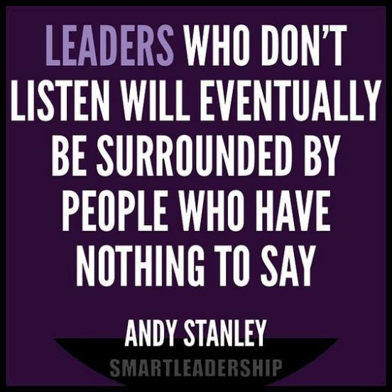
(Source: Stanley, A. [@AndyStanley]. (2021, August 19). Leaders who don't listen will eventually be surrounded by people who have nothing to say. [Tweet].)
Notes:
The pastor of the largest church in Atlanta, Andy Stanley of Northpoint church, is fond of repeating the above quote (Stanley, 2021). He tweets it and shares it often to remind everyone of the need for humility and to open their two ears to hear before they open their one mouth.
Matthew 11:15 and other places in Holy Scripture admonish us that “He who has ears, let them hear.” This is what we must do for the issues raised by our parishioners.
This quote also reminds us that we are the servant leaders of our parishioners and thus owe them the primacy of voice and helping to determine direction.
Our parishioners spoke loud and clear in their Weaknesses they identified in the SWOT Analysis. The PIPs want 1. a new church building, classrooms and gathering hall, and 2. their Parish Council to become the best true leaders they can be (Sts. RNI Strategic Plan, n.d.).
Today we start to prove we are listening to them.
Stanley, A. (2021, August 19) [Tweet] https://twitter.com/AndyStanley/status/1428471840603885577?lang=en

Slide 9
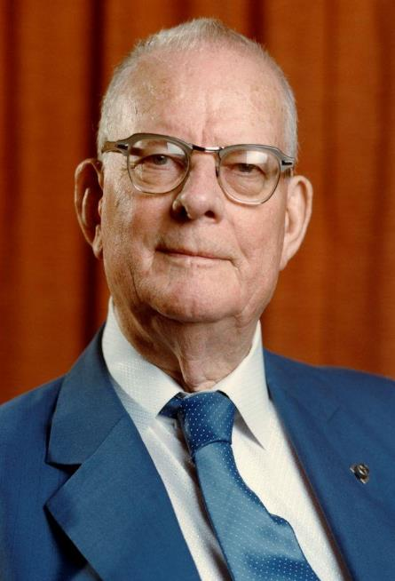
Who Owns The Problem?
“Any time the majority of people behave a particular way the majority of the time, the people are not the problem. The problem is inherent in the system.
As a leader, you own responsibility for the system.
… if you find yourself blaming the people, you should look again.”
(Source: Aguayo, R. (1991). Dr. Deming: The American who taught the Japanese about quality.)
Edwards Deming
(father of the Quality Movement)
Notes:
And lest you be inclined to blame the parishioners who most of whom are saying the same thing in different words and acting a particular way, the leader of the Quality Movement, W. Edwards Deming tells us to think again before blaming the PIPs (Aguayo, 1991).
The common problems they are complaining about are inherent in the systems, decisions, and operations that we as leaders are called to understand and address (Aguayo, 1991).

Slide 10
This is your last chance. After this, there is no turning back.
You take the blue pill, leave right now, the story ends, and you keep believing whatever you want to believe.
You take the red pill, you join me in the Sts. RNI Futures Wonderland, and I show you how deep the rabbit hole goes.
(Source: Wachowski, L. & Wachowski, L. (Directors). (1999). The matrix. [Film].)
Notes:
In the fascinating futurist movie The Matrix, early on, the leader Morpheus challenges the future leader, Neo. In the challenge he offers, Morpheus reminds Neo (and everyone who follows) that he has free will to decide the choices he makes, the path of his life, and impact he can achieve (Wachowski & Wachowski, 1999). Using the metaphor of a blue pill that keeps people in the mindless present state continuing to get what they’ve always gotten, or the red pill that takes them into the Matrix of the future. I offer you the same challenge right now.
If you wish to leave now and not challenge yourself to learn strategic foresight and imagine alternative futures for Sts. RNI, you are free to go with no condemnation or recriminations. [SPEAKERS NOTE: BE SURE TO SMILE AT THIS POINT.]
But if you stay, and I sincerely hope you will, you agree to remain for the entire workshop and fully engage in every aspect of the future smart journey and support the person to your left or right.
God has given you free will so the choice is yours. I will wait silently and drink some coffee to give you time to decide if you will leave or stay.
[SPEAKERS NOTE: Make sure to wait at least 15 seconds in case anyone wants to leave and until they laugh and realize they will partake in a very different kind of experience.]

Slide 11
“The domain of the Leader is the
The work of the leader is change.”
(Source: Kouzes, J. & Posner. B. (2017). The leadership challenge: How to make extraordinary things happen in organizations.)
Notes:
Two of the current gurus of leadership challenge all leaders to stay focused on the future and constantly changing things to make them better (Kouzes & Posner, 2017). A leader must always ensure there is alignment between their words, actions, and core values and focused on where they are leading their organization (Kouzes & Posner, 2017).
However, in Orthodox churches, my Stewardship Calling ministry has identified Three Levels of Stewardship Engagement (Stewardship Calling, n.d.b.). The Team Member executes the ministry activities given to them. The Ministry Manager ensures the Team Members have the necessary resources and manages the proper execution of Team Members’ tasks in alignment with the church’s vision and goals. But it is the Parish Council Leader’s job to constantly focus on the parish’s inspiring Why and changes necessary for a future that allows the parish to achieve its Vision consistent with its Core Values.
Many “so-called leaders” take their eyes off the future and vison to micro-manage and emasculate the Managers and even Team Members. Those people are not effective leaders. So, for this retreat, I ask you to ignore the tyranny of the urgent and significant parish internal minutiae that inevitably tries to demand your time and instead focus on the future with strategic foresight.

Slide 12
Μετάνοια
Metanoia
“a transformative change of heart”
Notes:
In the Orthodox Church, we are constantly challenged to experience a μετάνοια, which is a fundamental change of heart and personal transformation. What we are asking for in this workshop is for every Parish Council member to have such a μετάνοια and reimagine their role as a leader guiding the faithful toward a bright future rather than a manager of the status quo.

Slide 13
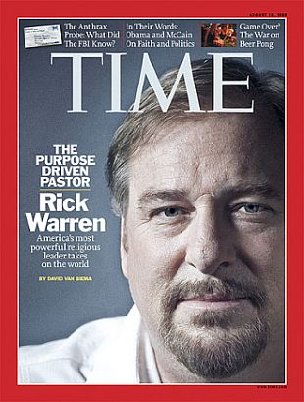
“Every church leader chooses how he/she will lead a flock:
as a risk taker,
as a caretaker, or
as an undertaker while it slowly dies.”
(Source: Warren, R. [@RickWarren]. (2013, November 11). Every pastor chooses how he will lead a flock: As a risk taker, as a caretaker, or as an undertaker while it slowly dies. [Tweet].)
Notes:
One of the most profound and challenging comments for church leaders was offered by the highly successful pastor of the Saddleback mega-church (Warren, 2013). [SPEAKERS NOTE: READ QUOTE].
While we understand we do not have authority to take risks or make changes to the timeless Orthodox theology handed down to us by the Apostles from Christ, the operational side of the church house must constantly be re-examined, improved, and changed AS NECESSARY to meet the needs of a diverse and growing community.

Slide 14
What would you do if you weren’t afraid?
Notes:
All this talk of change leads to the profound question of what would you do if you weren't afraid?
Everyone is afraid of something. You offered some of your biggest fears in the ice breaker. But there are more things that frighten you and keep you moored to the dock rather than sailing toward the horizon.
As a group, we need to help each other overcome our individual and collective fears so that we may more creatively imagine a powerful future untethered by fear.
To see through the forest to the clearing on the other side will take courage, leadership, and a committed and unified team. And in this moment, and at this place, God has chosen YOU to lead this journey!

Slide 15
“The best way to predict the future is to create it.”
(Source: Drucker, P. F. (2004). The daily Drucker: 366 days of insight and motivation for getting the right things done.)
Notes:
Attributed, alternatively to either noted business guru Peter Drucker (Drucker, 2004) or President Abraham Lincoln (with no source ever identified), “the best way to predict the future is to create it.”
This powerful and hopeful sentiment is one of encouragement that humbly and prayerfully encourages us that through the processes of being “Future Smart” (Canton, 2015) and the techniques of strategic foresight, we can help shape the desired future for ourselves, our parishioners, and Sts. RNI. The processes we learn and use today are some of the many tools we have at our disposal to build the futures our parishioners want and need.

Slide 16
(Source: New King James Version. (1982). Proverbs 29:18.)
Notes:
The courage we need as leaders of a parish is promised to us by our Lord and Saviour who challenged us to understand that unless we lead the Parish with vison, the consequences to the PIPs (parishioners on pews) and Sts. RNI can be suboptimal or downright dismal. (New King James Version, 1982, Proverbs 29:18).

Slide 17
What Does The Future Look Like?
(Source: Christensen, C. (2014). The importance of religion. [Video]. YouTube.)
Notes:
But what happens if we do not apply strategic foresight and become future smart? While clearly our parish will suffer, there is more at stake.
Dr. Clayton Christensen was one of the most famous and dynamic professors at Harvard Business School until his untimely passing a few years ago from cancer. He developed the “Disruptive Innovation” and “Jobs To Be Done” theories that revolutionized business thinking in our times (Christensen, 2016a; Christensen, 2016b).
But he was also a Godly man and devoted member of the Church of Jesus Christ of Later Day Saints. He constantly preached that religion played not only a critical role for the obvious theological reasons, but there was also a strategic foresight critical role religion played regarding one of the most important and cherished elements of our American society.
Let’s watch the video and think about the future he presents unless we do a better job with our work today.

Slide 18
Notes:
[ PRESENTER’S NOT: CLICK ON PLAY BUTTON FOR VIDEO]
Christensen, C. (2014). The importance of religion. [Video]. YouTube. https://www.youtube.com/watch?v=YjntXYDPw44

Slide 19
Strategic foresight is about
1. ANTICIPATING, mapping, and creating desired futures.
2. FRAMING objectives by scanning information to forecast alternative future visions.
3. SHAPING the future through plans to achieve the desired results.
(Sources: Canton, J. (2015). Future smart: Managing the game-changing trends that will transform your world.; Hines, A. (2006). Strategic foresight: The state of the art.; Kouzes, J. & Posner, B. (2017). The leadership challenge: How to make extraordinary things happen in organizations.; Slaughter, R. A. (1993). Futures concepts.)
Notes:
1. So how do we do this critical work? “Future smart” is a process of anticipating, mapping, and harnessing the unimagined by examining and extrapolating trends to predict the future (Canton, 2015).
2. Humans are capable of imagining the future but are usually motivated by curiosity, fear, or need (Slaughter, 1993). This is a unique opportunity for you as leaders to facilitate processes that imagine a better future for Sts. RNI and all its parishioners (Kouzes & Posner, 2017).
3. There are six future smart steps moving from “framing” objectives through “scanning” information to “forecasting” alternatives and determining a “vision,” “plan,” and “actions” to implement the desired future state (Hines, 2006, p. 18). We will begin by scanning the horizon and exploring a potential future smart opportunity for Sts. RNI.

Slide 20
Strategic foresight to become future smart moves us from internal comfort zones to external dimensions of unpredictable and limitless future possibilities.
(Sources: Benavides-Rincón, G., & Díaz-Domínguez, A. (2022). Assessing futures literacy as an academic competence for the deployment of foresight competencies.; Miller, R. (2007). Futures literacy: A hybrid strategic scenario method.; Slaughter, R. A. (1993). Futures concepts.)
Notes:
1. An early academic article about being future smart defined futures literacy as “the capacity to explore the potential of the present to give rise to the future” focusing on greater awareness of situations and the impacts of change over time (Miller, 2007, p. 347).
2. Becoming future smart is challenging because of the various approaches to achieving it juxtaposed against urgent needs, divergent cultural backgrounds, and the differing desires of diverse people and organizations. This leads to the need for a “futures literacy framework” that focuses on individuals being cognizant and conscious about the future and examining different assumptions and paths that vary depending on present desires and intentions (Benavides-Rincón & Díaz-Domínguez, 2022, p. 3).
3. While the future cannot be perfectly predicted accurately, the discipline of future smart studies focuses on providing examination, exploration, and mapping to partake in creating a desired future (Slaughter, 1993, p. 372).
4. This requires us to seek possible alternatives by “developing and interpreting stories about possible, probable and desirable futures” (Miller, 2007, p. 347).

Slide 21
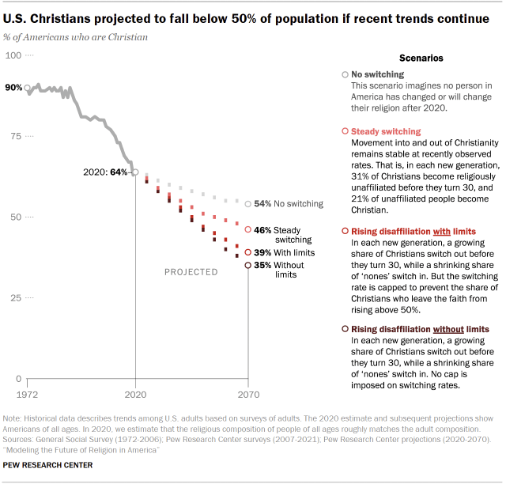
Horizon scanning systematically researches trends, threats, and opportunities on the horizon that might shape the future.
(Sources: Big Bang Partnership. (2023, November 2). Horizon scanning & foresight toolkit for innovators. [Video]. YouTube.; Cheah, S. L.-Y. (2020). Strategic foresight: Accelerating technological change.; Cuhls, K. E. (2020). Horizon scanning in foresight – Why horizon scanning is only a part of the game.; Pew Research Center. (2022). Modeling the future of religion in America: If recent trends in religious switching continue, Christians could make up less than half of the U.S. population within a few decades.)
Notes:
1. Scanning the horizon involves intentional and systematic research of relevant trends and the threats/opportunities that could impact an organization’s ability to achieve its objectives (Cheah, 2020).
2. Horizon scanning begins a process of looking to the future to identify possible events and results that can serve as a first step in creating strategies (Cuhls, 2020).
3. For example, The Pew Research Center calculated that if current religious trends continue, in less than 50 years, Christians will be in the minority in the United States (Pew Research Center, 2022).
4. Horizon scanning is described in a straightforward video as a “systematic process of gathering information to identify future risks, opportunities, and developments” (Big Bang Partnership, 2023).
[SPEAKERS NOTE: IF TIME PERMITS, Click on the URL below to learn more about horizon scanning beginning at the 4:30 mark of the YouTube video (Big Bang Partnership, 2023).]
https://www.google.com/search?q=futures+wheel&client=firefox-b-1-d&sca_esv=597665655&tbm=vid&ei=UoSgZcrJJY7b5NoP_I6_0As&start =10&sa=N&ved= 2ahUKEwjKutbYyNaDAxWOLVkFHXzHD7oQ8tMDegQIBBAE&biw=1728&bih=788&dpr=1.11#fpstate=ive&vld=cid:7eb0c832,vid:31iwzGVy10s,st:0)

Slide 22
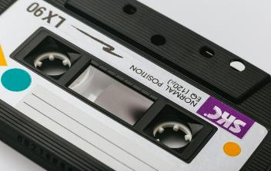
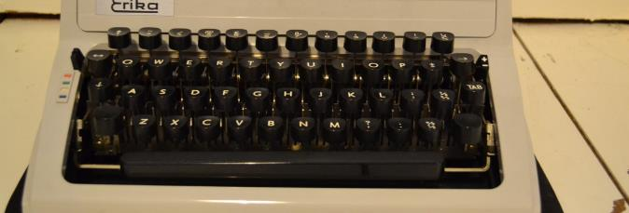
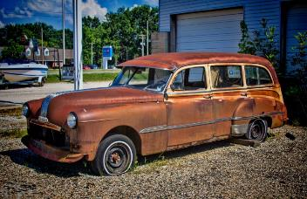
What Happens If An Organization Doesn’t Develop Strategic Foresight Skills
Notes:
So, what are some examples to which we can all relate of organizations that may not have practiced future smart strategic foresight?
Do you recognize any of these items in the pictures before you (that many of you may still have in your garages, attics or basements)? Do you have any idea what replaced them because they were not future smart?

Slide 23
Things Disrupted/Replaced By The iPhone
Television
Radio
Camera
Turntable
Cassette tape
Projector
CD player
MP3 players
Boombox
Jukebox
Metronome
Guitar tuner
Cards
Board games
Handheld games
Arcades
VCR
DVD Player
Travel Books
Watch
Clock
Alarm
Calendar
Organizer
Pedometer
Car/House/Hotel key
Landline
Answering machine
Pay phone
Beepers/pagers
Phone books
Books
Dictionary
Thesaurus
Encyclopedia
Newspaper
Atlas
e-Reader
Computer
Notepad
Sticky notes
Photo Albums
Light meter
Level
Compass
Stud finder
Calculator
Pens
Letters
Greeting cards
Sketchbook Address book Diary
Coupons
Owner’s manual
Scanner
Fax
GPS
Mirror
Magnifying glass
Measuring tape
Walkie Talkie
Light switch Dictation machine
Mouse
Flash Drive
Credit Card machine
Banking
Thermometer
Transit pass
Gift cards
Credit Cards
Rolodex
Business Card
Barcode Scanner
Language guides
Divine Liturgy Books
Source: Freeman, K. S. (2022, October 25). 101 things your iPhone has replaced.
Notes:
Take a moment and look down this partial list of the 101 products, services, machines, and technologies that the one iPhone replaced (Freeman, 2022).
Now let’s think about one more. The Orthodox services books in the pews have been replaced by the Digital Chant Stand app on your iPhone. So next time you see someone looking at their phone or iPad in church, don’t be so quick to judge them.
Freeman, K.S. (2022, October 25). 101 things your iPhone has replaced. iMore. https://www.imore.com/iphone/things-iphone-replaced. https://www.imore.com/iphone/things-iphone-replaced

Slide 24
Notes:
I bet some of you are thinking this right now.

Slide 25
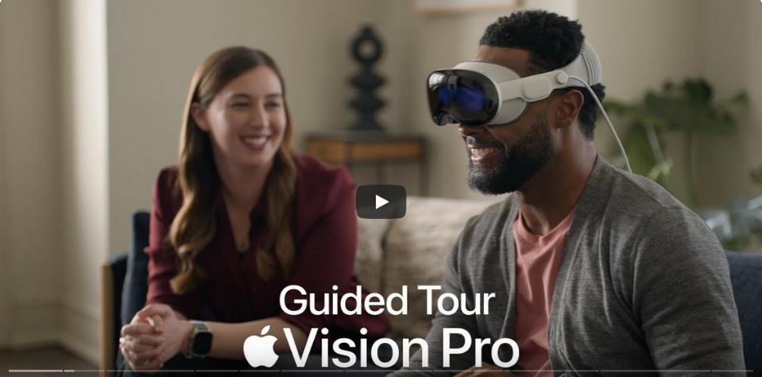
https://www.youtube.com/watch?v=Vb0dG-2huJE
HORIZON SCANNING: Say goodbye to movie theatres, live streamed church services, computers, Zoom, offices, museums, foreign travel, school buildings, B2B selling, and interpersonal interaction.
Introducing the next Future Smart Disruptive Innovation.
https://www.youtube.com/watch?v=TX9qSaGXFyg&list=PPSV
(Source: Apple. (2024). A Guided tour of Apple Vision Pro.)
Notes:
But I’m just warming up. Now, I want to challenge you with a future smart technology example that was just publicly released yesterday (Apple, 2024).
I’m not sure how many of you watched the release video of the Apple Vision Pro and started to conceive of the changes that will happen to products, services, and whole industries because of this disruptive innovation.
The link on this slide will take you to a great explanation video of this disruptive innovation. For those who can stick around after the workshop, we’ll watch part of it together and start to dream how this breakthrough technology can be used by Sts. RNI or the Orthodox church and its ministries. This is just one more modern example of being future smart.

Slide 26
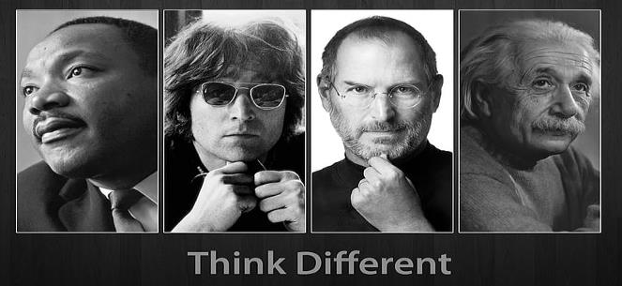
“Cars are just a fad”
(Horace Rackham, Michigan Savings Bank, 1903 – Henry Ford’s banker)
“Everything will be made of steel”
(Thomas Edison, 1911)
“Recorded music will destroy all musical ability”
John Philip Sousa, 1906, The menace of mechanical music.)
“Electricity is just a fad.”
(Junius Morgans advice to son J.P. Morgan)
“Telephonies will never catch on”
(William Orton, President of Western Union, 1876)
(Source: McKinley, J. (2021, August 3). 13 predictions about the future that were dead wrong.)
Notes:
And just to provide you some specific examples of famous people and companies who were not future smart, let’s take a trip down memory lane (McKinley, 2021).
[SPEAKERS NOTE: Read the quote and the source.]

Slide 27
“TVs aren’t really going to be a big thing.”
(Darryl Zanuck, 20th Century Fox , 1946)
“Remote shopping…will flop – because women like to get out of the house …”
(Time Magazine, The Futurists essay, 1966).
“Planes will fall from the skies, the electrical grid will crash, all computers and phones will stop working…”
(Y2K predictions January 1, 2000)
“There’s no chance that the iPhone is going to get any significant market share. No chance.”
(Steve Balmer, CEO of Microsoft, 2007)
(Source: McKinley, J. (2021, August 3). 13 predictions about the future that were dead wrong.)
Notes:
Here are some further examples of not so future smart people or companies (McKinley, 2021). [SPEAKERS NOTE: Read the quote and the source.]
Given the previous slide about the 101 technologies or products replaced by the iPhone, I find particularly funny the CEO of Microsoft, Steve Balmer, who so confidently stated “There’s no chance that the iPhone is going to get any significant market share. No chance!” (Steve Balmer, CEO of Microsoft, 2007).
3. Swing and a miss!

Slide 28
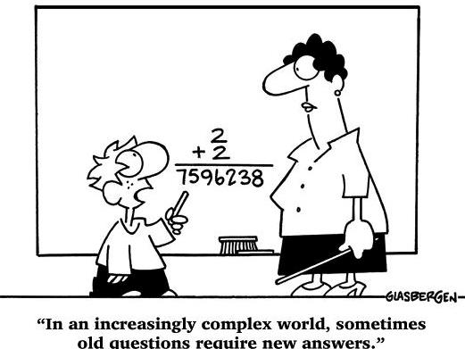
(Source: Glasbergen, R. (2005). Education cartoons.)
Notes:
I know sometimes we futurists often feel like this young lad when speaking to the laggards (Glasbergen, 2005). There is a fine line between genius and craziness.

Slide 29
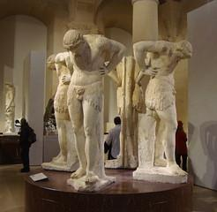
You miss the future on the external horizon (and the world around you) when you only look internally and contemplate your navel.
Ancient Navel Concentration
Modern Navel Concentration
Notes:
But interestingly throughout the centuries to the present people have been obsessed with the here and now as they proverbially contemplated their navels (or only what was immediately in front of their eyes) as they missed the bigger picture of trends going on around them that would lead the world (or their lives) in an entirely different direction. Today, we look up from the internal and cast our view to the external and future and discern how it will affect us and how we might shape it.

Slide 30
So, how will we
…of 2 of our 3 Sts. RNI biggest identified weaknesses simultaneously?
Leadership & Buildings
Notes:
Today, we tackle the two big issues raised in the strategic planning SWOT Analysis and focus simultaneously on a future smart leadership challenge of dealing with our buildings and facilities (Sts. RNI Strategic Plan, n.d.).

Slide 31
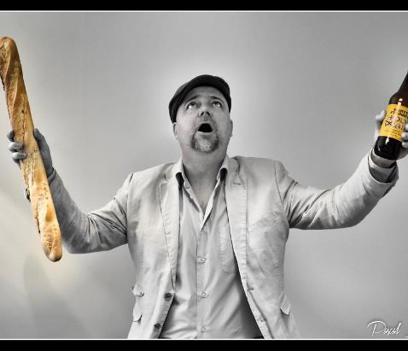
Whose Great Idea Was It To:
~ put peanut butter in chocolate
~ put cream cheese on a bagel
~ add a camera to a phone
Introducing a steeple on a wheel…
Notes:
Let’s get ready for something new and different just like the first person that put peanut butter inside chocolate, or cream cheese on a bagel, or added a phone to a camera.

Slide 32
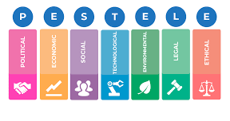
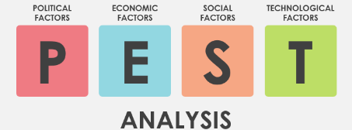
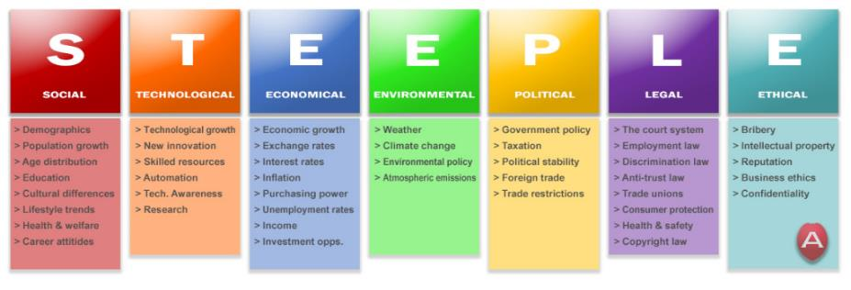
“A Rose By Any Other Name” (Shakespeare, W. (1597). Romeo and Juliet.)
2
1
¹ Professional Academy. (n.d.). Marketing theories – PESTEL Analysis.
² Visual Paradigms. (n.d.). What is PEST analysis?
3
³ Stephens, L. (2021, October 25). STEEPLE analysis outline for an organization.BUD Leaders Online Community.
Notes:
A variety of future smart template tools have been created with which you might be familiar. While the acronyms are slightly different, the concepts are similar. The focus is to identify the future issues and consequences in discrete areas that require thoughtful analysis.
Three examples of these types of models include P.E.S.T. (Visual Paradigms, n.d.), P.E.S.T.L.E. (Professional Academy, n.d.), and the version we will use today called S.T.E.E.P.L.E. (Stephens, 2021).

Slide 33
WHY
~ What if you had a strategic tool to help you imagine future possibilities organized the areas of most significance?
~ How can you expand your perspectives in many helpful and useful ways?
~ What are the most critical external topical areas you should consider?
~ S.T.E.E.P.L.E. is P.E.S.T.L.E. with the “Ethical” factors added
(Source: Richardson, V. (2020a, 2020b, 2023c). Strategic Foresight: Parts 1, 2 and 3 introduction to Strategic Foresight.)
Notes:
Here are questions to ask ourselves as we contemplate how we might shape the future (Richardson, 2020a.; Richardson, 2020b.; Richardson, 2020c.).
And for those of you more familiar with P.E.S.T.L.E., S.T.E.E.P.L.E. causes us to also look at “Ethical” considerations (Richardson, 2020a.; Richardson, 2020b.; Richardson, 2020c.).

Slide 34
Scan the Horizon and Look At Factors, Issues, Trends
Social (cultural, demographic, population growth, lifestyle...)
Technological (innovations, automation, skilled resources…)
Economical (economy, inflation, interest rates, credit access…)
Environmental (use consumption, weather, waste, resources…)
Political (governmental policy, political stability, economy, tax policy…)
Legal (zoning, courts, health & safety, discrimination, equal opportunity…)
Ethical (trust, reputation, business ethics, morals, confidentiality…)
(Source: Stephens, L. (2021). STEEPLE analysis outline for an organization.)
Notes:
Let’s unpack the S.T.E.E.P.L.E. model a little to see what each of the acronyms letter askes us to explore in greater depth (Stephens, 2021).
[SPEAKERS NOTE: READ THROUGH THE EXAMPLES OF EACH ITEM IN THE ACRONYM AND ASK IF EVERYONE UNDERSTANDS.]

Slide 35
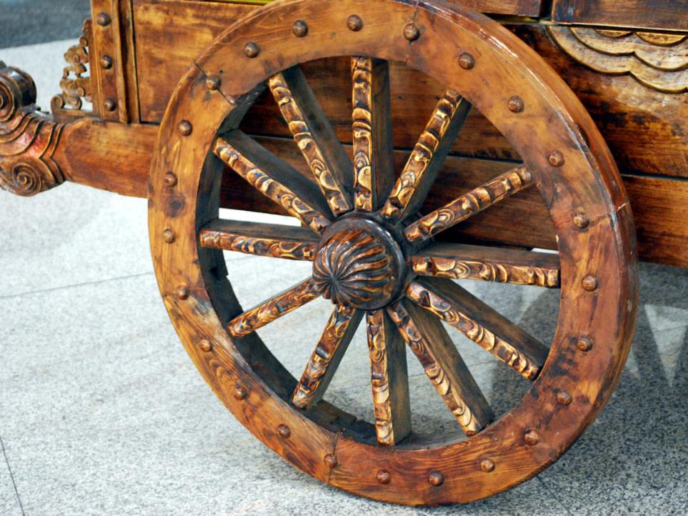
Let’s Not Reinvent The Wheel
Notes:
But having a tool without a vehicle to put it on may not lead anywhere. So, let’s not reinvent the wheel but instead take a ride on the Futures Wheel.

Slide 36
The FUTURE: Seen Through The Lens of a Futures Wheel
Organize thoughts about the future of an event (or trend) through brainstorming
A method to think about future implications of current issues things and how they are related
Separate immediate primary impacts (1st Order), from secondary impacts (2nd Order) from tertiary impacts (3rd Order), etc.
(Sources: Glenn, J. C. (2009). The futures wheel. Futures research methodology.; Glenn, J. C. & Gordon T.J. (Eds.). (2009). Futures research methodology-version 3-0.)
Notes:
Initially, there are three critical elements of a Futures Wheel worth understanding (Glenn, 1972).
Imagine a process to organize your thoughts about the future and their implications and interrelationships as you separate the causal impacts of each possible outcome (Glenn, 1972).

Slide 37
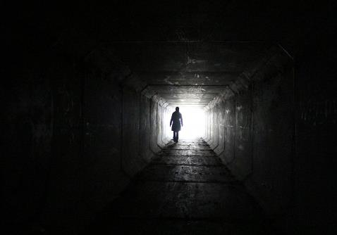
Futures Wheel Benefits
A proven process to rationally consider the future
Reorients from the rearview mirror to the horizon
Group collaboration fosters creativity
Exposes what we don’t know that could hurt or impact us
Projects trends into the future
Starts to prepares us for an uncertain future
(Source: Richardson, V. (2020a, 2020b, 2023c). Strategic Foresight: Parts 1, 2 and 3 introduction to Strategic Foresight.)
Notes:
Here are six specific advantages of using the Futures Wheel methodology (Richardson, 2020a; Richardson, 2020b; Richardson 2023c).
[SPEAKERS NOTE: READ EACH ITEM AS YOU CLICK THROUGH AND BUILD THE SLIDE.]

Slide 38
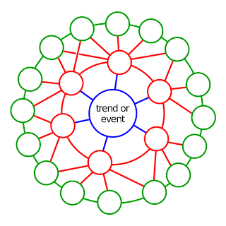
A Glimpse Into The FUTUREs Wheel?
A trend or event is the driver of change in the center (the “Domain”) and lights the fuse to the future (blue circle)
2
2
2
The initial “1st Order Impacts” are the possible corresponding results or consequences of the Domain event (red circles)
The secondary “2nd Order Impacts” are the results or consequences from the 1st Order Impacts (green circles)
2
2
1
2
1
2
1
2
2
1
1
2
2
1
2
2
2
2
2
Sources: Richardson, V. (2020a, 2020b, 2023c). Strategic Foresight: Parts 1, 2 and 3 introduction to Strategic Foresight.)
Notes:
1. A picture of a perfect Futures wheel (which doesn’t exist) shows there is a central issue or decision called the Domain (Richardson, 2020a; Richardson, 2020b; Richardson 2023c).
2. We will first explore the 1st order impacts or consequences that can immediately result if the domain occurs. We next focus on 2nd order impacts and consequences that arise because of the 1st order impacts (Richardson, 2020a; Richardson, 2020b; Richardson 2023c).

Slide 39
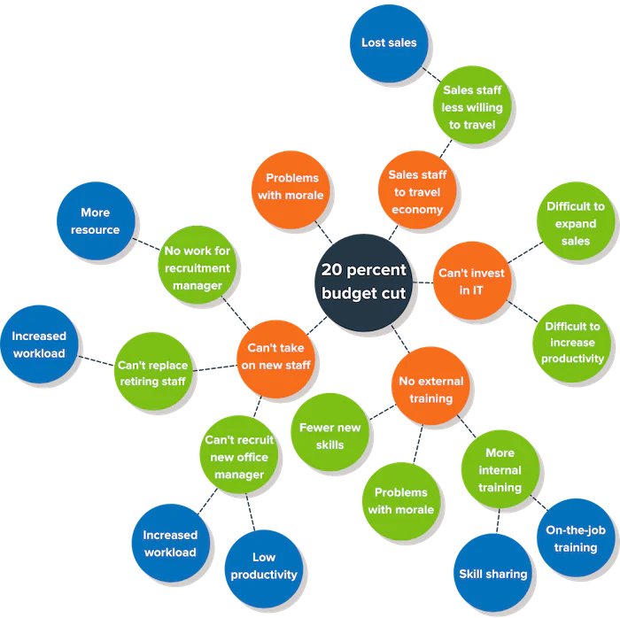
EXAMPLE The Real FUTURE Is Never As Linear
(Source: Mind Tools. (2024).The futures wheel: Identifying consequences of a change.)
Notes:
Here’s an example of a completed futures wheel that shows you how unilinear it can appear (Mind Tools, 2024).

Slide 40
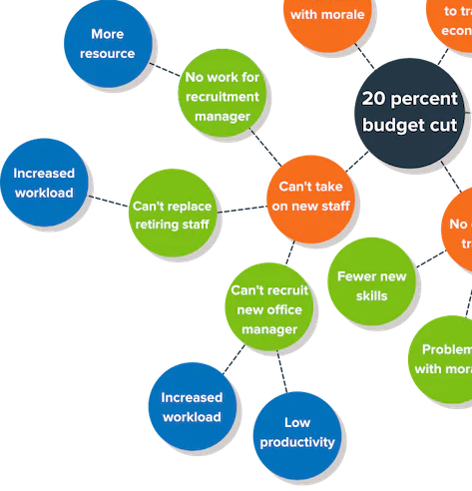
Specific Example
3rd Order
2nd Order
Domain
1ST Order
(Source: Mind Tools. (2024).The futures wheel: Identifying consequences of a change.)
Notes:
So, let’s click our way through exploring just one 1st level impact of a 20% budget cut, and the corresponding 2nd level 3rd level impacts (Mind Tools, 2024).
[SPEAKERS NOTE: THIS SLIDE REQUIRES THREE CLICKS TO SUCCESSIVELY REVEAL THE 1st, 2nd and 3rd ORDER IMPACTS.]

Slide 41
The S.T.E.E.P.L.E. + Futures Wheel
DOMAIN
Social
Environ-mental
Political
Ethical
Technical
Economic
Legal
Notes:
Ultimately, here is a graphic representation of how a S.T.E.E.P.L.E analysis template can fit around a Domain in a Futures Wheel analysis.

Slide 42
Rules Of Engagement
ROEs
Notes:
And now for a few ground rules about our discussions.

Slide 43
1. I will keep us on schedule
2. Everyone is equal
3. We’ll interact confidentially
4. Ask questions if confused about instructions not brainstormed ideas
5. We’ll park tangential discussions
6. No distractions (phones/watches off)
7. Everyone should participate
8. Be honest, not defensive, NO spin or discussion killers
9. Think creatively and outside the box and follow “Brainstorming Rules”
10. Share things you‘re hearing or thinking about that aren’t your opinion – you’re brainstorming not advocating
The 12 Commandments
12. We:
(a) are members of the Body of Christ and
(b) will treat everyone with love and respect (c) will allow the Holy Spirit to participate freely
(d) embrace Sts. RNI WHY:
To welcome all on a transformational journey to a life of purpose and salvation.
(Source: Stewardship Calling. (n.d.). Church Strategic Planning.)
Notes:
You may remember the 15 Stewardship Calling Rules of Engagement (ROEs) we used during the Sts. RNI strategic planning process (Sts. RNI Strategic Plan, n.d.; Stewardship Calling, n.d.).
Let’s review a slightly shortened list of 12 ROEs we will use for this workshop.
Now that I have reminded you of our Rules of Engagement for the rest of this workshop, is there anyone who can’t live with any ROE? Speak now or forever hold your peace as you will be bound by them as we proceed.

Slide 44
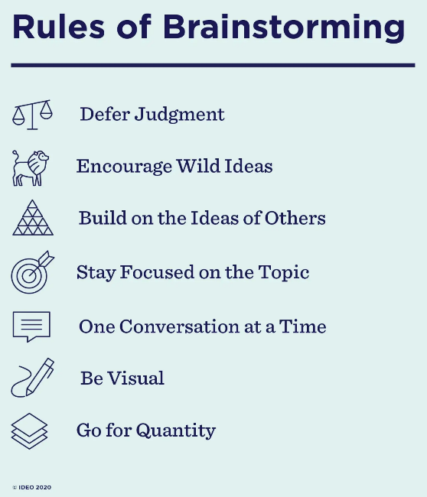
Judgment-free zone – no commentary
Little difference between brilliant and outrageous – think outside the box
Use “and” instead of “but” to encourage positivity
See: ROE 5 - The Domain is the topic
See: ROE 6 - No Greek verbal multitasking or κουτσομπολεύω
We will use technology, flipcharts, etc.
We want the most ideas possible
(Source: IDEOU. (2020). 7 simple rules of brainstorming.)
Notes:
To review and expand on ROE #9 regarding our brainstorming rules, let’s read through each of these elements of great brainstorming (IDEO, 2020).
Are there any questions, and can everyone abide by these rules?

Slide 45
To Learn Future Smart Skills, Let’s Simultaneously Tackle Two Top Identified Weaknesses/Challenge
#1 Facilities/Building Campaign
#3 Parish Council Leadership
(Source: Sts. RNI Strategic Plan. (n.d.). Strategic plan of Saints Raphael, Nicholas & Irene Greek Orthodox Church.)
Notes:
OK I refresh your memory of the first and third biggest Weaknesses identified in the Sts. RNI strategic plan SWOT analysis (Sts. RNI Strategic Plan, n.d.).

Slide 46
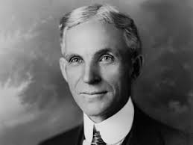
“If you keep doing what you’ve always done, you’ll keep getting
what you’ve always got.”
Henry Ford
(Source: Quote Investigator. (2016, April). If you always do what you’ve always done, you always get what you’ve always gotten.)
Notes:
And as we challenge ourselves to be future smart leaders, let’s remind ourselves of the prophetic words of Henry Ford so that we can overcome these weaknesses and imagine a future where we resolve them (Quote Investigator, 2016).

Slide 47
Process
INSTRUCTIONS – What Will We Do Next?
Our DOMAIN will be: “MOVING Sts. RNI”
(either buy and build on new property
or buy and retrofit an existing building)
We will “Brainstorm” several S.T.E.E.P.L.E. areas (a) 1st order direct consequences and effects
(b) 2nd order indirect consequences and effects
3. Discuss both direct and indirect implications and debrief what we learned
Notes:
The challenging Domain we will tackle is “Moving Sts. RNI.” This entails selling the current property and either buying and refurbishing an existing building, or buying raw land and building what we want with the proceeds from the sale of our current property.
We know that the original plan and building and capital campaign have stalled, and we are anywhere between $3.5 and $5 million short of the funds necessary to build the first phase of what is needed. So, let’s do what leaders do when Plan A is stalled and explore a Plan B by applying the S.T.E.E.P.L.E. analysis process to see what 1st, 2nd or 3rd order impacts might arise in each of the S.T.E.E.P.L.E. categories if we move Sts. RNI (Richardson, 2020a; Richardson, 2020b; Richardson 2023c).
Does anyone have any questions?
Let the brainstorming begin!

Slide 48
Social Analysis
1st Order
2nd Order
1. Excitement of something new
2. Fear of the change/unknown
3. Lose people who don’t want to change
4. Reattract people who left because of inaction
5. Potential disrespect to early parishioners who bought current property
6. How would this change be communicated, and a consensus of parish be achieved
Change emotions
1 Lose connections established in Forsyth county
2 Gain new connections somewhere else
3. Move to a location with better future opportunities
4. May lose current high visibility of our parish on Bethelview road
5. Potential farther/closer location to current parishioners
6. May move to a location with better future growth opportunities evangelization potential
7. Encourage/welcome more people to join/centralized location
8. Opportunity for more Greek Americans and/or more converts
Location impacts
1. How do our plans change as a result of moving
2. Ensure we have enough space to grow
3. What new ministries could add
4. Would we need more staff
Facilities impacts
Disruption Impacts
1. How long will it take to move(time necessary to evaluate/research - speed to results)
2. Where would we worship in meantime
3. Impact to existing ministries
New Parish Planting Impacts
1. How does this impact an additional mission church
2. Can we create a satellite orthodox parish
Notes:
[NOTE: These are the organized results of the brainstorming. The brainstormed ideas were immediately transcribed and not categorized as they were presented. After the workshop, the brainstormed ideas were organized into these 1st and 2nd order impacts.]

Slide 49
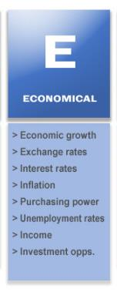
Economical Analysis
1st Order
2nd Order
Unknown economic impacts
1. What is the value of current property vs. another
2. Impact to Sts. RNI Greek festival
1. Change will drive success/movement in stalled capital campaign
2. new revenue streams potential from new location
3 Possibility of additional daycare or school
Positive economic benefits of new location
1 Costs implications of the move
2. Relocate parish priest home
3. Might need to buy more land in future
Negative economic impact of move
Notes:
[NOTE: These are the organized results of the brainstorming. The brainstormed ideas were immediately transcribed and not categorized as they were presented. After the workshop, the brainstormed ideas were organized into these 1st and 2nd order impacts.]

Slide 50
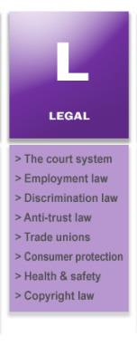
Legal Analysis
1st Order
1 Any rezoning that might be required of any new property purchased
1 Required Jurisdictional approvals required from the Metropolitan and Greek Orthodox Metropolis of Atlanta
Notes:
[NOTE: These are the organized results of the brainstorming. The brainstormed ideas were immediately transcribed and not categorized as they were presented. After the workshop, the brainstormed ideas were organized into these 1st order impacts.]

Slide 51
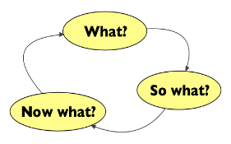
What did we learn about the move option?
Why is it important?
How can we use this information in the future?
What are some next steps?
What was your biggest takeaway?
(Sources: Richardson, V. (2020a, 2020b, 2023c). Strategic Foresight: Parts 1, 2 and 3 introduction to Strategic Foresight.)
Notes:
Any process worth its salt has a debrief session to step back and contemplate what we’ve done. So, lets’ take the time to answer these five questions (Richardson, 2020a; Richardson, 2020b; Richardson 2023c).
You can answer any question you want, but we will make sure we have at least some answers to each question.

Slide 52
People are open for discussion of alternatives
This process provides a sober assessment process to determine how to move forward and resist personality conflicts
There is not just one path for the parish to take
Other options should be explored and then a decision made
This a good exercise and should be used to periodically review this and other key decisions and issues
We need research and true costs before determining best decision
It is critical to define a good future for the parish
This process provides a good roadmap for pitfalls and evaluations
There are many (maybe overwhelming numbers of) options to do what we need to be done and some may be better options
Its time to get off the dime and get to a final decision
We all want a better parish future
(Source: Sts. RNI Parish Council. (2024). Answers to debriefing questions following future smart strategic foresight workshop.)
Notes:
[NOTE: These are the results of the answers to the debriefing questions provided by the workshop participants.]

Slide 53
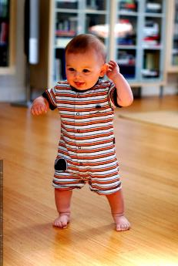
1. After Action Report follow- up from today 2. Share discussions with SP Building Implementation Team 3. Consider off-sight Leadership Retreat
NEXT STEPS
Notes:
As we wrap up our productive time together, here are some possible next steps we should discuss.

Slide 54
Today’s Last Step

Slide 55
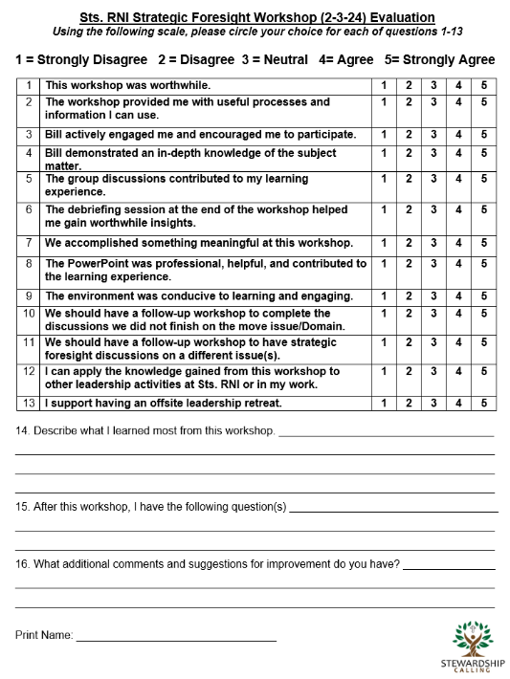
Next Steps For Success
to please complete the Evaluation Form now!
Notes:
1. Finally, we need everyone's input and evaluation of today's workshop so that we can assess how well we did and recalibrate what we need to change for the future.
2. Please take as long as you need to complete the survey you’ve been given and please be as honest as possible.

Slide 56
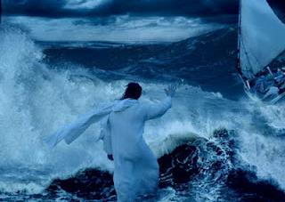
Fortune Favors The Bold…
Now, Lord, look on their threats, and grant to Your servants that with all boldness they may speak Your word!
Acts 4:29
(Source: New King James Version. (1982). Acts 4:29).
Notes:
After all this strategic work, it is always helpful to ground ourselves and end on an important spiritual note. And what better way then to understand that as we face the threats before us, we are admonished by the Lord to act with boldness as we work to bring people closer to Christ and each other and welcome all on a transformational journey to a life of purpose and salvation. (New King James Version, 1982, Acts 4:20; Sts. RNI Strategic plan, n.d.).
Thanks for your invaluable time, your active participation, and for all you do “To welcome all on a transformational journey to a life of purpose and salvation.”
Have a blessed day.

Slide 57
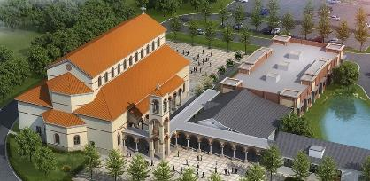
Saints Raphael, Nicholas & Irene Parish Council Strategic Foresight Leadership Workshop
“Where there is no vision, the people will perish”
Proverbs 29:18
Bill Marianes

Slide 58
References
Aguayo, R. (1991). Dr. Deming: The American who taught the Japanese about quality. Simon & Schuster.
Aguilar, F.J. (1967). Scanning the business environment. Macmillan.
Apple. (2024). A guided tour of Apple Vision Pro. Apple. [Video]. YouTube. https://www.youtube.com/watch?v=Vb0dG-2huJE
Benavides-Rincón, G., & Díaz-Domínguez, A. (2022). Assessing futures literacy as an academic competence for the deployment of foresight competencies. The Journal of Policy, Planning and Futures Studies, 135. 102872-. https://doi.org/10.1016/j.futures.2021.102872
Big Bang Partnership. (2023, November 2). Horizon scanning & foresight toolkit for innovators. [Video]. YouTube. https://www.google. com/search?q=futures+wheel&client=firefox-b-1-d&sca_esv= 597665655&tbm=vid&ei =UoSgZcrJJY7b5NoP _I6_0As&start =10&sa=N&ved= 2ahUKEwjKutbYyNaDAxWOLVk FHXzHD7oQ 8tMDegQIBBAE&biw=1728&bih=788&dpr=1.11 #fpstate=ive&vld=cid:7eb0c832,vid:31iwzGVy10s,st:0
Canton, J. (2015). Future smart: Managing the game-changing trends that will transform your world. Da Capo Press.
Cheah, S. L.-Y. (2020). Strategic foresight: Accelerating technological change. (S. Lai-Yin, Y. Cheah, Eds.). De Gruyter. https://doi.org/10.1515/9783110672916
Christensen, C. (2014). The importance of religion. [Video]. YouTube. https://www.youtube.com/watch?v=YjntXYDPw44
Christensen, C. (2016a). Competing against luck. Harper Business.
Christensen, C. (2016b). The innovator’s dilemma. Harvard Business Review Press.
Cuhls, K. E. (2020). Horizon scanning in foresight – Why horizon scanning is only a part of the game. Futures & Foresight Science, 2(1). https://doi.org/10.1002/ffo2.23
Deming, W. E. (2000). Out of the crisis. The MIT Press.
Drucker, P. (2004). The daily Drucker: 366 days of insight and motivation for getting the right things done. Harper Business.
Freeman, K.S. (2022, October 25). 101 things your iPhone has replaced. iMore. https://www.imore.com/iphone/things-iphone-replaced

Slide 59
References
Glasbergen, R. (2005). Education cartoons. [Cartoon]. https://www.glasbergen.com/
Glenn, J. C. (2009). The futures wheel. Futures research methodology—version, 3, 19.
Glenn, J. C., & Gordon, T. J. (Eds.). (2009). Futures research methodology-version 3-0. Editorial desconocida.
Hines, A. (2006). Strategic foresight: The state of the art. In The Futurist, 40(5), 18-24.
IDEO. (2020). 7 simple rules of brainstorming. [Infographic]. IDEO U. https://www.ideou .com/blogs/inspiration/7-simple-rules-of-brainstorming
Kouzes, J. & Posner, B. (2017). The leadership challenge: How to make extraordinary things happen in organizations. (6th ed.). John Wiley & Sons, Inc.
McKinley, J. (2021, August 3). 13 predictions about the future that were dead wrong. The Healthy. Retrieved February 5, 2024, from https://www.rd.com/list/predictions-that-were-wrong/
Miller, R. (2007). Futures literacy: A hybrid strategic scenario method. Futures, 39 (4), 341-362. 10.1016/j.futures.2006.12.001
Mind Tools. (2024, January 31). The futures wheel: Identifying consequences of a change. Retrieved February 5, 2024, from https://www.mindtools.com /a3w9aym /the-futures-wheel
New King James Version. (1982). Thomas Nelson.
Pew Research Center. (2015, May 12). America’s changing religious landscape. Retrieved February 5, 2024, from https://www.pewresearch.org/religion/ 2015/05/12/americas-changing-religious-landscape/
Pew Research Center. (2022, September 13). Modeling the future of religion in America: If recent trends in religious switching continue, Christians could make up less than half of the U.S. population within a few decades. Retrieved February 5, 2024, from https://www.pewresearch.org/ religion/2022/09/13/modeling-the-future-of-religion-in-america/
Plato. (2007). The republic. (D. Lee, Trans.). (2nd ed.).
Quote Investigator. (2016, April). If you always do what you’ve always done, you always get what you’ve always gotten. Retrieved February 5, 2024, from https://quoteinvestigator.com/2016/04/25/get/

Slide 60
References
Richardson, V. (2020a). Strategic Foresight: Part 1, introduction to Strategic Foresight [Video]. Regent University, School of Business and Leadership.
Richardson, V. (2020b). Strategic Foresight: Part 2, introduction to STEEPLE Analysis [Video]. Regent University, School of Business and Leadership.
Richardson, V. (2023c). Strategic Foresight: Part 3, Strategic Foresight Workshop [Video]. Regent University, School of Business and Leadership.
Slaughter, R. A. (1993). Futures concepts. The Journal of Policy, Planning and Futures Studies, 25(3), 289–314. https://doi.org /10.1016/0016-3287(93)90138-J
Stanley, A. [@AndyStanley]. (2021, August 19). Leaders who don't listen will eventually be surrounded by people who have nothing to say. [Tweet]. Twitter. https://twitter.com /AndyStanley/status/1428471840603885577?lang=en
Stephens, L. (2021, October 25). STEEPLE analysis outline for an organization. Retrieved February 5, 2024, from https://community.budleaders.org/activity /steeple-analysis-outline-for-an-organisation
Sts. RNI (n.d.) Sts. RNI S.W.O.T. Analysis. Retrieved February 5, 2024, from https://stewardshipcalling.com/saints-raphael-nicholas-irene-cumming-ga/
Sts. RNI Strategic Plan. (n.d.). Strategic plan of Saints Raphael, Nicholas & Irene Greek Orthodox Church. Retrieved February 5, 2024, from https://stewardship calling.com/saints-raphael-nicholas-irene-cumming-ga/
Sts. RNI Parish Council. (2024). Answers to debriefing questions following future smart strategic foresight workshop. Retrieved February 11, 2024, from https://stewardshipcalling.com/strategic-planning/
Stewardship Calling. (n.d.). Church Strategic Planning. Retrieved February 5, 2024, from https://stewardshipcalling.com/ strategic-planning/
Thompson, P. (1980). “Margaret Thatcher: a new illusion.” [pdf]. Perception, 9(4), 483–484. doi:10.1068/p090483.)
Wachowski, L. & Wachowski, L. (Directors). (1999). The matrix. [Film]. Warner Bros.
Warren, R. [@RickWarren]. (2013, November 11). Every pastor chooses how he will lead a flock: As a risk taker, as a caretaker, or as an undertaker while it slowly dies. [Tweet]. Twitter. https://twitter.com/rickwarren/status/ 400014337093685250

Slide 61
Appendix Unused S.T.E.E.P.L.E. Slides

Slide 62
Technological Analysis
1st Order
2nd Order
1
2
3
4
5
6
7
1
2
3
4
5
6
7
1
2
3
4
5
6
7
1
2
3
4
5
6
7
1
2
3
4
5
6
7
1
2
3
4
5
6
7

Slide 63
Environmental Analysis
1st Order
2nd Order
1
2
3
4
5
6
7
1
2
3
4
5
6
7
1
2
3
4
5
6
7
1
2
3
4
5
6
7
1
2
3
4
5
6
7
1
2
3
4
5
6
7

Slide 64
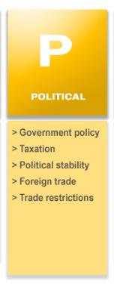
Political Analysis
1st Order
2nd Order
1
2
3
4
5
6
7
1
2
3
4
5
6
7
1
2
3
4
5
6
7
1
2
3
4
5
6
7
1
2
3
4
5
6
7
1
2
3
4
5
6
7

Slide 65
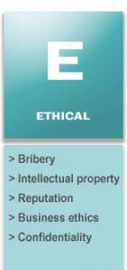
Ethical Analysis
1st Order
2nd Order
1
2
3
4
5
6
7
1
2
3
4
5
6
7
1
2
3
4
5
6
7
1
2
3
4
5
6
7
1
2
3
4
5
6
7
1
2
3
4
5
6
7

