Slide 1
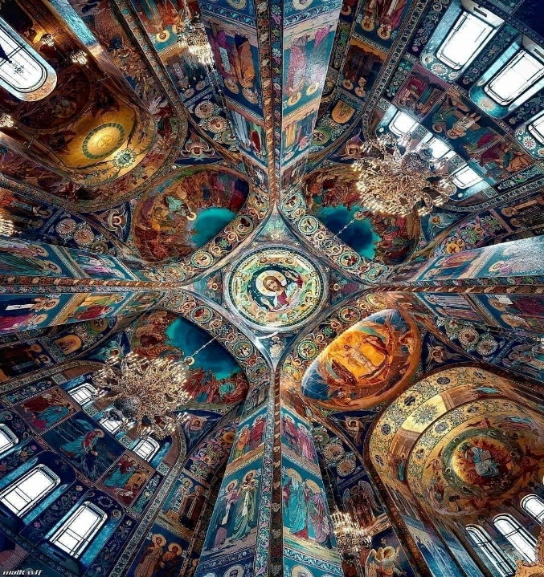
OIC
Oneness In Christ
Εἰς μίαν, ἁγίαν, καθολικὴν καὶ ἀποστολικὴν Ἐκκλησίαν
Bill Marianes
September 2024
Stewardship Calling

Slide 2
What if I told you that you will
Live Forever?

Slide 3
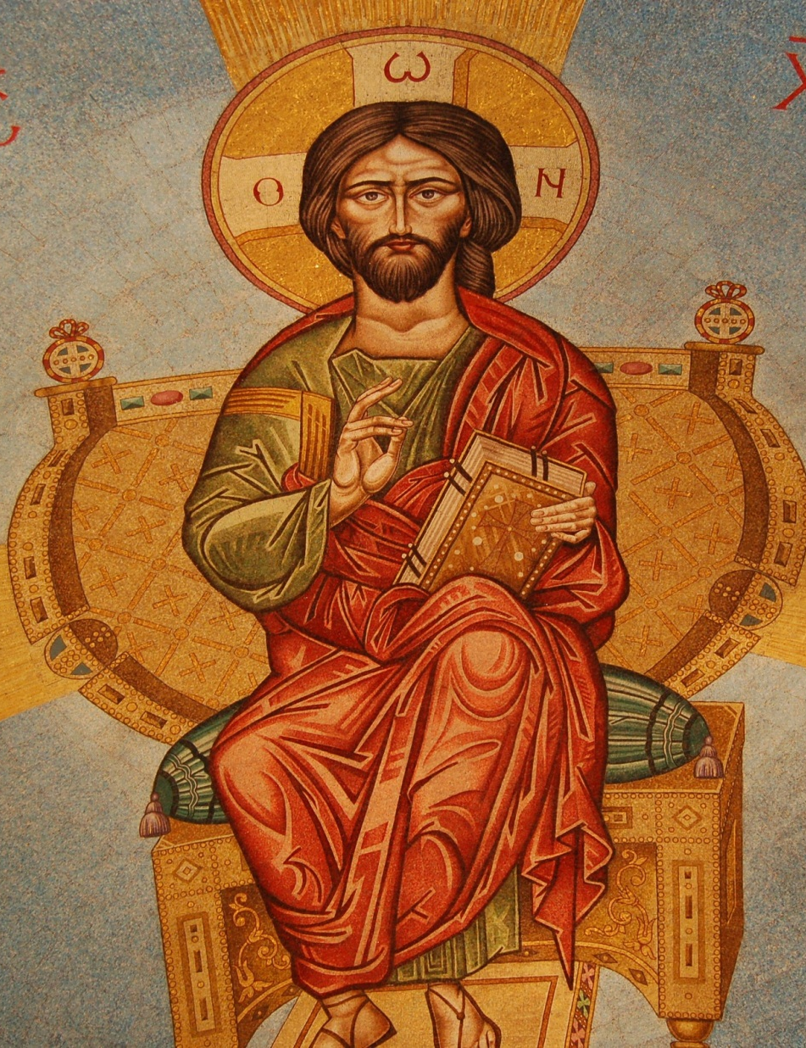
“That the end of our lives may be Christian, without pain, blameless and peaceful, and for a
good account before the awesome judgment seat of Christ.”
II Corinthians 5:10
Orthodox Divine Liturgy

Slide 4
Today’s Roadmap
Why Is This Important
Origins of Oneness In Christ (OIC)
3. The Current Facts
4. One OIC Roadmap
5. Your Calling

Slide 5
Please return your seat backs to the locked and upright position

Slide 6
Today’s Roadmap
Why Is This Important
Origins of Oneness In Christ (OIC)
3. The Current Facts
4. One OIC Roadmap
5. Your Calling

Slide 7
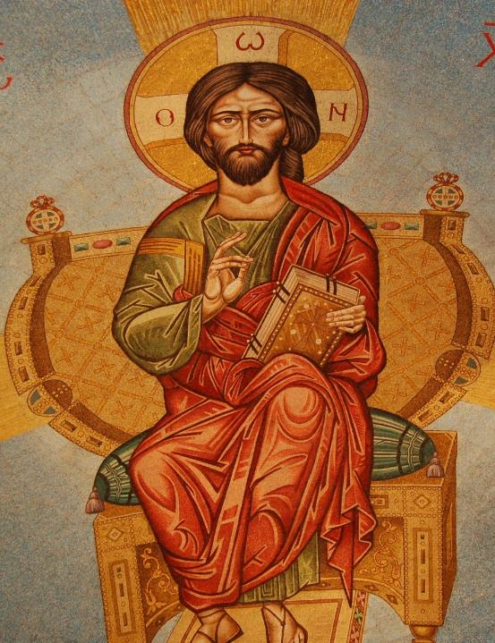
“…good account before the awesome judgment seat of Christ.”
II Corinthians 5:10
Orthodox Divine Liturgy

Slide 8
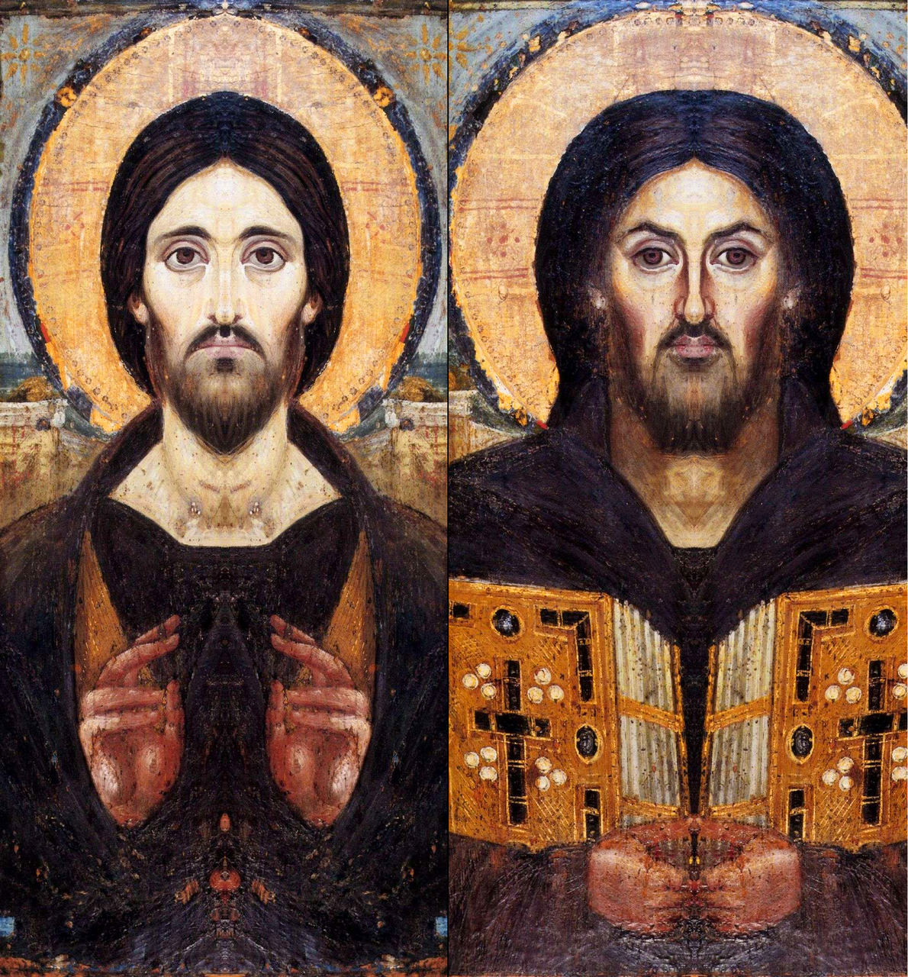
Christ’s possible very difficult question

Slide 9
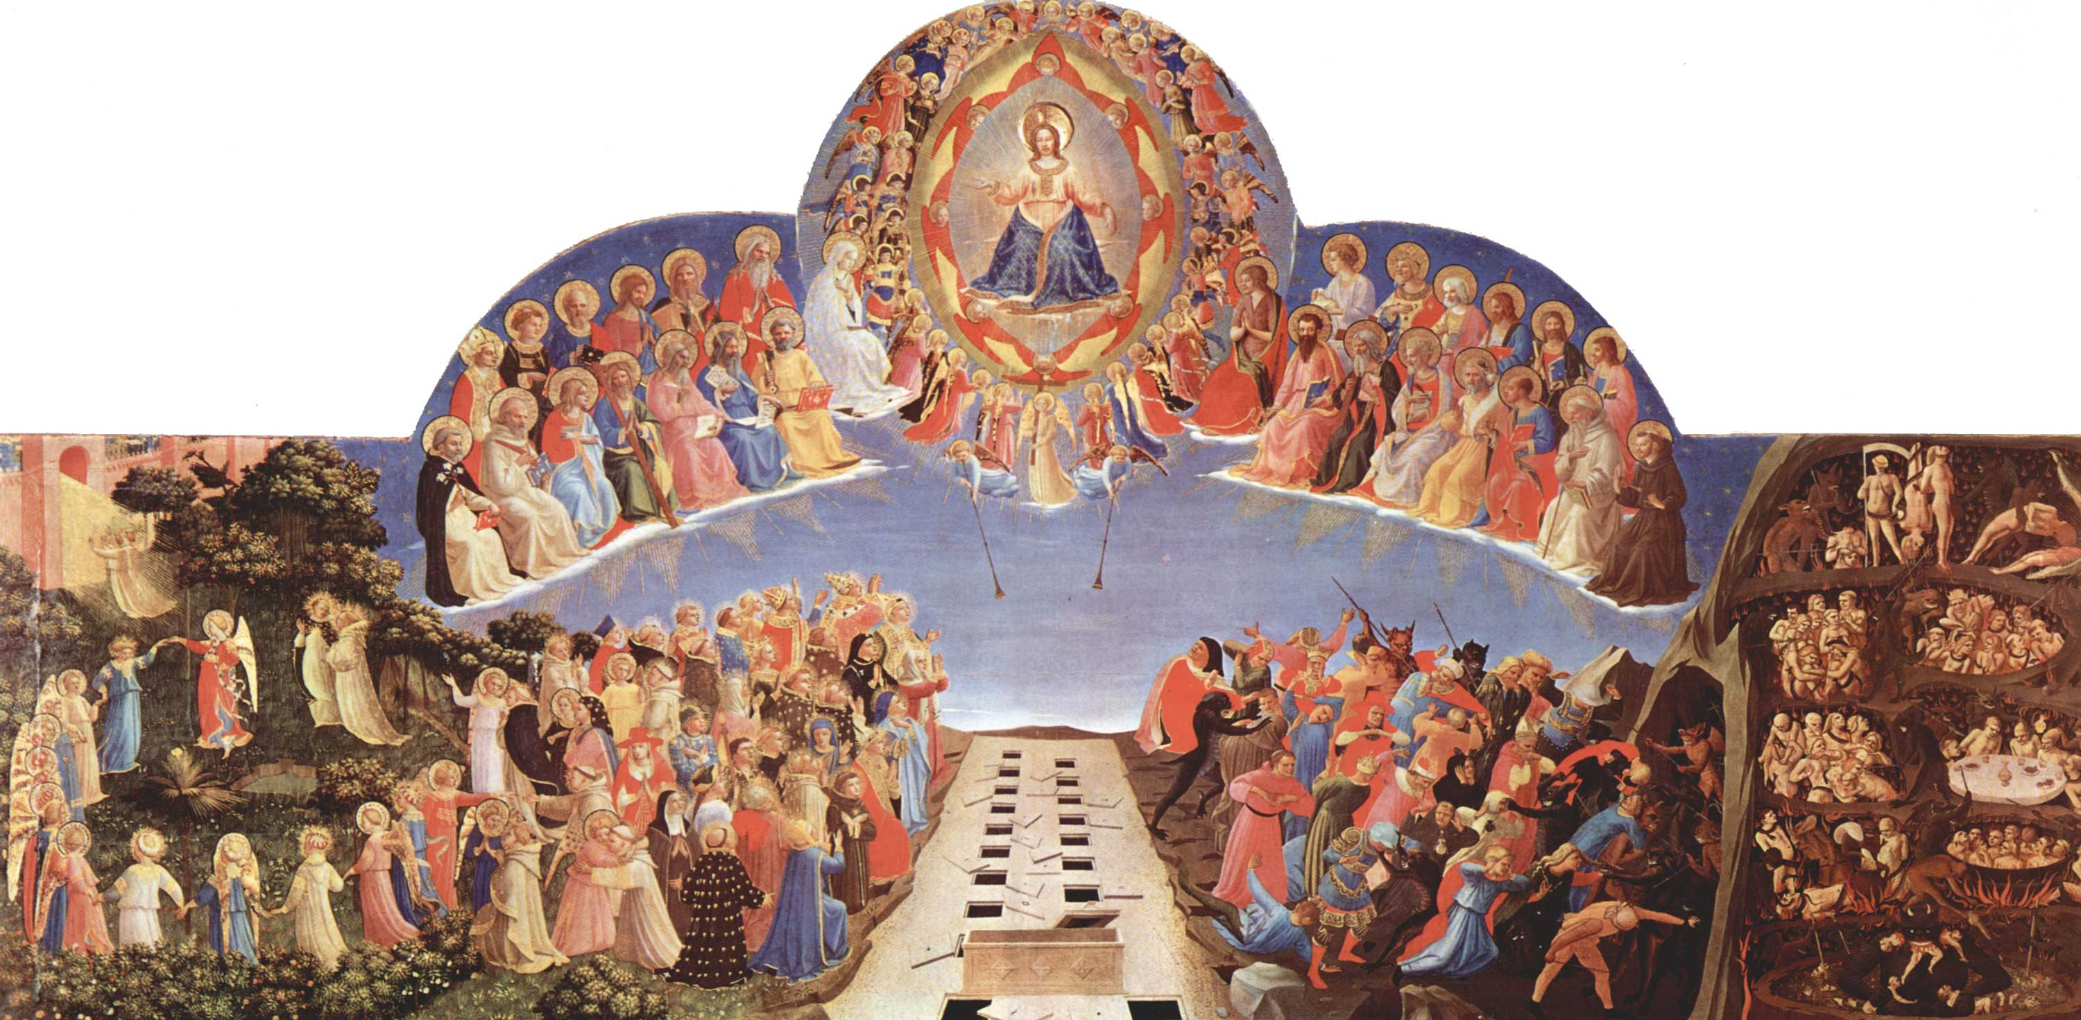
What did you do,
for My church and My people,
under your watch,
given all of the gifts I gave you ?

Slide 10
Today’s Roadmap
Why Is This Important
Origins of Oneness In Christ (OIC)
3. The Current Facts
4. One OIC Roadmap
5. Your Calling

Slide 11
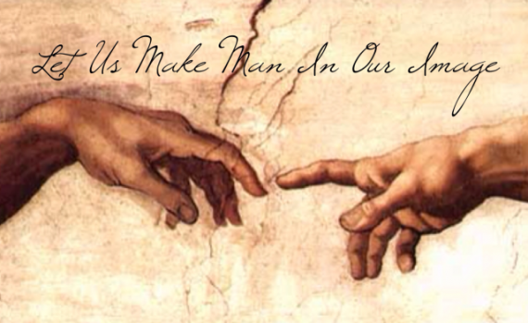
OIC – Part 1
“Let us make mankind in our image, in our likeness”
(Genesis 1:26 NIV)

Slide 12
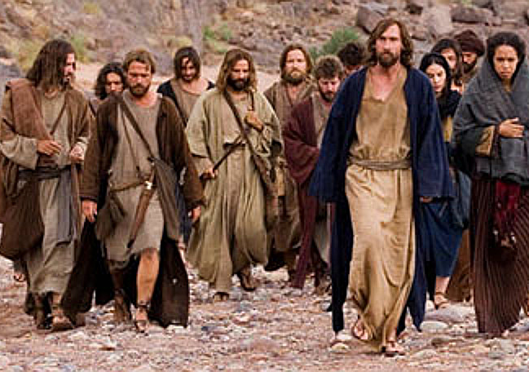
OIC – Part 2
“Therefore, go and make disciples of all nations, baptizing them in the name of the
Father and of the Son and of the
Holy Spirit.”
(Matthew 28:19 NIV)

Slide 13
OIC – Part 3
“I appeal to you, brothers and sisters, in the name of our Lord Jesus Christ, that all of you agree with one another in what you say and that there be no divisions among you, but that you be perfectly united in mind and thought.
(1 Corinthians 1:10 NIV)

Slide 14
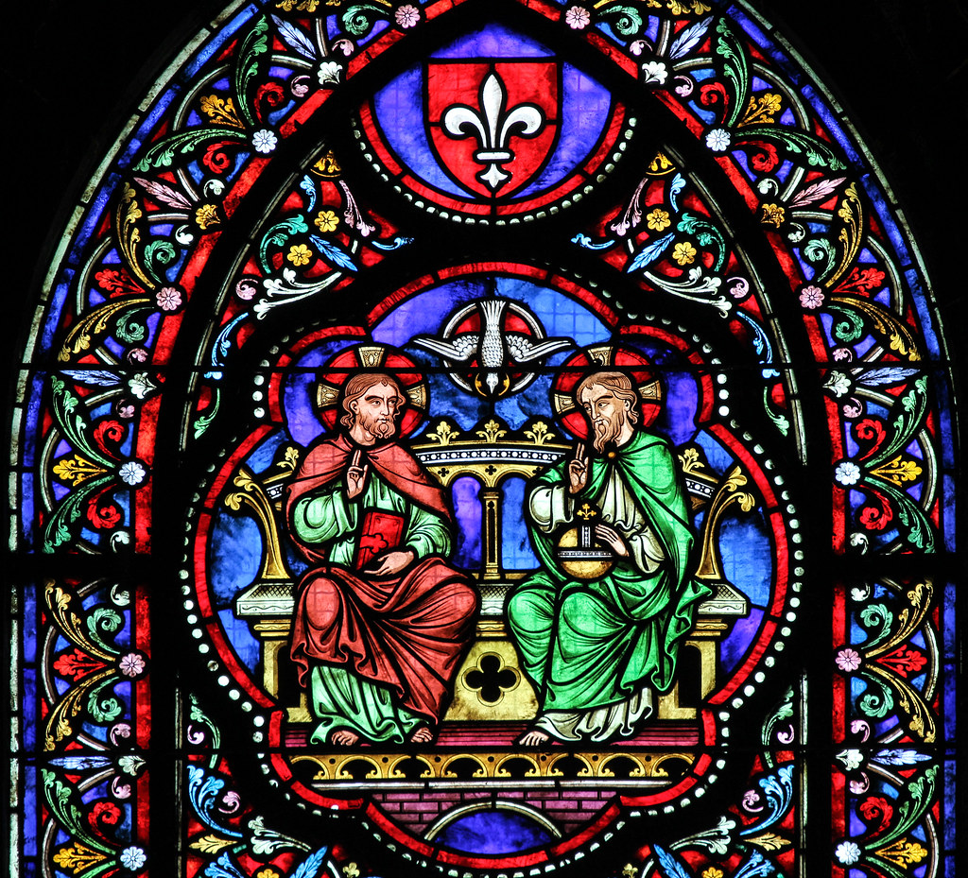
OIC – Part 4
“I pray also for those who will believe in me through their message, that all of them may be one, Father, just as you are in me and I am in you.
I have given them the glory that you gave me, that they may be one as we are one”
(John 17:20,22 NIV)

Slide 15
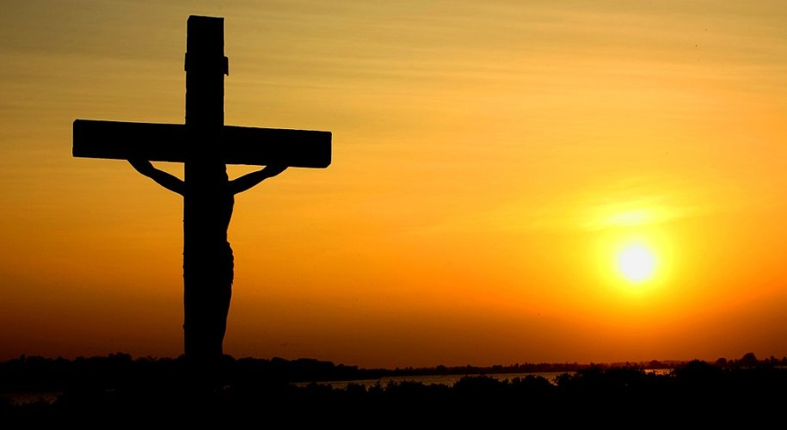
OIC – Part 5
“I have been crucified with Christ and I no longer live, but Christ lives in me.”
(Galatians 2:20 NIV)

Slide 16
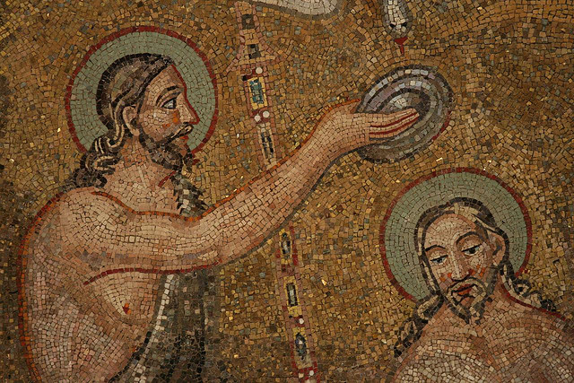
OIC – Part 6
“For as many of you as were baptized into Christ have put on Christ.
There is neither Jew nor Gentile, neither slave nor free, nor is there male and female,
for you are all one in Christ Jesus.
(Galatians 3:27-28 NIV)

Slide 17
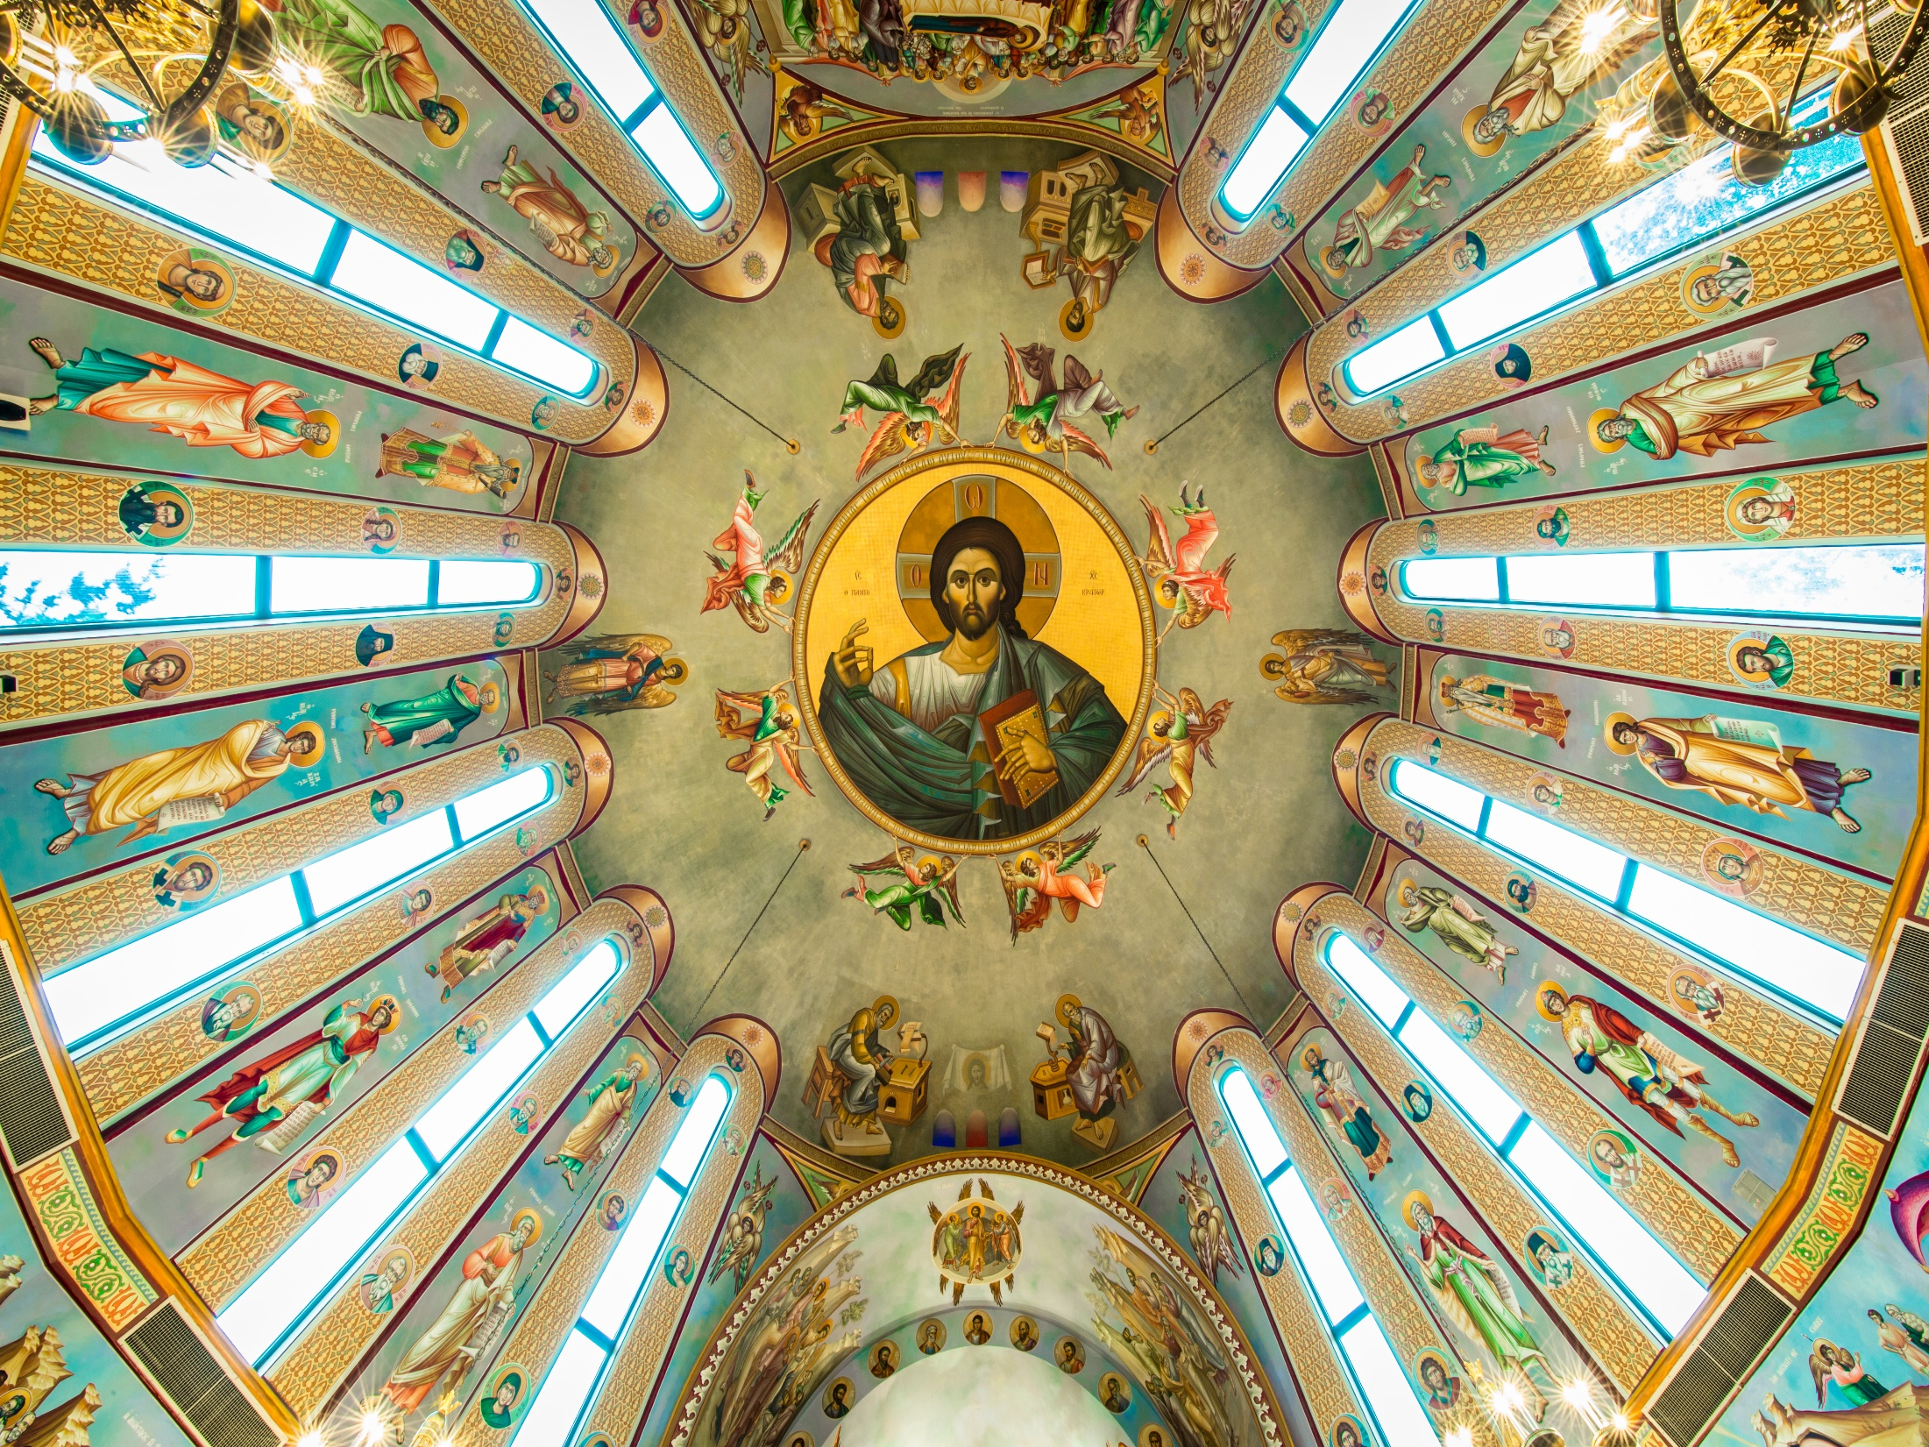
OIC – Part 7 First Council of Nicaea (325 A.D.) First Council of Constantinople (381 A.D.)
“Eἰς μίαν, ἁγίαν, καθολικὴν καὶ ἀποστολικὴν Ἐκκλησίαν”
“One, holy, catholic, and apostolic church”

Slide 18
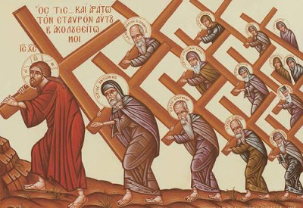
OIC – Part 8 Who Are You?
OIC Disciple = Christians who believe, practice, and teach OIC
Denominational Disciple = Individuals primarily focused on supporting and promoting their particular Denomination instead of OIC

Slide 19
Μετάνοια
Metanoia
“a transformative change of heart”
(Ellwanger & Gehrke, 2020)

Slide 20
Today’s Roadmap
Why Is This Important
Origins of Oneness In Christ (OIC)
3. The Current Facts
4. One OIC Roadmap
5. Your Calling

Slide 21
W. Edwards Deming

Slide 22
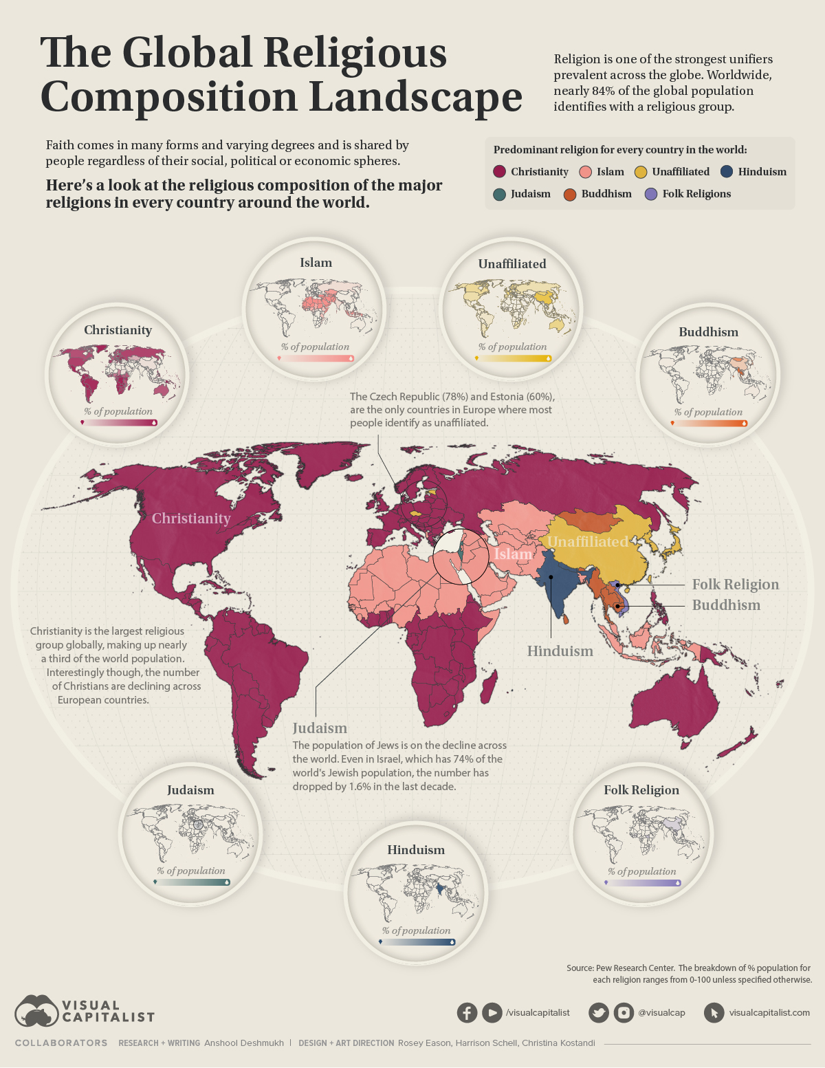
(Deshmukh, 2022)

Slide 23
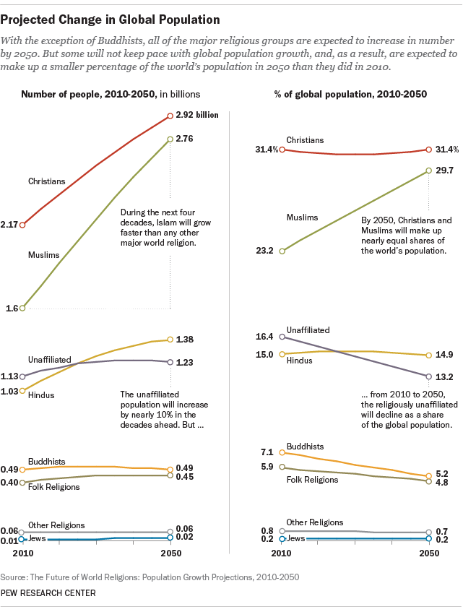
~ Muslims will grow from 23.2% of global population to grow to 29.7% by 2025
~ Christians will remain flat at 31.4% of global population
(Pew Research Center, 2015a, 2015b).

Slide 24
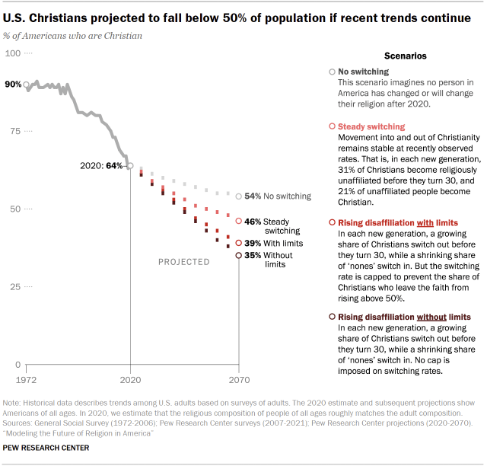
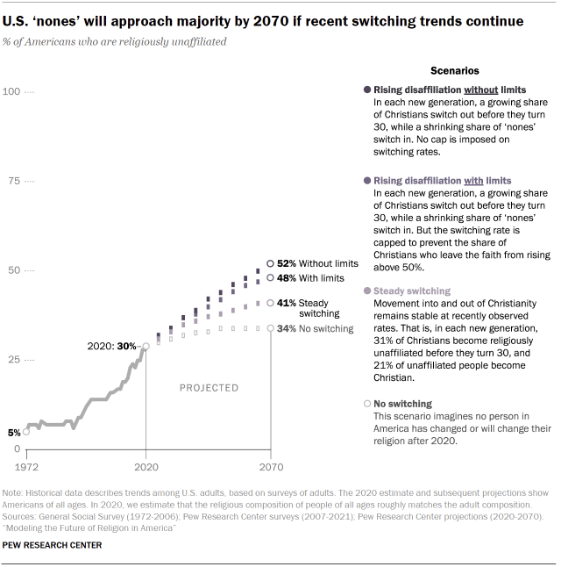
U.S. “NONES” Become The Majority by 2070
(Pew Research Center, 2022)

Slide 25
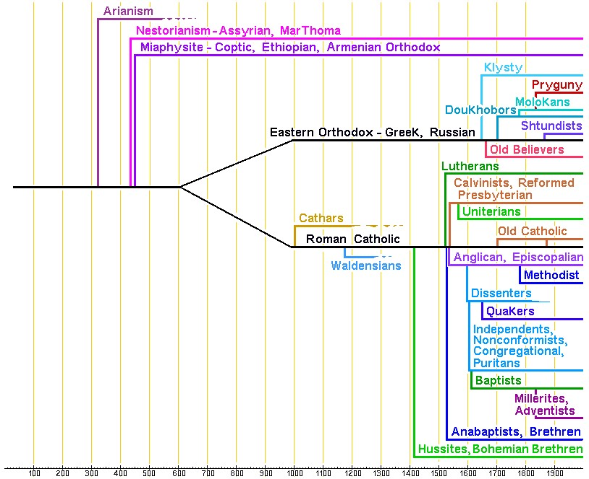
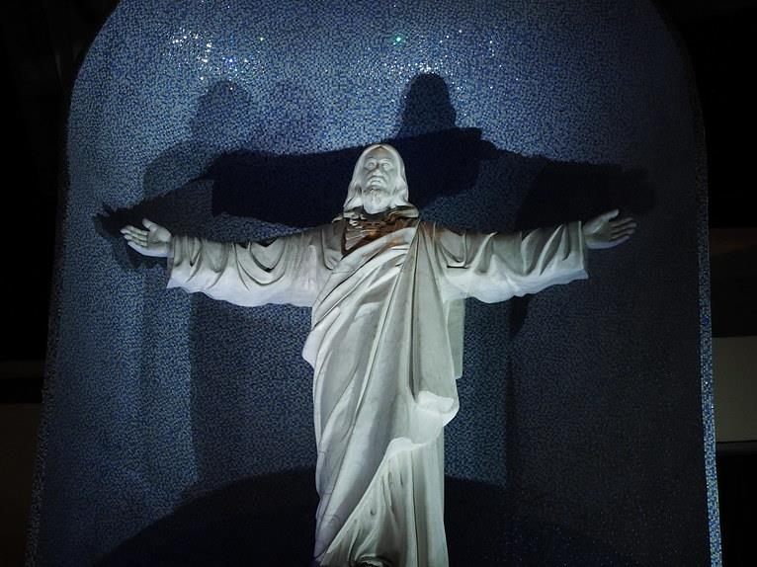
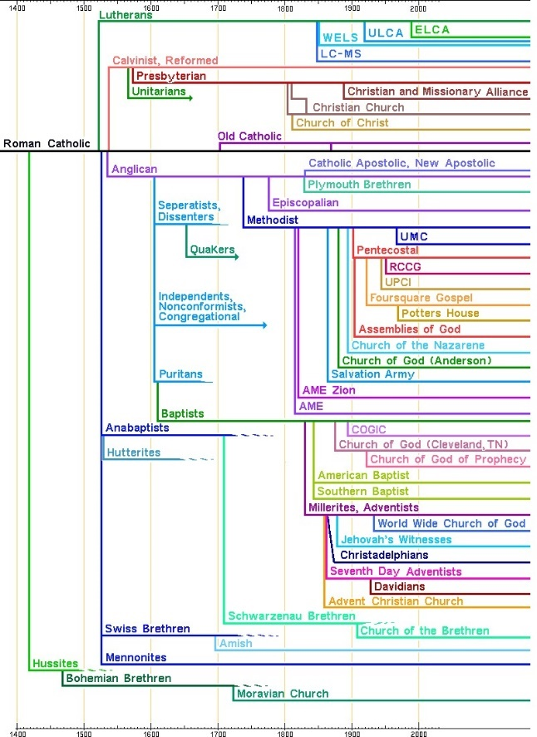
There are over 200 U.S. Christian denominations
(and growing)
(Coffey, 2022; Dyvik, 2024; Noll, 2002; Rollison, 2023)

Slide 26
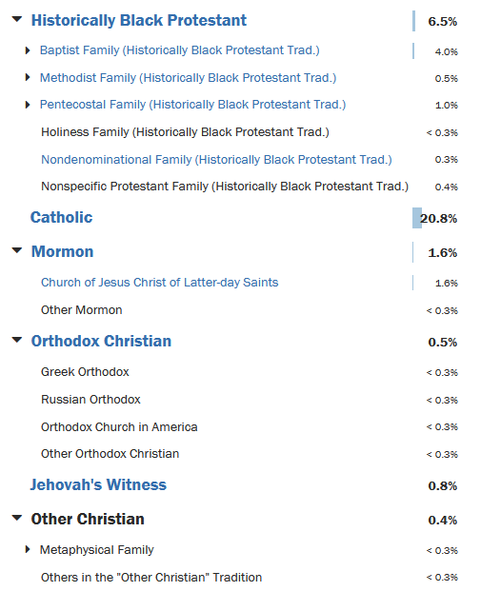
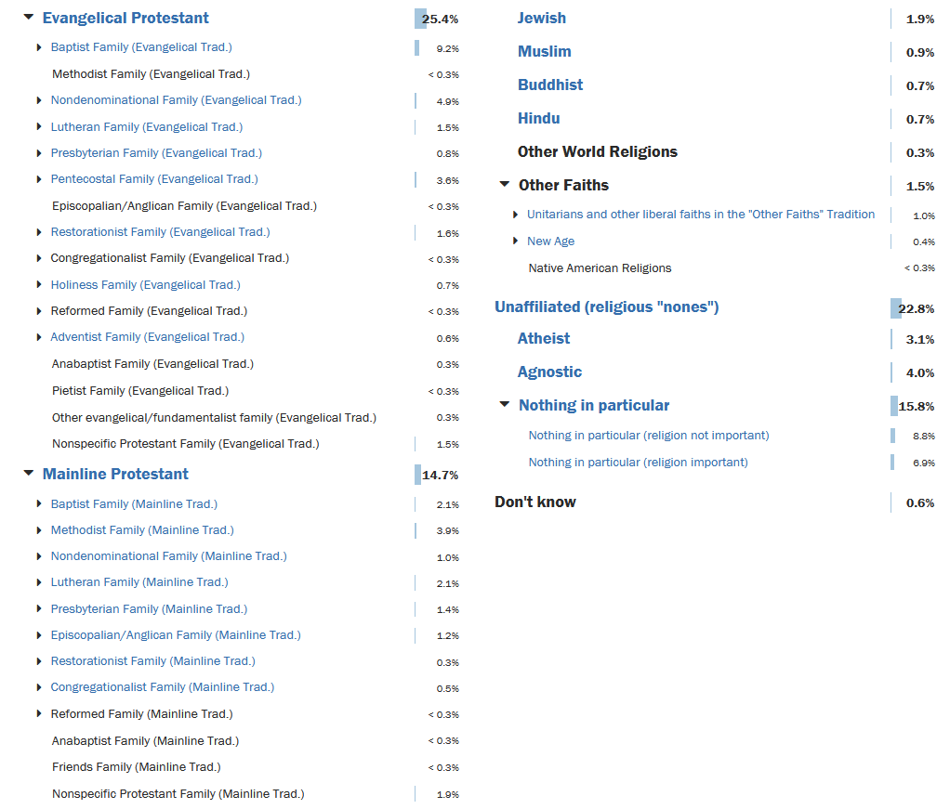
Selected Current U.S. Christian Subdivisions
(Pew Research Center, 2015a, 2015b, 2022),

Slide 27
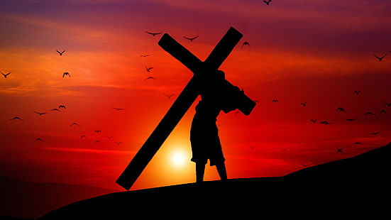
Does this look like
Oneness In Christ to you ?
33 A.D. = ONE holy catholic and apostolic church founded and led by Jesus Christ
2024 A.D. = over 200 U.S. Denominations and over 45,000 Global Denominations founded and/or led by many different people
(Coffey, 2022; Dyvik, 2024; Noll, 2002.)

Slide 28
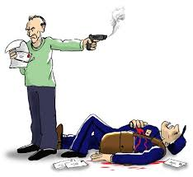
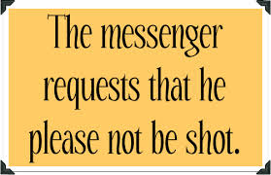

Slide 29
How Did We Get Divided?
~ The Root Cause = a failure of Christian leadership in maintaining OIC
~ Division results from “poor leadership of those seeking to maintain their power and authority”
(Case & Maner, 2014; Greenleaf, 1977)

Slide 30
Today’s Roadmap
Why Is This Important
Origins of Oneness In Christ (OIC)
3. The Current Facts
4. One OIC Roadmap
5. Your Calling

Slide 31
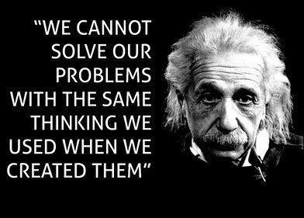
(The Journal of Transpersonal Psychology, 1969)

Slide 32
“ The best way to predict the future is to create it.”
Peter Drucker & Dennis Gabor
(Cohen, 2009; Gabor, 1964)

Slide 33
OIC American Christian Church (ACC) Five Step Process
Step 1
Step 2
Step 3
Step 4
Step 5
Find OICD Transformational Leaders
Determine OIC ACC WHY and Core Values
Reconcile Sacred Beliefs/Practices and mere Traditional Rituals
Determine ACC Vision, Strategic Goals, and Timelines
Implement

Slide 34
OIC American Christian Church (ACC) Five Step Process
Step 1
Find OICD Transformational Leaders
~ Identify U.S. Christian Denominational leaders (OICD Leaders) committed to OIC who gather like the past “Ecumenical Councils” to address differences
~ OICD Leaders determine a target OIC ACC Unity Date

Slide 35
American Christian Church (ACC)
Step 2
Determine OIC ACC WHY and Core Values
~ Within one year, the OICD Leaders reach consensus on an ACC WHY Statement and Core Values
~ OICD Transformational Leaders reconcile cultural collaboration (clan culture) and encourage creative alternatives (adhocracy culture)
(Cameron & Quinn, 2011; Kouzes & Posner, 2017; Sinek, 2011)

Slide 36
American Christian Church (ACC)
Step 3
Differentiate Sacred Beliefs/Practices from Mere Traditional Rituals
~ OICD Leaders harmonize Denominational sacred practices/beliefs by consensus with the Holy Spirit’s assistance
~ OICD operational change agents leaders harmonize operational practices/rituals by consensus

Slide 37
American Christian Church (ACC)
Step 4
Determine ACC Vision, Strategic Goals, and Timelines
~ Trained Christian facilitators lead a Strategic Planning process with a diverse cross-Denominational team
~ Consensus ACC Vision, Strategic S.M.A.R.T. Goals and “low hanging fruit” tactical actions are determined with step-by-step action plans

Slide 38
American Christian Church (ACC)
Step 5
Leave It to the Experts to Implement
~ The Holy Spirit
~ Trained denominationally-diverse professionals (ACC Implementation Team) implement the ACC Strategic Plan toward the OIC unity date

Slide 39
Today’s Roadmap
Why Is This Important
Origins of Oneness In Christ (OIC)
3. The Current Facts
4. One OIC Roadmap
5. Your Calling

Slide 40
This is your last chance.
You take the blue pill - the story ends, you wake up in your bed and believe whatever you want to believe.
You take the red pills - and join me working for OIC and we see how far we can go together.
(Wachowski & Wachowski, 1999)

Slide 41
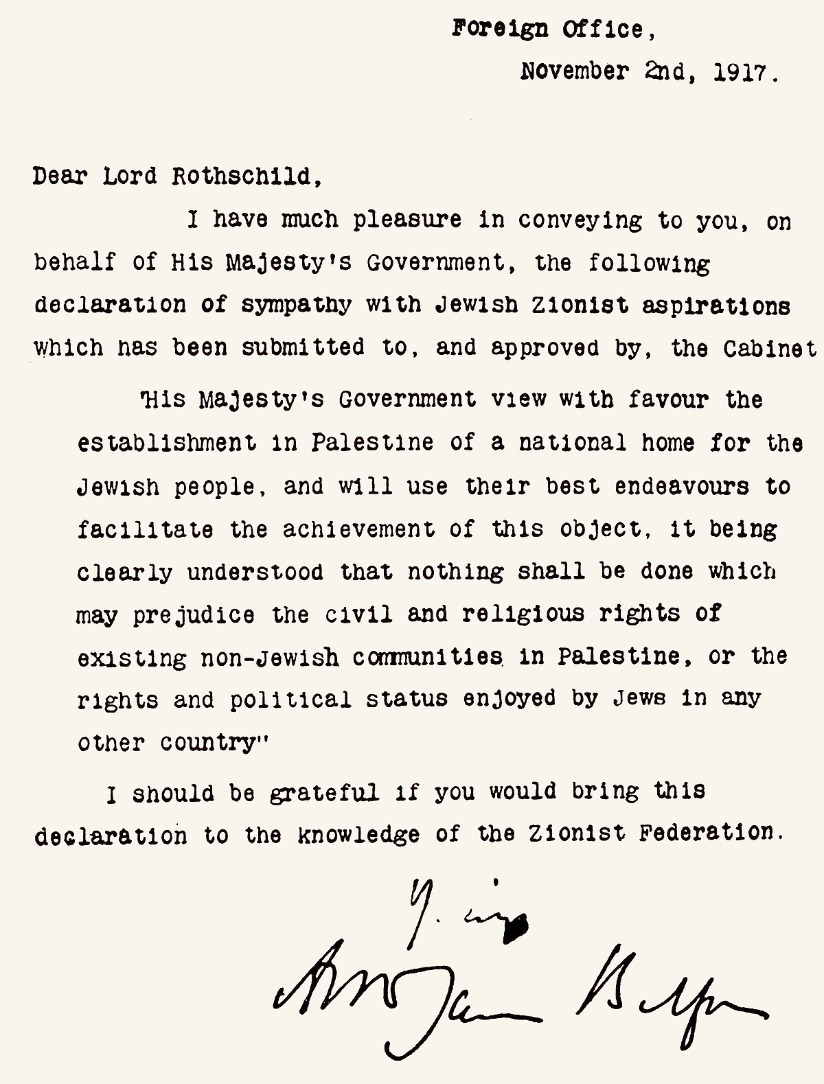
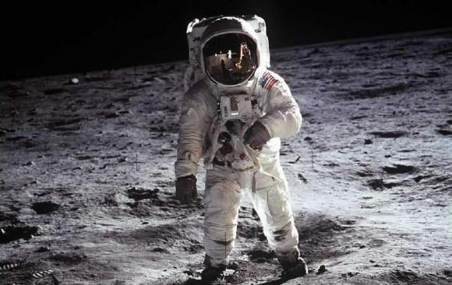
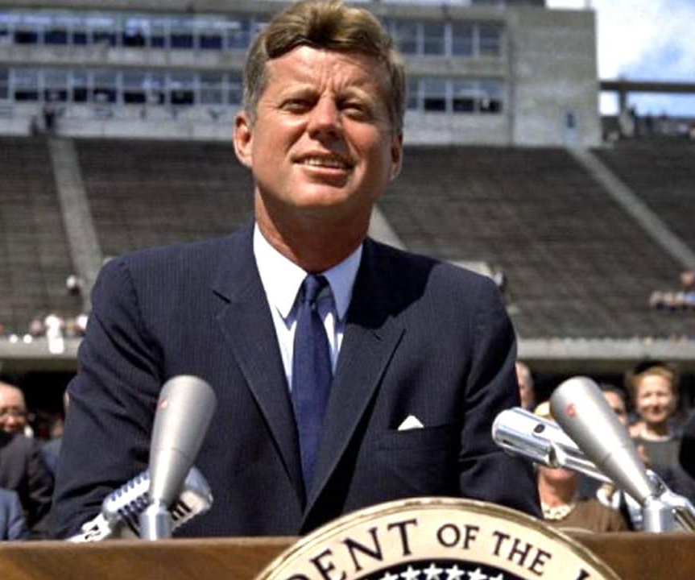
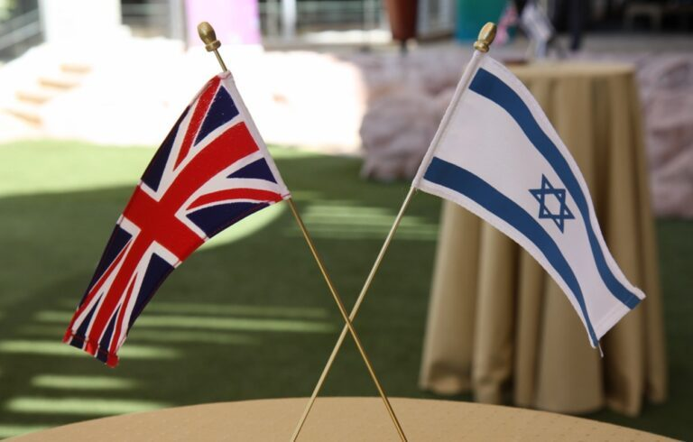
Balfour Declaration Kennedy Moon Shot November 2, 1917 September 12, 1962

Slide 42
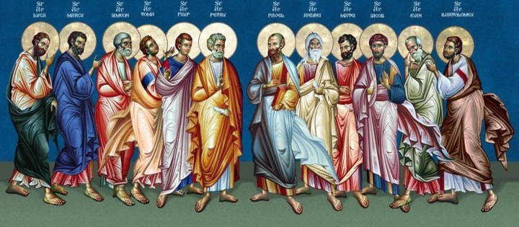
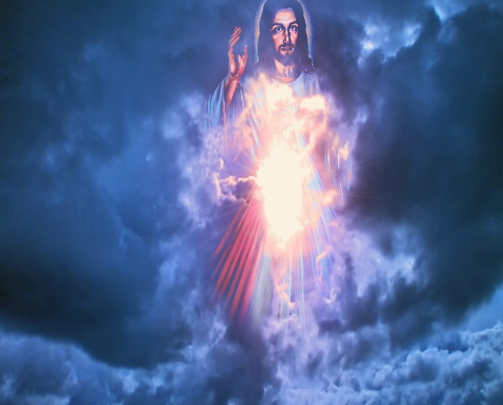
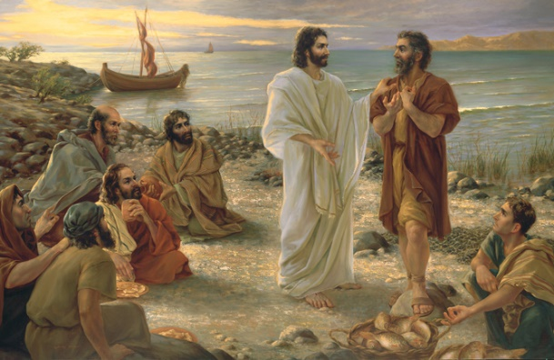
God qualifies the called.”
“God doesn’t call the qualified;
(Batterson, 2016, p. 78)

Slide 43
“The domain of the Leader is the
The work of the leader is change.”
(Kouzes and Posner, 2017)

Slide 44
What will you do to be a Oneness In Christ Disciple and a Human Light Bulb “Light of the World?”

Slide 45
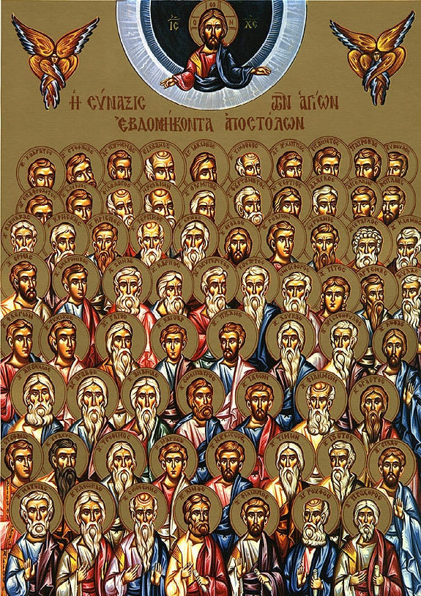
You’ve been called like the 70 Oneness In Christ Disciples to
(Luke 10:1)
One, holy, catholic, and apostolic
Christian
Church in America
Bill Marianes
Bill@stewardshipcalling.com
Stewardship Calling
For more OIC information: https://stewardshipcalling.com/oneness-in-christ-american-christian-church/

Slide 46
References
Batterson, M. (2016). The circle maker: Praying circles around your biggest dreams and greatest fears. Zondervan.
Case, C. R., & Maner, J. K. (2014). Divide and conquer: When and why leaders undermine the ‎cohesive fabric of their group. Journal of Personality And Social Psychology, 107(6), 1033.‎
Coffey, D. (2022, July 29). Why does Christianity have so many denominations? Live Science. ‎Retrieved July 24, 2024, from https://www.livescience.com/christianity-denominations.html
Cohen, W. A. (2009). Drucker on leadership: New lessons from the father of modern management. John Wiley & Sons.
Deshmukh, A. (2022, February 11). Mapped: The world’s major religions. Visual Capitalist. Retrieved September 22, 2024, from https://www.visualcapitalist.com/mapped-major-religions-of-the-world/
Dyvik, E. H. (2024, July 4). Share of global population affiliated with major religious groups ‎‎2022. Statista. Retrieved July 9, 2024, from https://www.statista.com/ ‎statistics/374704/share-of-global-population-by-religion/‎
Ellwanger, A., & Gehrke, P. J. (2020). Metanoia: Rhetoric, authenticity, and the transformation of the self. Penn State University Press.
Gabor, D. (1964) Inventing the future. Penguin.

Slide 47
References
Greenleaf, R. K. (1977). Servant leadership: A journey into the nature of legitimate ‎power & greatness. Paulist Press.‎
Kouzes, J. M., & Posner, B. Z. (2010). The truth about leadership: The no-fads, heart-of-the-matter facts you need to know. Josey-Bass.
Kouzes, J. M. & Posner, B. Z. (2017). The leadership challenge: How to make extraordinary things happen in organizations. Josey-Bass.
New International Version. (2011). Biblica.
Noll, M. A. (2002). World Christian encyclopedia: A comparative survey of churches and religions in the modern world. The world by countries: Religionists, churches, ministries (Vol. 1). The world by segments: Religions, peoples, languages, cities, topics (Vol. 2). (2d ‎ed.). D. B. Barrett, G. T. Kurian, & T. M. Johnson (Eds.). ‎Oxford University Press. Vol. 1: xii+ 876 pp. Vol. 71(2), 448-454.‎
The Journal of Transpersonal Psychology. (1969). Volumes 1-4, p.124. Transpersonal Institute. American Transpersonal Association.
Pew Research Center. (2015a, April 2). The future of world populations: Growth projections 2010-2050 – Why Muslims are rising fastest and the unaffiliated are shrinking as a share of the world’s population. Retrieved July 9, 2024, from https://www.pewresearch.org /religion/2015/04/02/religious-projections-2010-2050/

Slide 48
References
Pew Research Center. (2015b, May 12). Chapter 1: The changing religious composition of the ‎U.S. Retrieved July 24, 2024, from https://www.pewresearch.org/religion/ ‎‎2015/05/12/chapter-1-the-changing-religious-composition-of-the-u-s/‎
Pew Research Center. (2022, September 13). How U.S., religious composition has changed in ‎recent decades. Retrieved July 10, 2024, from https://www.pewresearch.org/religious-‎landscape-study/database/‎Wachowski, L. & Wachowski, L. (Dirs). (1999). The matrix. [Film]. Warner Bros.
Rollison, S. (2023, September 30). A brief history of denominations. Retrieved July 24, 2024, ‎from https://www.drshirley.org/hist/hist21-denominations.html
Warren, R. [@RickWarren]. (2013, November 11). Every pastor chooses how he will lead a flock: As a risk taker, as a caretaker, or as an undertaker while it slowly dies [Tweet]. Twitter. https://twitter.com/rickwarren /status/400014337093685250

Slide 49
Oneness In Christ (OIC)
Εἰς μίαν, ἁγίαν, καθολικὴν καὶ ἀποστολικὴν Ἐκκλησίαν
Bill Marianes
September 2024
Stewardship Calling
Notes:
FROM WHITE PAPER PAGE 2
The current Orthodox Christian Church in the United States remains divided into 18 different, unequal, sub-optimally resourced, and operationally challenged and struggling fragments. This is far from the righteous Nicene Creed Unity Vision of “ONE, holy, catholic, and apostolic church.” It also does not model the melting pot vision of the United States of America and the culture of unconditional and sacrificial love in Christ’s new commandment. Thus, the Orthodox Christian Church in this land of religious freedom remains largely splintered along historic foreign ethnic lines with all the inefficiencies, challenges, and difficulties one would expect in a divided house.
The seminal question is:
Does Christ want His American Orthodox Church to be a “House Divided” or a “House United” in keeping with the Nicene Creed vision of unity?
This White Paper will explore the Unity Vision cast in the Nicene Creed by asking this seminal question in 4 parts and looking at answers from:
Part 1. Christ and Holy Scripture,
Part 2. The current presiding Patriarchs and Hierarchs of the Orthodox Mother Churches,
Part 3. The Hierarchs of the Eastern Orthodox Jurisdictions in the United States,
Part 4. Best leadership and operational practices.
If the above four perspectives support a “House Divided,” then the status quo should continue. If the answer demands a “House United,” the final 5th part of this White Paper will discuss a high-level road map for addressing a Unity Vision. Ultimately, the Holy Spirit must provide a definitive answer and plan.

